Slide 1
Biochemistry (Organic Molecules)
Biology – Chapter 6
https://www.youtube.com/watch?v=7L7x0BAqWis
Notes:
1

Slide 2
Outline of Notes
Basic Chemistry
Review of atomic structure and composition of compounds
Biochemistry
Introduction to chemicals involved in biological processes
Comparison of biological macromolecules
Notes:
2

Slide 3
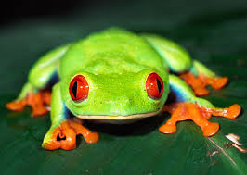
LEVELS OF ORGANIZATION (BIGGEST TO SMALLEST)
Organism

Slide 4
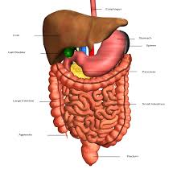
LEVELS OF ORGANIZATION (BIGGEST TO SMALLEST)
Organism→ Organ System

Slide 5
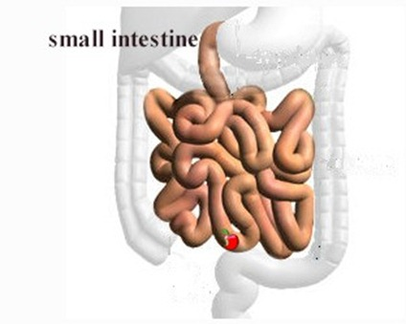
LEVELS OF ORGANIZATION (BIGGEST TO SMALLEST)
Organism→ Organ System→ Organ

Slide 6
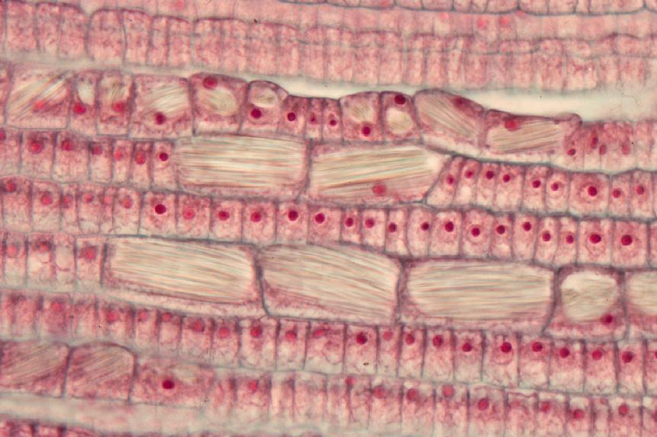
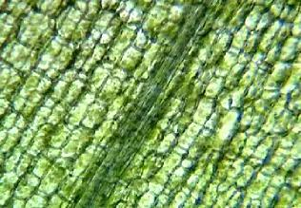
LEVELS OF ORGANIZATION (BIGGEST TO SMALLEST)
Organism→ Organ System→ Organ→ Tissue

Slide 7
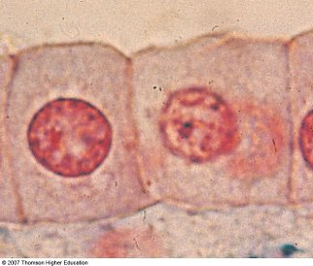
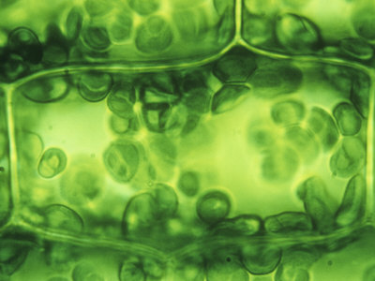
LEVELS OF ORGANIZATION (BIGGEST TO SMALLEST)
Organism→ Organ System→ Organ→ Tissue→ Cell

Slide 8
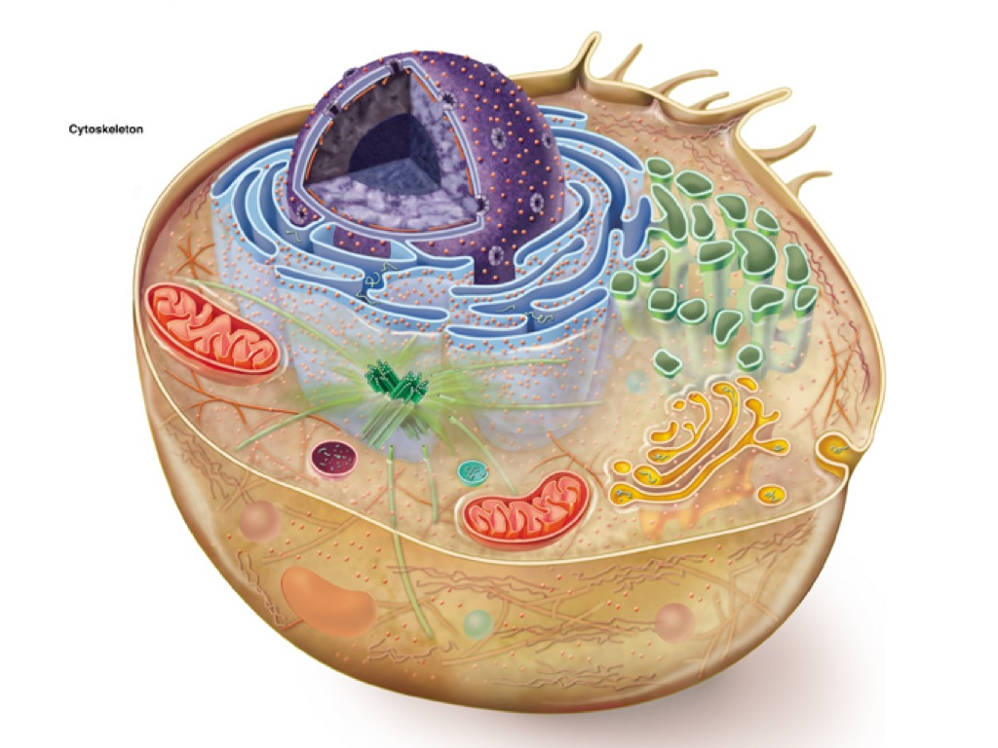
LEVELS OF ORGANIZATION (BIGGEST TO SMALLEST)
Organism→ Organ System→ Organ→ Tissue→ Cell→ Organelles

Slide 9
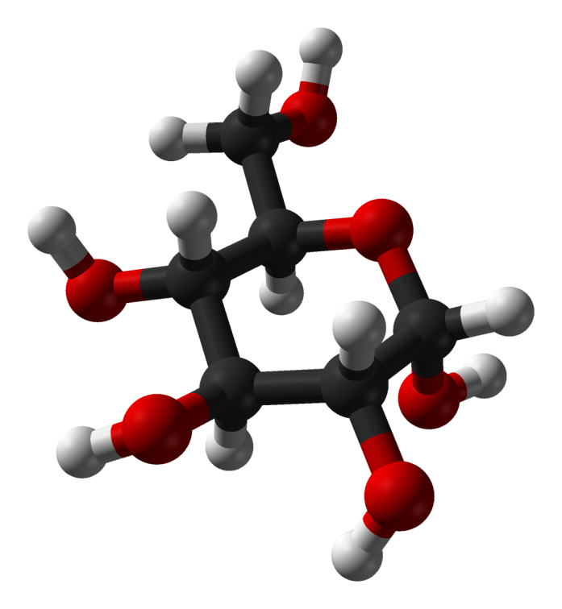
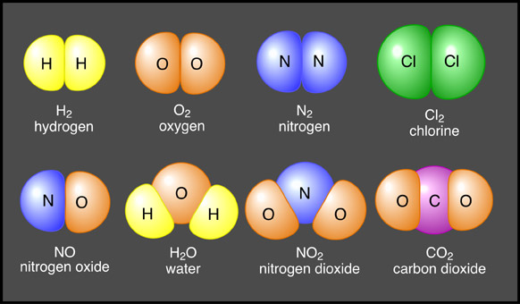
LEVELS OF ORGANIZATION (BIGGEST TO SMALLEST)
Organism→ Organ System→ Organ→ Tissue→ Cell→ Organelles→ Molecules

Slide 10
LEVELS OF ORGANIZATION (BIGGEST TO SMALLEST)
Organism→ Organ System→ Organ→ Tissue→ Cell→ Organelles→ Molecules→ Atoms

Slide 11
Everything is made of atoms.
Notes:
11

Slide 12
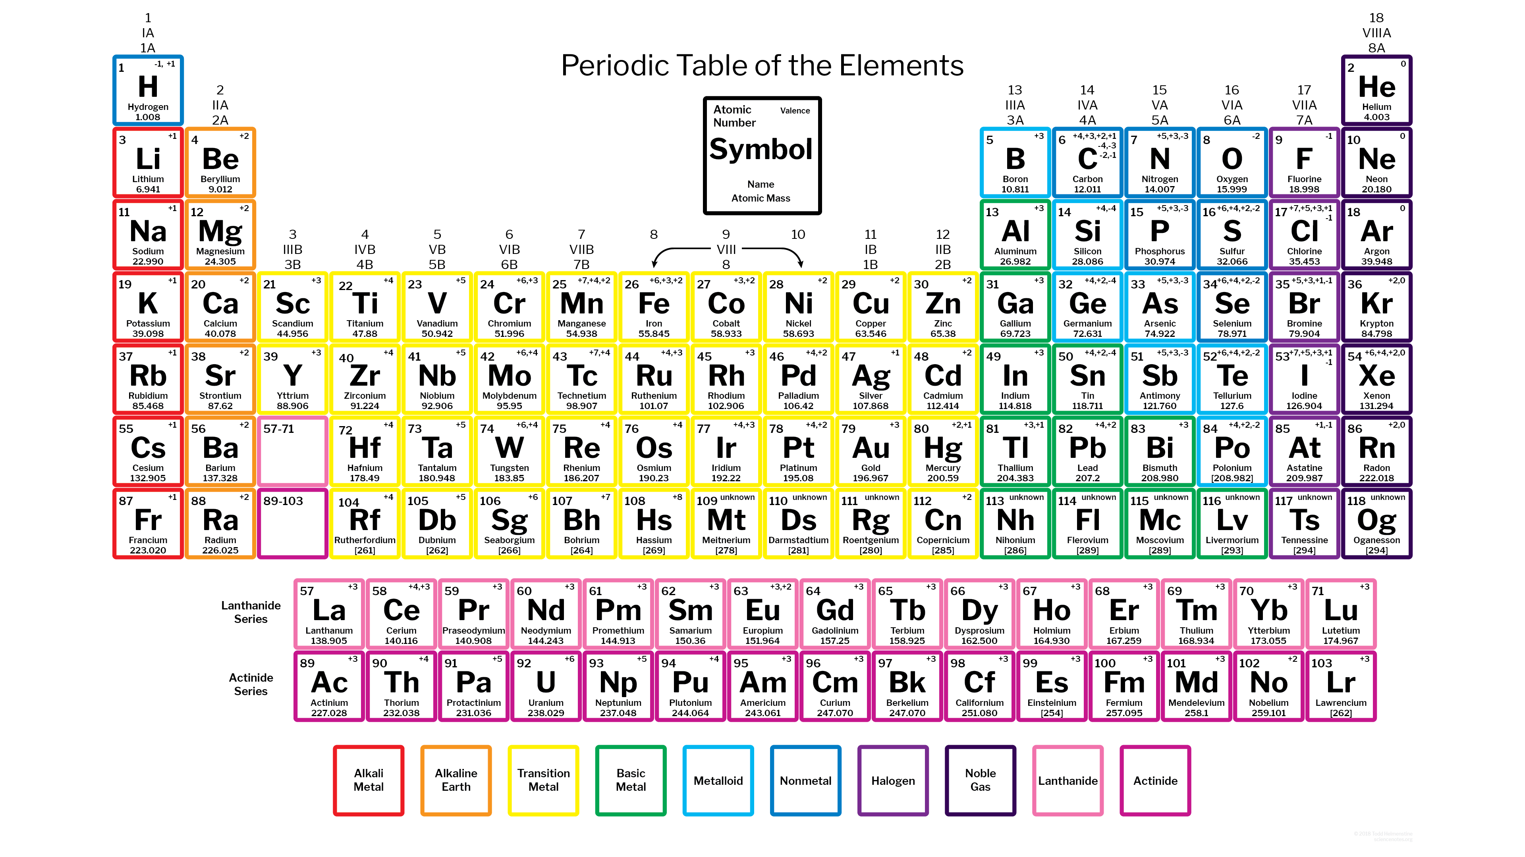
Basic Chemistry
Chemical symbols are used to represent each atom.
Found on the Periodic Table
Notes:
12

Slide 13
Basic Chemistry
Atoms combine to form Molecules.
Molecules are combinations of 2 or more atoms.
Combination has different properties than the individual atoms
Notes:
13

Slide 15
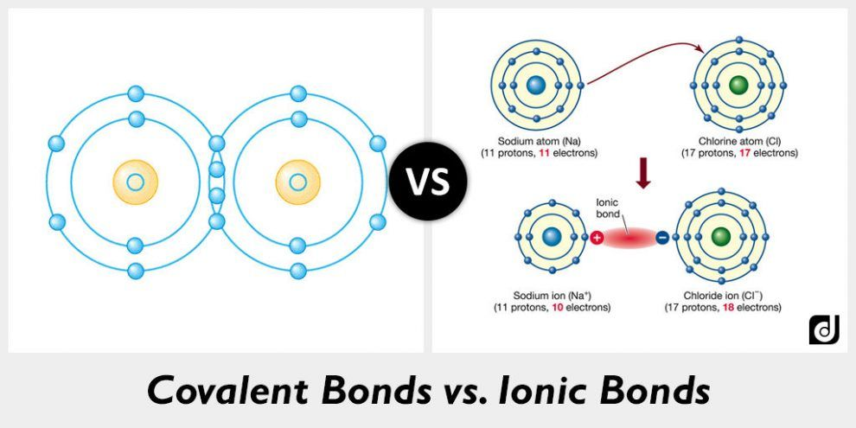
Molecules are held together with chemical bonds.
Ionic Bonds
Exchange electrons
Called ions
Covalent Bonds (Non-metals)
Share electrons
Called molecules

Slide 16
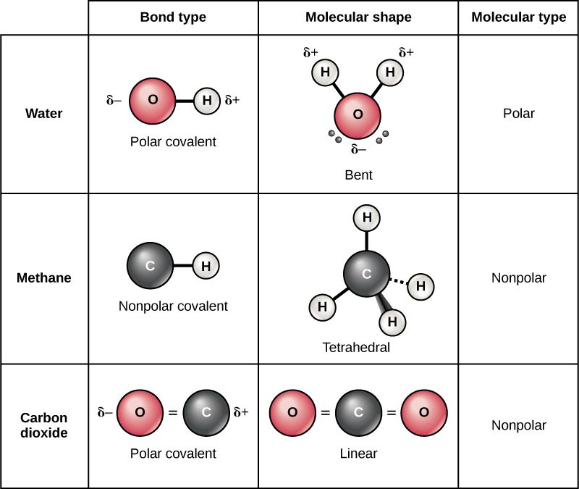

Slide 18
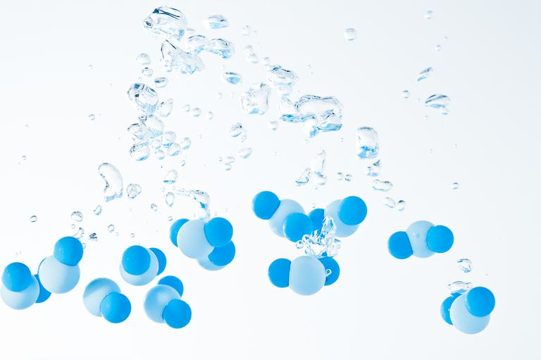
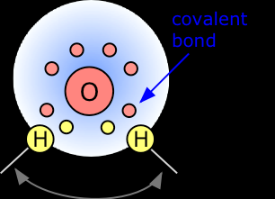
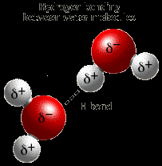
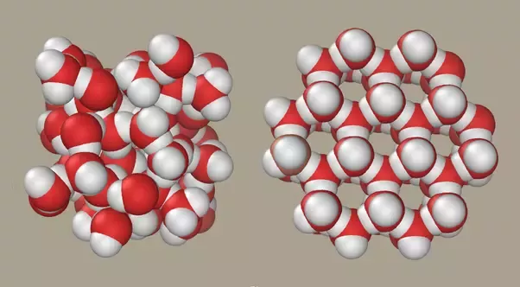

Slide 19
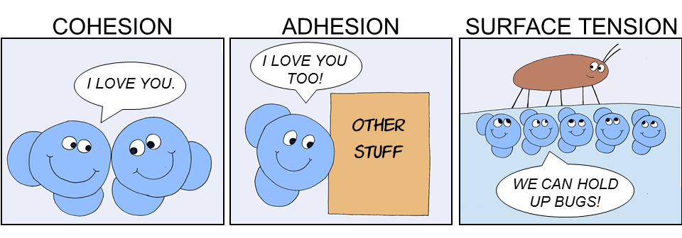
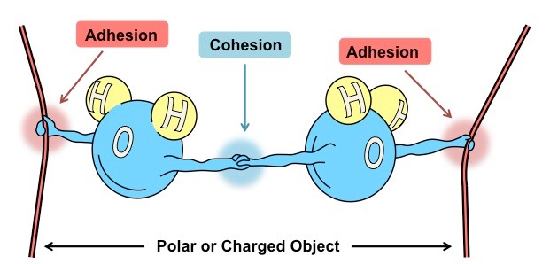
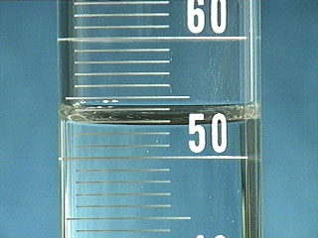
https://www.youtube.com/watch?v=yYpz7-KZr4s

Slide 20
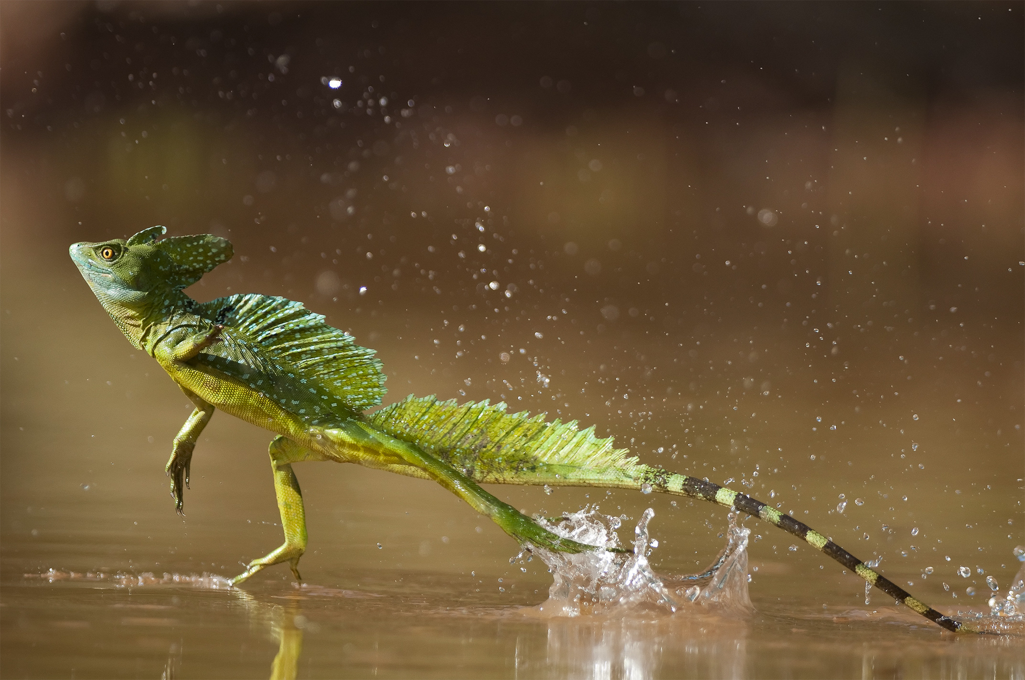
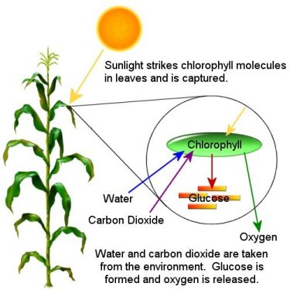
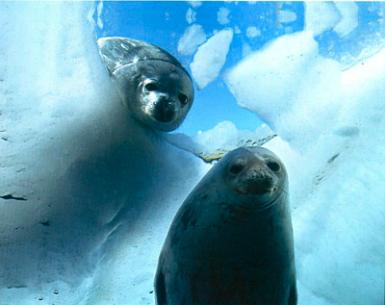
https://video.nationalgeographic.com/video/00000144-0a2a-d3cb-a96c-7b2fc1020000

Slide 21
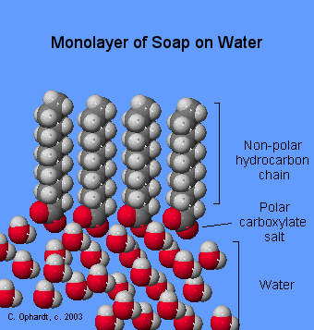
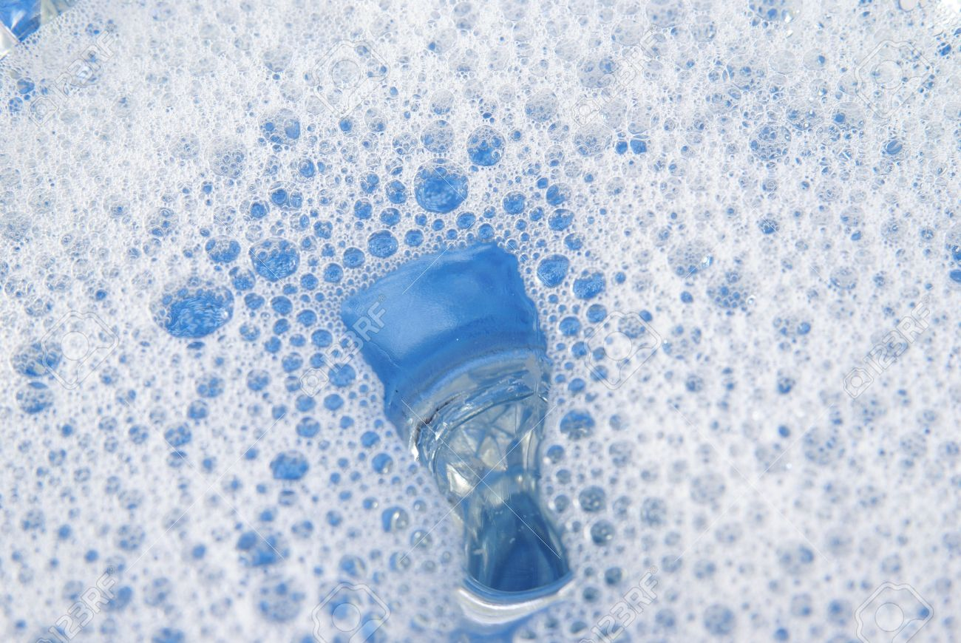
Water lab

Slide 22
**OUR BIG QUESTION:
What are living things (like us) made of?

Slide 23
WHAT ARE WE MADE OF?
All living things are made of just 4 substances called biomolecules.
Sometimes we call them organic molecules or macromolecules.

Slide 24
4 BIOMOLECULES
These 4 biomolecules that make up living things are:
Carbohydrates
Lipids
Proteins
Nucleic Acids

Slide 25
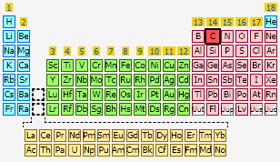
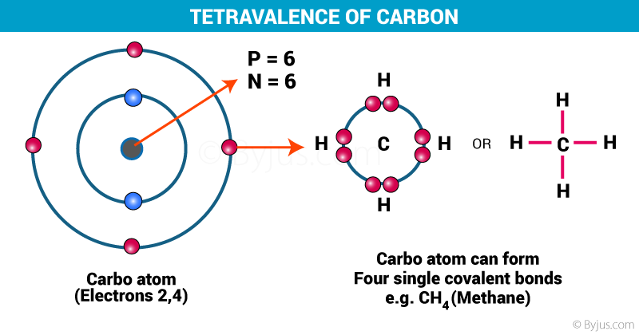
CARBON
All Biomolecules contain the element (atom) carbon shown by the letter C.

Slide 26
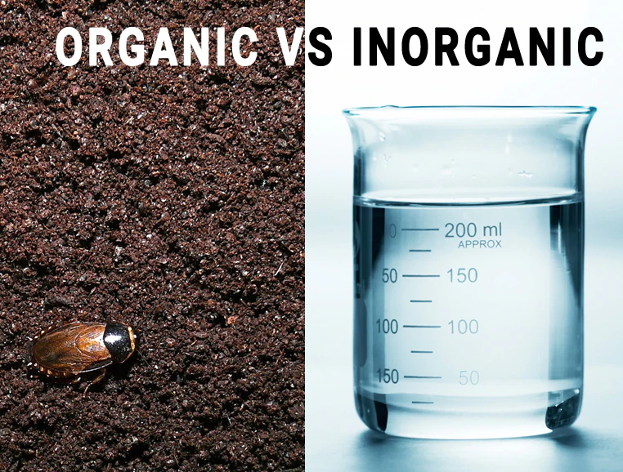
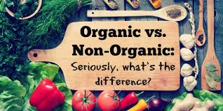

Slide 27
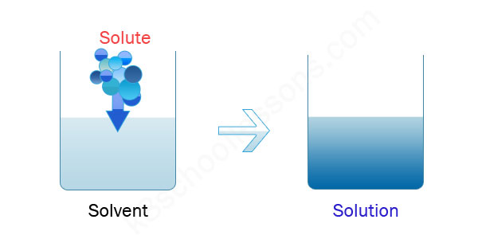

Slide 28
The pH Scale

Slide 29
The pH Scale
0
7
14

Slide 30
The pH Scale
0
Acid
7
Neutral
14
Base
“A comes before B”

Slide 31
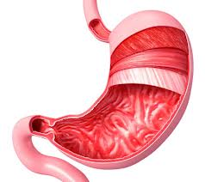
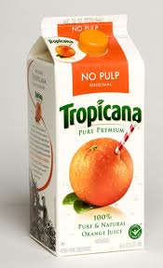
The pH Scale
0
Acid
7
Neutral
14
Base

Slide 32
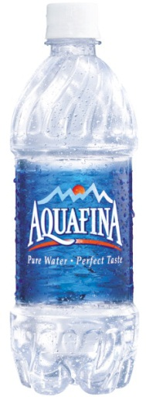
The pH Scale
0
Acid
7
Neutral
14
Base

Slide 33
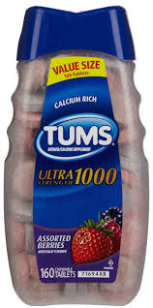
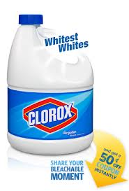
The pH Scale
0
Acid
7
Neutral
14
Base

Slide 34
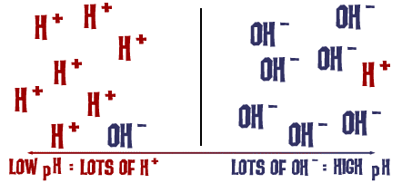
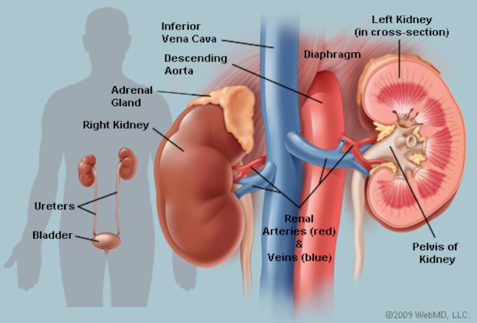
https://www.youtube.com/watch?v=lDmn8zeJbQs&app=desktop&disable_polymer=true

Slide 35
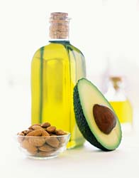
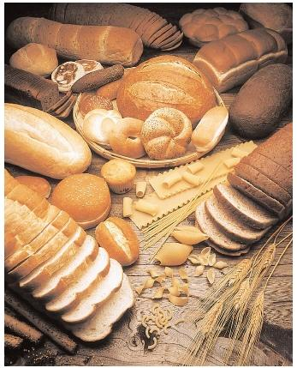
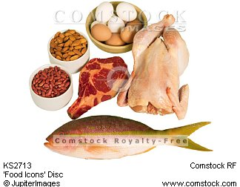
Biochemistry
Types of Organic Molecules (Macromolecules)
Carbohydrates
Lipids
Proteins
Nucleic Acids
Notes:
35

Slide 36
Biochemistry
Elements (atoms) that make up living things:
C = Carbon, H = hydrogen, N = nitrogen,
O = oxygen, P = phosphorus, S = sulfur
Some other elements are needed in very small quantities: trace elements
Notes:
36

Slide 37
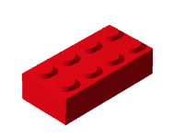
Biochemistry
Terms to Know: Mono = One Poly = Many
Monomer – the smallest unit of a substance
Example: like one Lego block
Polymer – many monomers linked together to make a large structure; a.k.a. macromolecules
Example: Lego blocks put together to make a Lego house
Notes:
37

Slide 38
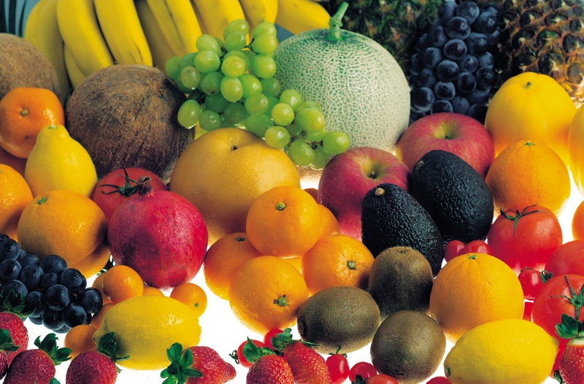
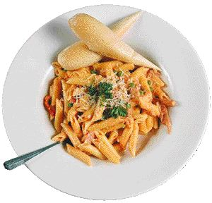
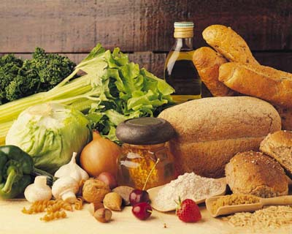
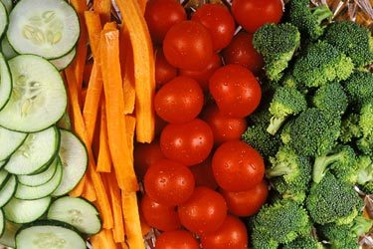
Carbohydrates (Sugars & Starches)
Notes:
38

Slide 39
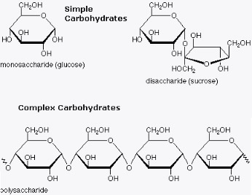

Slide 40
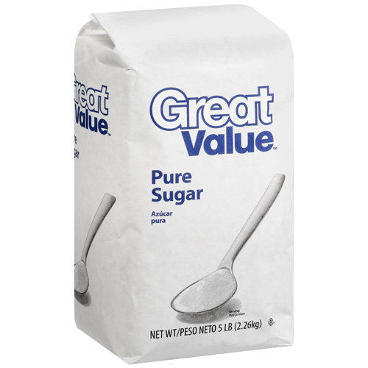
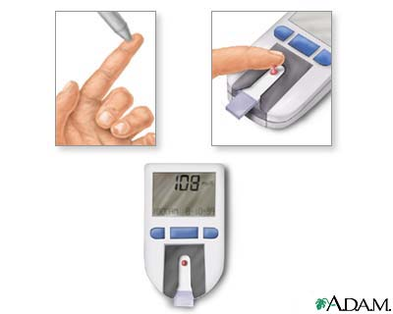
Carbohydrates
Simple Sugars: taste sweet; digested very quickly by the body.
Ex: sucrose = white sugar
glucose= blood sugar

Slide 41
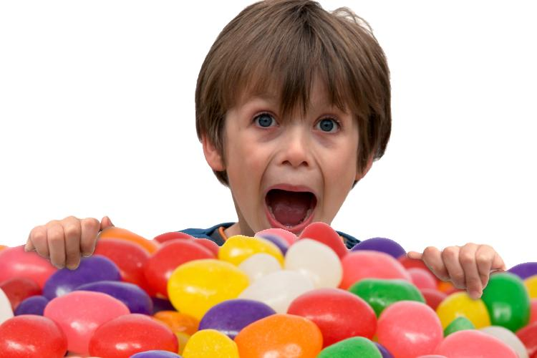
Carbohydrates
Carbs are composed of the elements: carbon, Hydrogen, and oxygen in a 1:2:1 ratio
(Example: C₆H₁₂O₆)
Names usually end in –ose (Example: glucose)
Function: provide quick energy to the body
For mono-SAC-charide—Sugars and Starches
Notes:
41

Slide 42
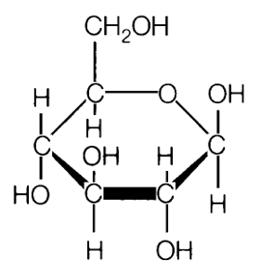
Carbohydrates
Monomer of Carbohydrates →
monosaccharide
Trick: “Sac of Sugar” -or-
“Sac of Potatoes”
A.K.A. “Simple Sugars”—Ex: glucose, fructose
For mono-SAC-charide—
Sugars and Starches
Notes:
42

Slide 44
Disaccharide: “Di” = 2
-2 linked sugar monomers
Polymer → Polysaccharide—Many monomers linked together

Slide 45
Carbohydrates
Starches: taste bland; digested more slowly—good for sports
Notes:
45

Slide 46
Carbohydrates
Examples of Starches
amylose = starch in bread, pasta, potatoes, rice, etc.;
(energy storage for plants)
Notes:
46

Slide 47
Carbohydrates
Examples of polysaccharides
Cellulose → found in plant cell walls; animals can not digest (fiber)
Notes:
47

Slide 48
Carbohydrates
Examples of polysaccharides
Glycogen → stores energy in your muscles & liver (makes muscle meat dark)
Notes:
48

Slide 49
Carbohydrates
Examples of polysaccharide
Chitin → in insect exoskeletons
Notes:
49

Slide 51
Watch this video on Dehydration Synthesis:
https://www.youtube.com/watch?v=ZMTeqZLXBSo

Slide 53
Lipids
Notes:
53

Slide 54
Lipids
Fats, Sterols, Phospholipids and Waxes
trick: “FAT LIP”
Lipids are hydrophobic: they do not mix with water → living things use lipids to form waterproof layers.
Notes:
54

Slide 55
Lipids
Composed of carbon, hydrogen, and oxygen in a non-specific ratio (Example: C₂₁H₁₇O₄₃)
Notes:
55

Slide 56
Lipids
Functions:
Insulation: to keep the
body WARM;
Notes:
56

Slide 57
Lipids
Functions:
(Long Term) energy storage: energy you don’t use is stored as FAT!
Notes:
57

Slide 58
Lipids
Functions:
steroids: HORMONES &
ANTI-INFLAMMATORY
medications
Notes:
58

Slide 59
Lipids TRILYCERIDES
Monomer of lipids → glycerol and 3 fatty acids

Slide 60
Lipids
Monomer → glycerol and 3 fatty acids
Glycerol
(backbone)

Slide 61
Lipids
Types of Lipids (Fats)
Saturated Fats: usually soild at room temperature;
can clog arteries; mostly found in animal products

Slide 62
Lipids
Types of Lipids (Fats)
Unsaturated Fats: usually liquid at room temperature;
typically from plant oils; healthier for your heart

Slide 63
Lipids
Types of Lipids (Fats)
Trans Fats: unsaturated fats that are
chemically processed to become
saturated fats;
Increase risk of cancer.

Slide 65
Indicator (Test Lipids)

Slide 66
Phospholipids

Slide 68
Sterols

Slide 71
Proteins

Slide 72
Proteins
Microscopic machines that do the body’s work
Composed of carbon, hydrogen, oxygen, nitrogen
Monomer of proteins→ amino acids
Polymer → polypeptide
Account for most of the dry weight of cells
Trick: Proteins have “pep.”

Slide 73
Proteins
Monomer of proteins→ amino acids
Polymer → polypeptide

Slide 75
Functions of Proteins
Proteins make up most of the tissues in your body

Slide 76
Functions and Examples of Proteins
Needed to build muscles, tendons,
and ligaments
Fibers that make up skin, hair, & fingernails
Cell transport
Notes:
76

Slide 77
Functions and Examples of Proteins
Insulin: controls blood sugar levels
Notes:
77

Slide 78
Functions and Examples of Proteins
Antibodies: defense against disease
Notes:
78

Slide 79
Functions and Examples of Proteins
Hemoglobin: blood protein that carries oxygen
Notes:
79

Slide 80
Proteins
Enzymes: special proteins that speed up chemical reactions in the body.
Notes:
80

Slide 81
Indicator (Test Proteins)

Slide 83
Nucleic Acids

Slide 84
Nucleic Acids
Made of carbon, hydrogen, oxygen, nitrogen, sulfur, phosphorus
Function → control genetic traits, code for building proteins
Notes:
84

Slide 85
Nucleic Acids
Monomer of Nucleic Acids → nucleotide
Notes:
85

Slide 86
Nucleic Acids
Polymers of Nucleic Acids →
DNA → deoxyribonucleic acid
RNA → ribonucleic acid
“N.A.’s” like DNA and RNA
Notes:
86

Slide 87
https://www.youtube.com/watch?v=V9BZ3zx8b8I
How DNA is built.
Millions of these nucleotides come together….
Like this.
To build one of these.
(DNA—Nucleic Acid)

Slide 89
Complementary base pairing

Slide 90
Missin

Slide 95
2
1
4
3

