Slide 1
STERNGRR Examples in representative organisms

Slide 2
What are Life Processes?
S | Synthesis | How and what do they make?
T | Transport | How do they move materials?
E | Excretion | How do they remove waste?
R | Respiration | How do they make ATP energy?
N | Nutrition | How do they make or get food?
G | Growth & Development | How do they grow and develop?
R | Regulation | How do they maintain homeostasis?
R | Reproduction | How do they reproduce?

Slide 3
Synthesis (How do organisms get the food/energy they need; how do they build necessary molecules.) Transport (How organisms get what they need to cells; how they move wastes from their cells to the organs of excretion) Excretion (How organisms get rid of their waste and balance their fluids (pH, salt concentration, water)) Regulation (How organisms control body processes- hormones?,nervous system?) Nutrition (How organisms break down and absorb foods. Heterotrophs consume and autotrophs make their own food by photosynthesis.) Growth and Development (metamorphosis, development in egg or in uterus, growth from seed or spore) Respiration (How organisms exchange gases) Reproduction (sexual vs. asexual, eggs, seeds, spores, placental, type of fertilization)

Slide 4
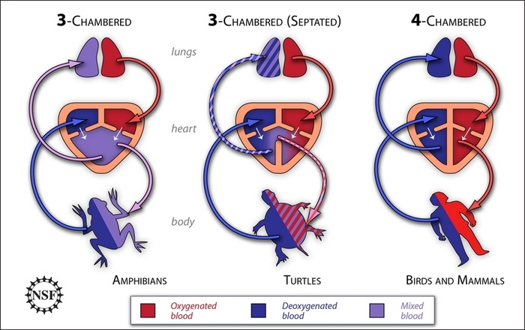
Example 1:
Amphibians have a 3 chambered heart that pumps blood to the lungs and other organs
Draw, AND label, ONLY the three-chambered heart in the space provided

Slide 5
Example 2:
Worms get rid of nitrogenous waste (like our urine) through structures called nephridia.
Draw this image in the space provided.
Solid waste leaves the worm through its anus.
Watch this on Giant Earthworms!!!
https://www.youtube.com/watch?v=uO4lkv-jLRs

Slide 6
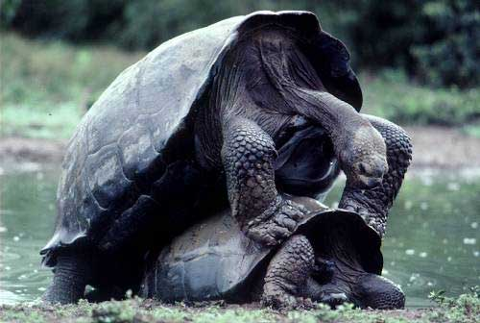
Example 3:
Terrestrial organisms use internal fertilization. The male inserts the sperm into the female’s body.
Draw this image in the space provided.

Slide 7
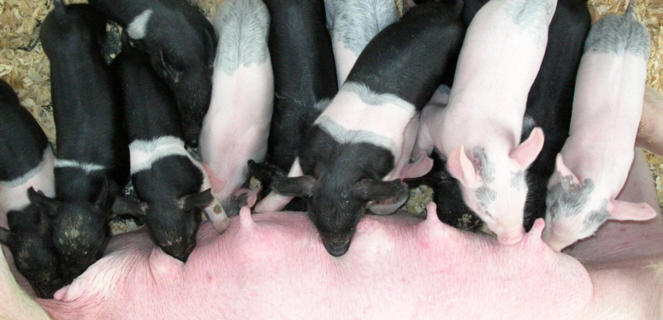
Example 4:
Mammal mothers keep their young
inside of their uterus until they are
fully developed. This is called the
GESTATION period.
Draw the picture of a baby in the mother’s womb. Label the placenta and DEFINE the word placenta as “the network of blood vessels that nourishes the baby in the mother’s uterus.”
When they are born, they are nursed with milk from the mammary glands.

Slide 8
Kangaroo Birth

Slide 9
The Birth of a Giraffe

Slide 10
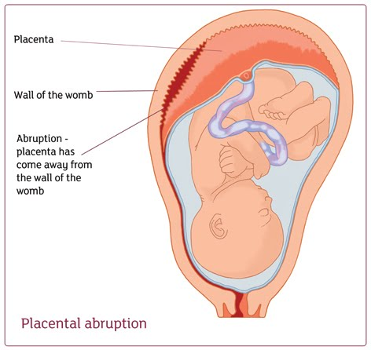
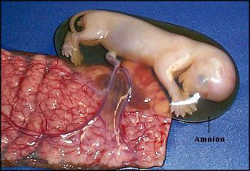
Placenta
Watch the birth of Mia’s First Puppy!

Slide 11
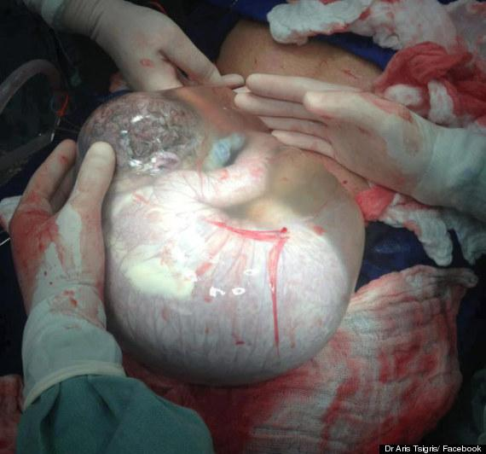

Slide 12
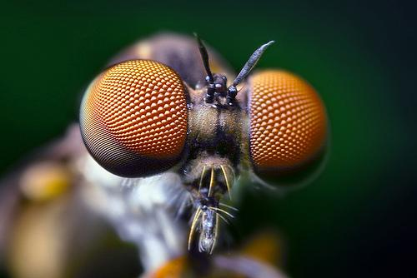
Example 5:
Insects have COMPOUND EYES, antennae, sensory hairs, and PHEROMONES (chemicals used by species to communicate with each other) to obtain information from their environment.
Draw and label the compound eye and the pheromone image in the space provided.

Slide 13
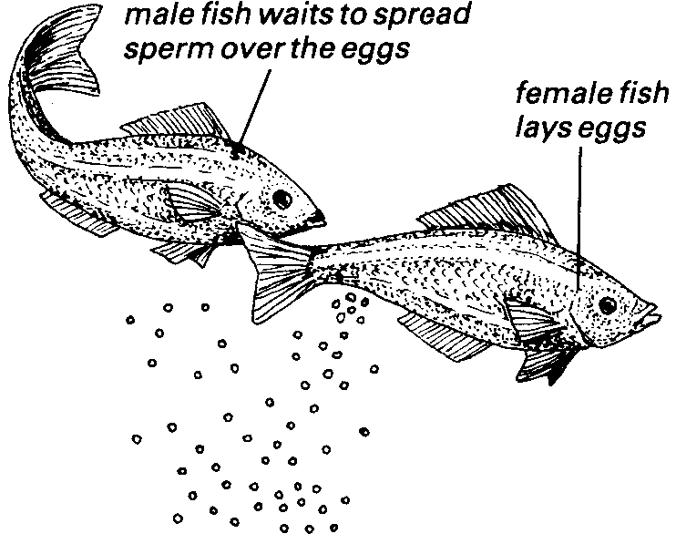
Example 6:
Many aquatic (water) organisms have EXTERNAL fertilization (this is where sperm and egg meet outside of the body). Frog eggs hatch into tadpoles. Tadpoles gradually grow limbs, lose their tails and gills, and become meat-eaters as they develop into adults.
Draw the image in the space provided. Click on the image to see frogs having sex.

Slide 14
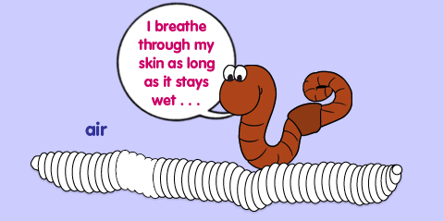
Example 7:
Oxygen diffuses directly through the skin of worms. Carbon dioxide diffuses out through the skin. Worms must keep their skin moist so gases can diffuse across it.
Draw and label the image in the space provided.

Slide 15
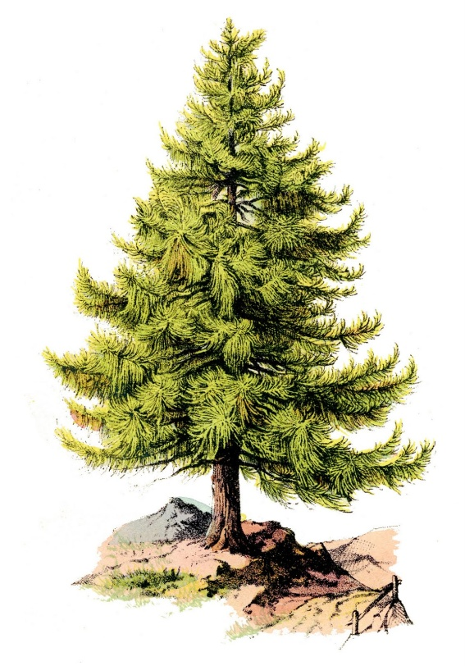
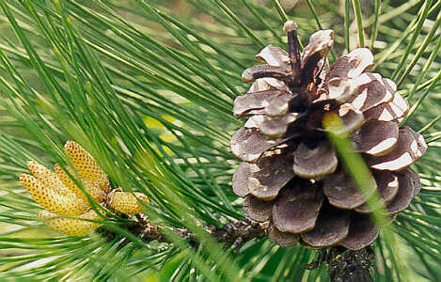
Example 8:
Gymnosperms capture energy from the sunlight to make glucose molecules.
Draw the images in the space provided and label the male and female cone.

Slide 16
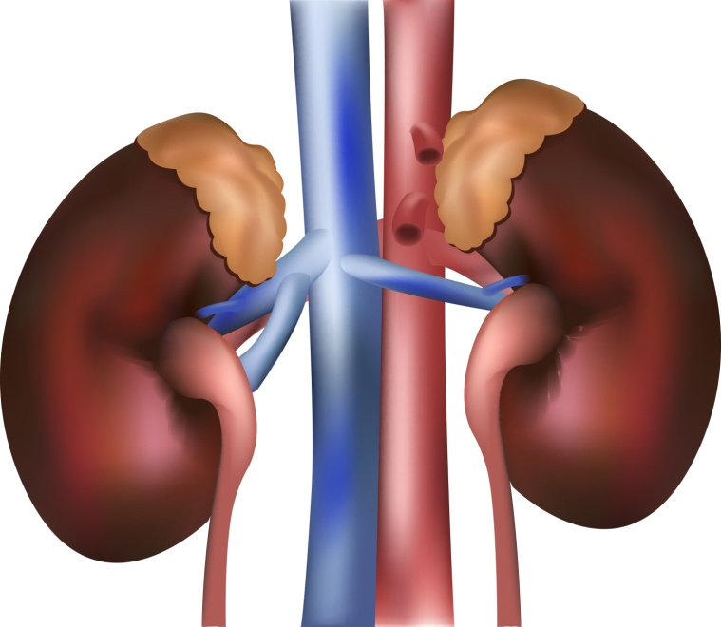
Example 9:
KIDNEYS maintain the proper balance of salt/water in an organism.
Draw the kidneys in the space provided and label the kidneys and blood vessels.
Click on the kidneys to see what happens when kidneys fail.
List three problems associated
with malfunctioning kidneys.

Slide 17
Example 10:
Mammals have a four chambered heart that pumps oxygenated blood throughout the body and deoxygenated blood to the lungs.
Draw and LABEL only the four-chambered heart of the bird/mammal.
Click on the image to view the video of a living, beating human heart.

