Slide 1
Bell Ringer
Objective: Explain that mutations occur during DNA replication or transcription and may be random or a result of environmental agents.
Question: POD page 35

Slide 2
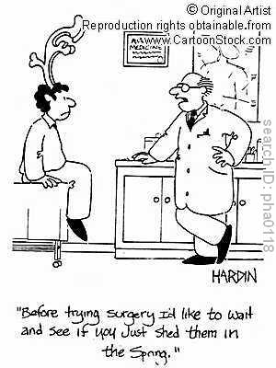
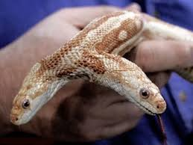
Mutations
changes in the sequence of DNA

Slide 3
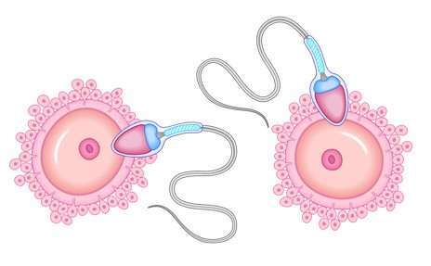
Locations: Mutation in Reproductive Cells
1. Sperm and/or eggs
2. Passed to the next generation

Slide 4
Location: Somatic (Body) Cell Mutation
1. Any cell other than egg or sperm cells
2. May/may not cause problems for the individual with the mutation
3. All cells that come from the mutated cell will have the mutation → may cause cancer
4. Will NOT be passed onto their offspring

Slide 5
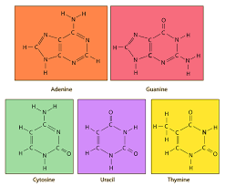
Mutation Type: Nitrogen Base
Point Mutation – change in one nitrogen base
Original DNA – TCGATTTGA
Changed DNA – TCGATATGA

Slide 6
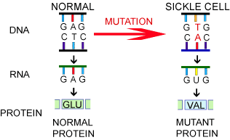
Example of Point Mutations
https://www.dnalc.org/resources/3d/17-sickle-cell.html

Slide 7
Mutation Type: Nitrogen Base
Frameshift Mutation – single nitrogen base is added or deleted; results in a shift in the codon reading frame
Original DNA – TCGATTTGA
Addition – TCGAGTTTGA
Deletion – TCGTTTGA

Slide 8
https://www.youtube.com/watch?v=RzEpkBU-ITA

Slide 9
Silent Mutations

Slide 10
Mutation Type: Chromosomal Mutations
Original Chromosome – ABCDEFGHIJ
(letter = gene)
Deletion → ABCEFGHIJ
**One or more genes is/are deleted

Slide 11
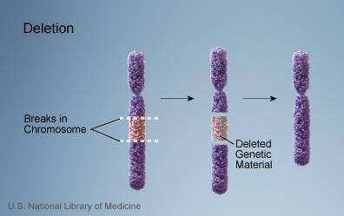
Chromosomal Deletion

Slide 12
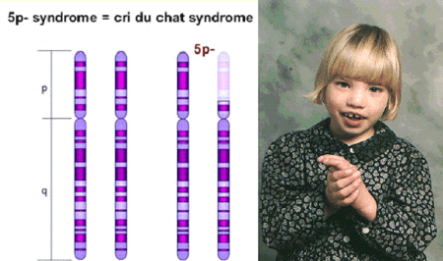

Slide 13
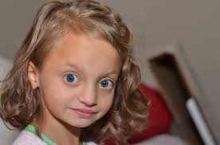
Wolf-Hirschhorn syndrome

Slide 14
Mutation Type: Chromosomal Mutations
Original Chromosome – ABCDEFGHIJ
Inversion → ABCFEDGHIJ
***Set of genes are flipped/inverted

Slide 15
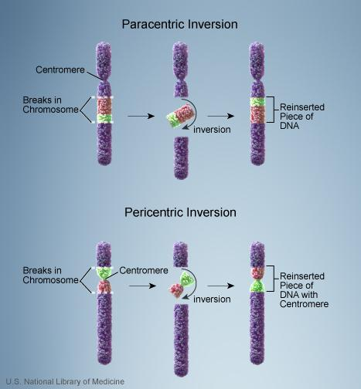
Chromosomal Inversion

Slide 17
Mutation Type: Chromosomal Mutations
Original Chromosome – ABCDEFGHIJ
Insertion → ABCDCDEFGHIJ
***One or more genes are re-inserted & appear more than one time
***Inserted genes may come from
any chromosome

Slide 18
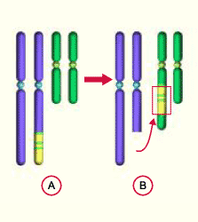
Chromosomal Insertion

Slide 19
Mutation Type: Chromosomal Mutations
Original Chromosome – ABCDEFGHIJ
Translocation → ABCDHIJ &
ABCDEFGHIJEFG
**One or more genes are moved from one chromosome to another chromosome; they exchange places

Slide 20
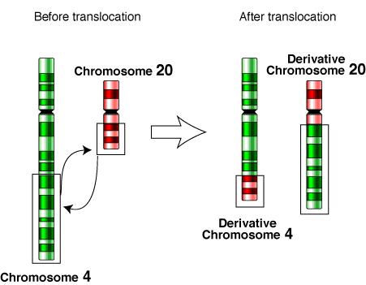
Chromosomal Translocation

Slide 21
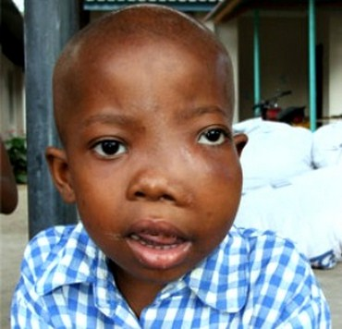
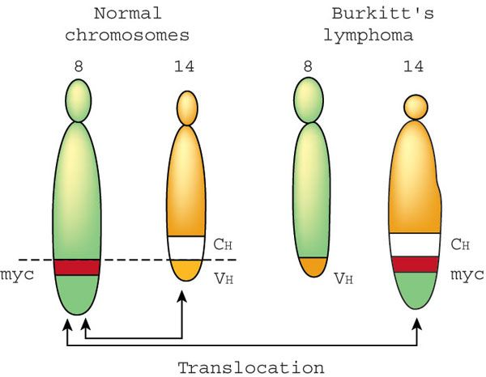

Slide 22
Possible Causes of Mutations
A. X-rays/exposure to radioactivity
B. Exposure to UV (ultraviolet) light
C. Exposure to harmful chemicals (mutagens)
D. Unhealthy lifestyle →
smoking, drugs, etc.

Slide 23
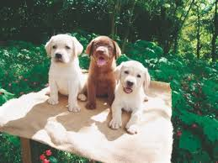
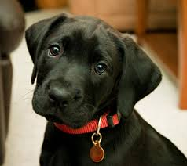
Mutation Mini “Lab”

Slide 24
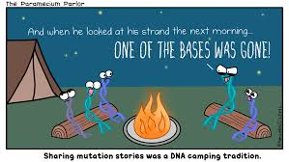
Amoeba Sisters: on individual computers. (CC or headphones)

