Slide 1
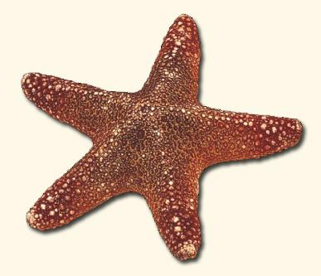
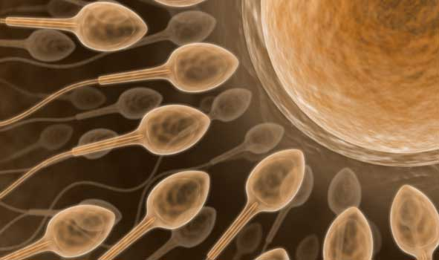
Asexual Reproduction vs. Sexual Reproduction
Remember asexual reproduction is the production of offspring through simple cell division = mitosis.
Sexual reproduction is the production of haploid sex cells (gametes) and subsequent joining of the 2 different sex cells to make offspring

Slide 2
Diploid Cells vs. Haploid Cells
Sexually reproductive organisms have two types of cells that they can reproduce: DIPLOID and HAPLOID.
DIPLOID: a cell with 2 of each kind of chromosome (i.e. 2 of chromosome I, 2 of chromosome II, etc.) where one is from mom and the other is from dad; represented by 2n, examples: all body cells in animals and plants except the sex cells
HAPLOID: a cell with only 1 of each kind of chromosome, represented by n; examples: sex cells (sperm and egg in mammals, pollen and egg in plants)

Slide 3
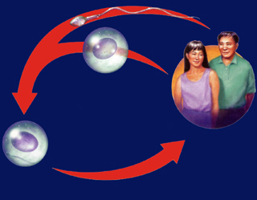
FERTILIZATION PROCESS
Sperm (haploid) are male gametes
Eggs (haploid) are female gametes
Sperm + Egg = Fertilization
Fertilization: the process of a sperm and an egg fusing together to form a diploid zygote
Haploid gametes
(n=23)
Meiosis
Sperm Cell
Meiosis
Egg Cell
Fertilization
Diploid zygote
(2n=46)
Multicellular
diploid adults
(2n=46)
Mitosis and Development
https://www.youtube.com/watch?v=VnDcGlyjWug
https://www.youtube.com/watch?v=xmfs9d1KiX8
https://www.youtube.com/watch?v=6og2qljBNkw

Slide 5
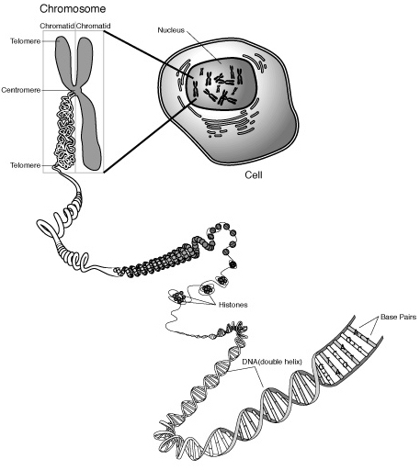

Slide 6
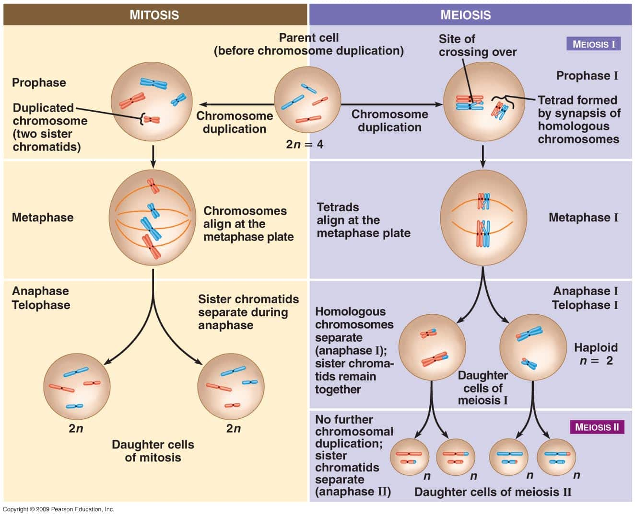

Slide 7
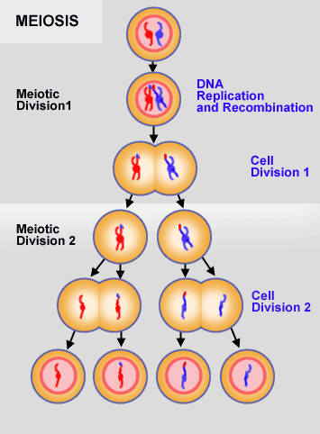
Process of Meiosis
Meiosis: the formation of haploid gametes (sex cells)
Cells in the gonads (boys: testes, girls: ovaries) will undergo meiosis when they need to produce gametes for sexual reproduction.
Males: Make 4 sperm in meiosis
Females: Make 1 egg and 3 polar bodies in meiosis
https://www.youtube.com/watch?v=toWK0fIyFlY
https://goo.gl/CNnZ9V

Slide 8
Process of Meiosis
Meiosis divides the chromosomes differently during the phases to ensure that there are 4 new cells produced, each genetically different, with half of the chromosomes that the body cells have.
Steps of MEIOSIS: Interphase → Prophase 1 →
Metaphase 1 → Anaphase 1→ Telophase 1 →
Prophase 2 → Metaphase 2 → Anaphase 2 →
Telophase 2
(DNA is still duplicated/replicated during Interphase)
End Results: 4 genetically different sex cells

Slide 9
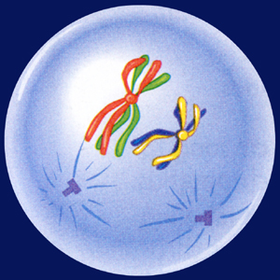
PROPHASE 1 of Meiosis
Homologous chromosomes:
-the 2 chromosomes of a pair in a diploid cell (remember, one from mom and one from dad), humans for instance have 46 chromosomes, 23 homologous pairs
½ of your chromosomes in a cell (23) come from MOM and the other half (23) come from DAD. This totals to your 46 chromosomes per cell.
During prophase these chromosomes pair up in their homologous pairs and form tetrads.
Each tetrad has a chromosome from MOM and the matching chromosome from DAD.

Slide 10
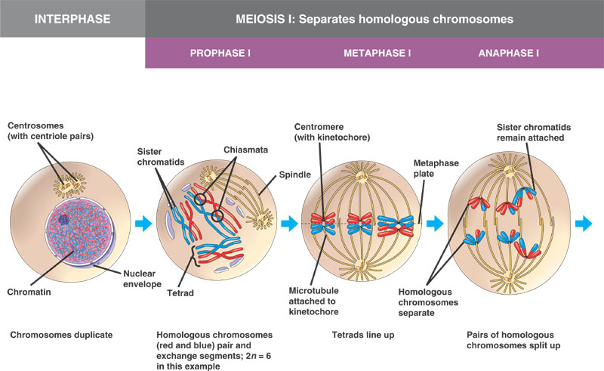

Slide 11
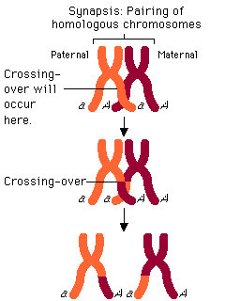
Crossing Over
While the homologous chromosomes are in their tetrads, the ends of the chromosomes that overlap will break off certain pieces and exchange them with the homologous chromosome.
This process is called CROSSING OVER.
This process is why 4 genetically DIFFERENT sex cells are produced.

Slide 12
Meiosis 2 (Prophase 2 → Metaphase 2 → Anaphase 2 → Telophase 2)
Meiosis 2 is exactly like Mitosis
The chromosomes will line up in a single file line along the equator during Metaphase 2, sister chromatids will separate during Anaphase 2, and each cell will make 2 cells during Telophase 2)

Slide 13
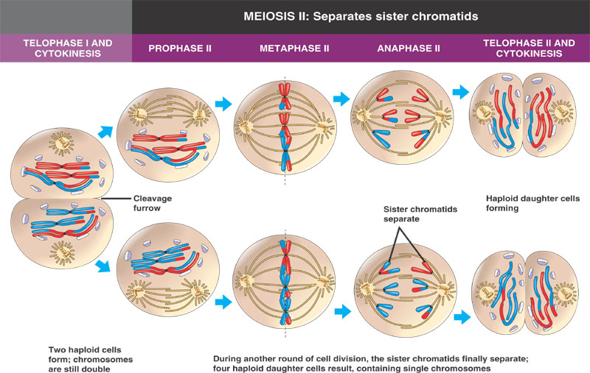
http://highered.mcgraw-hill.com/sites/0072495855/student_view0/chapter28/animation__how_meiosis_works.html

Slide 14
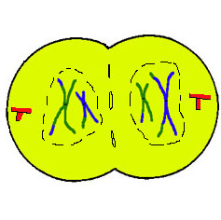
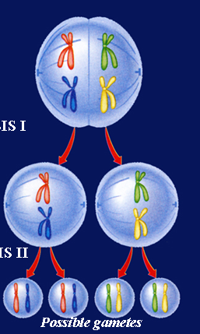
Anaphase/Telophase 1
During these phases, homologous chromosome pairs separate, cutting the number of chromosomes in each resulting cell in half.

Slide 15
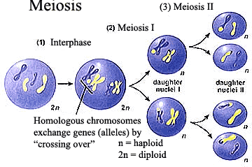

Slide 16
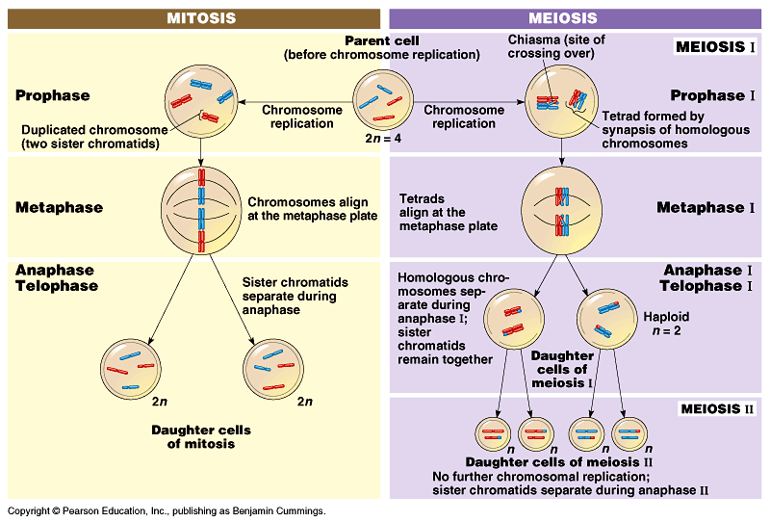
Animation Comparing Mitosis and Meiosis

Slide 17
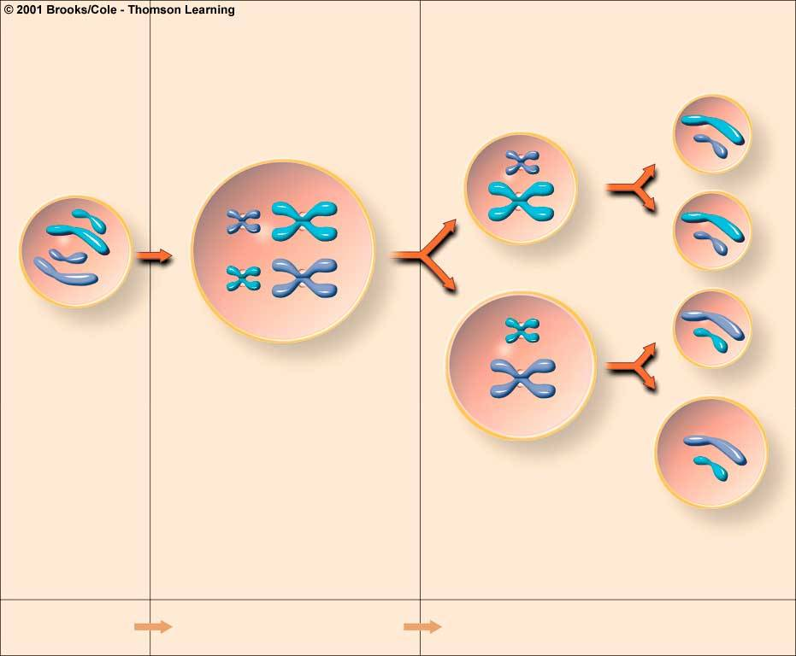
How is Meiosis Different than Mitosis?
Meiosis has 2 divisions
Meiosis produces 4 new cells
Meiosis produces genetically different cells
Meiosis occurs only in the gonads

Slide 18
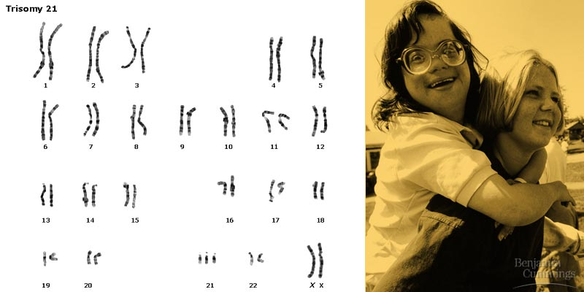
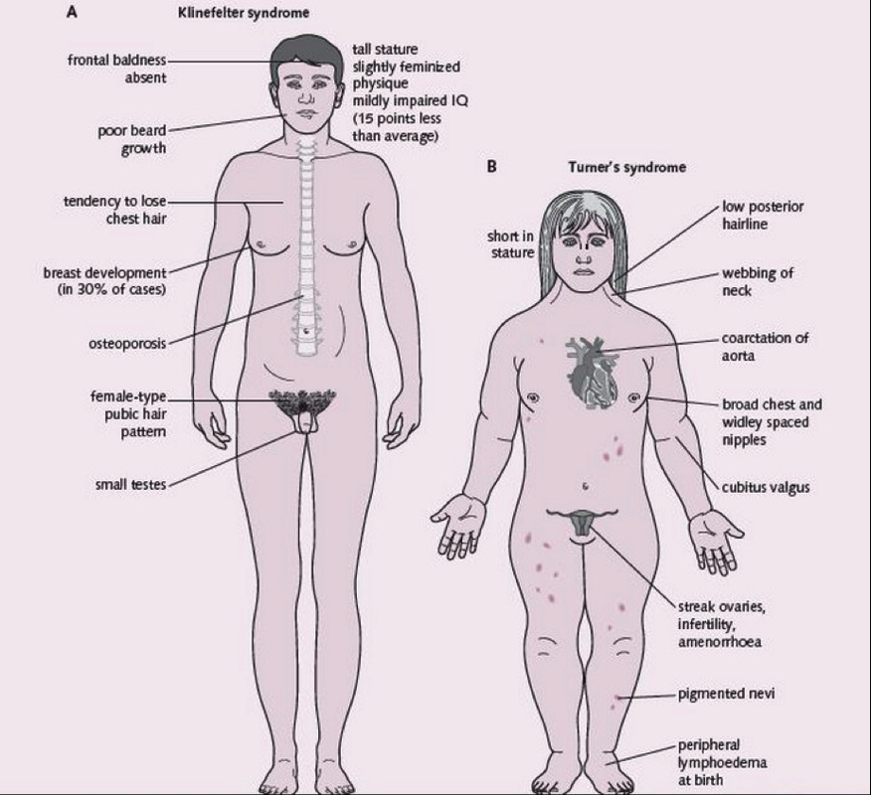
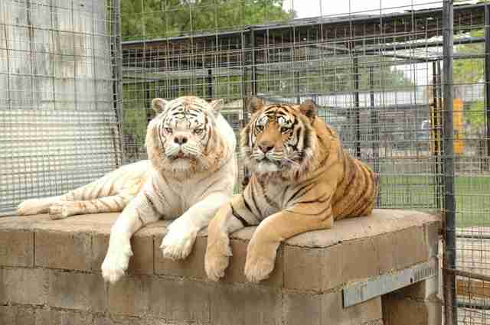
Nondisjunction: the failure of chromosomes to separate properly during meiosis; creates genetic abnormalities where some cells have too many chromosomes and others possibly have too few
Example: Down’s Syndrome
Autosomes
https://www.youtube.com/watch?v=EA0qxhR2oOk

