Slide 1
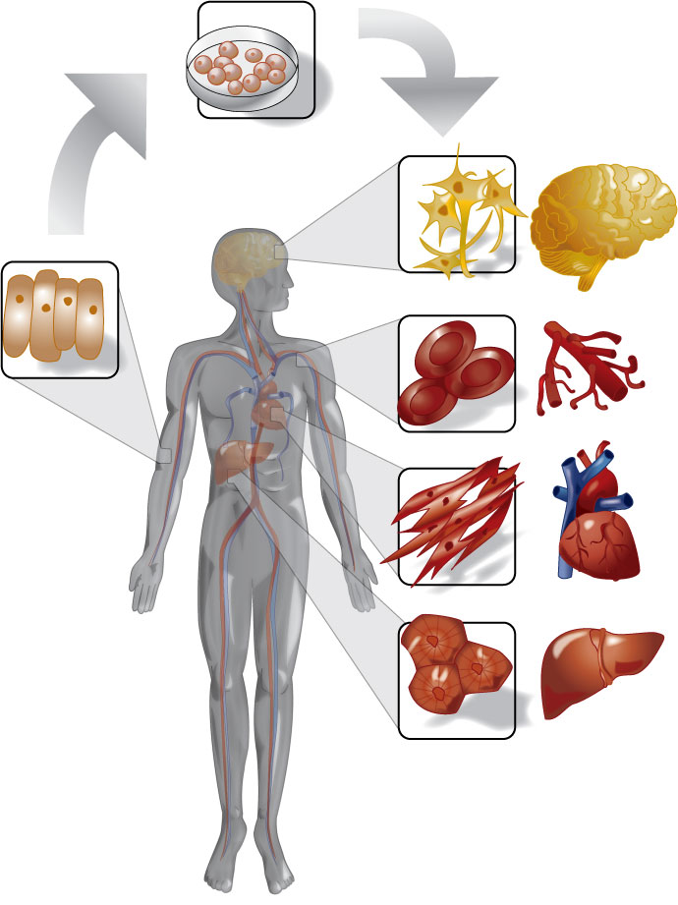
Human Cell Types

Slide 2
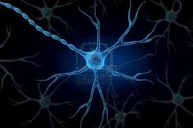
Nerve Cell (Neuron)
Sends electrical signals between the brain and the rest of the body.

Slide 3
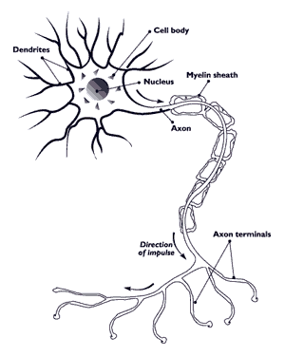
Nerve Cell (Neuron)

Slide 4
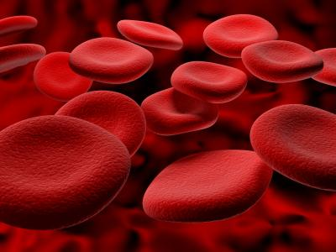
Red Blood Cell
Picks up oxygen from the lungs, and is pumped by the heart to the rest of the body. Hemoglobin is the protein that carries the oxygen.

Slide 5
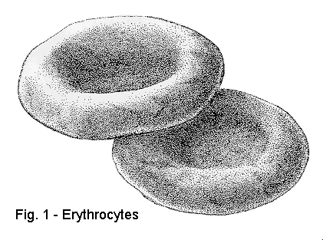
Red Blood Cells

Slide 6
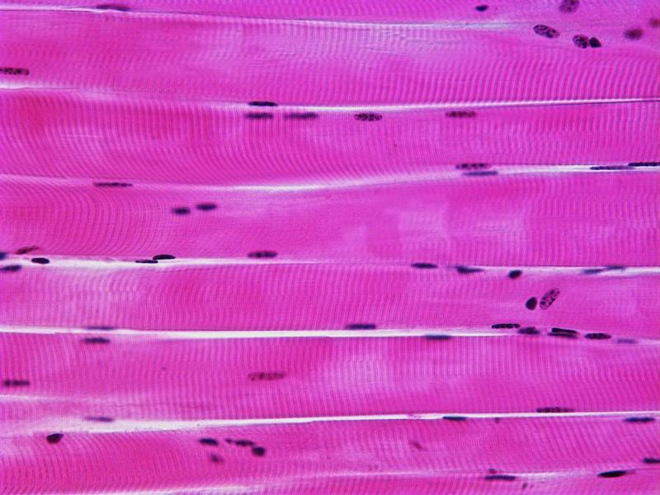
Muscle Cells
Contracts to make your body move. Packed with mitochondria because movement requires lot of energy.

Slide 7
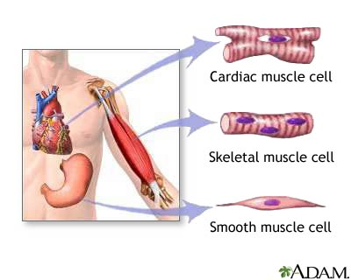

Slide 8
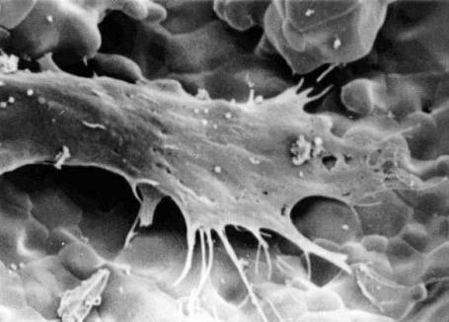
Bone Cells
Makes strong bones to hold the body together and protect your organs. Spiny cells lock together.

Slide 9
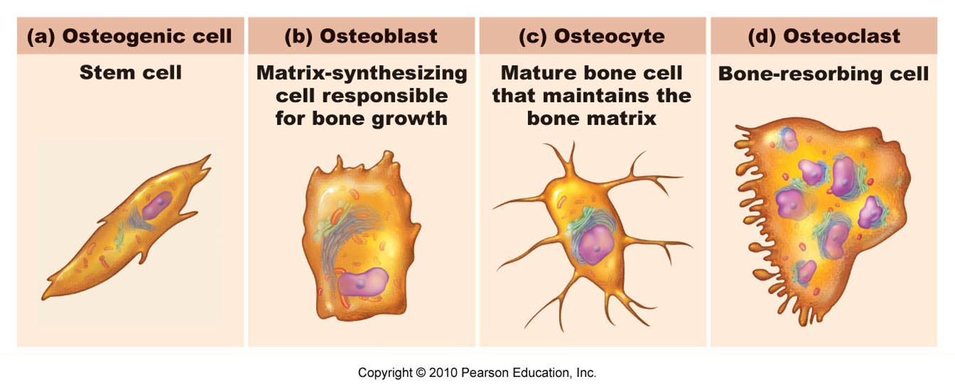

Slide 10
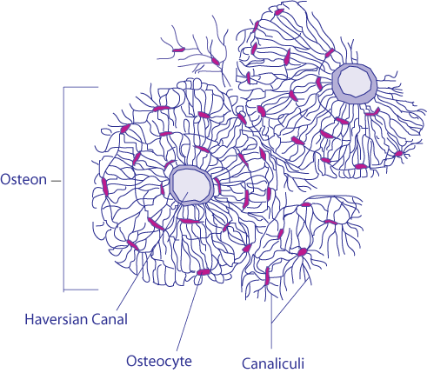
Bone Cells

Slide 11
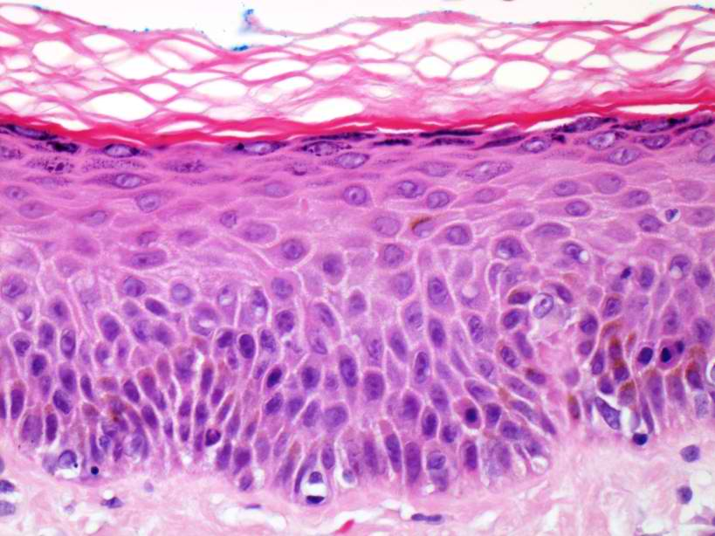
Skin Cells
Forms layers to protect your body (inside and outside).

Slide 12
Skin Cells

Slide 13
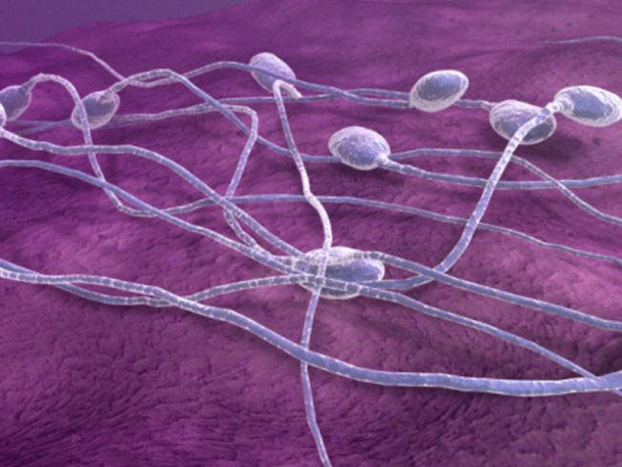
Sperm Cells
Male sex cell—uses its flagellum (tail) to swim in search of an egg to fertilize. Packed with mitochondria for energy.

Slide 14
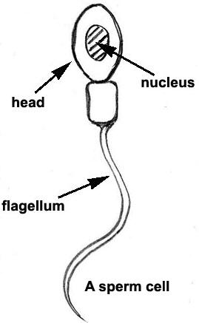
Sperm Cell

Slide 15
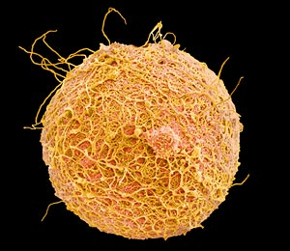
Egg Cells
Female sex cell—fertilized by sperm. Contains nutrients for the growing embryo.

Slide 16
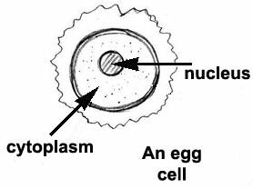
Egg Cell

Slide 18
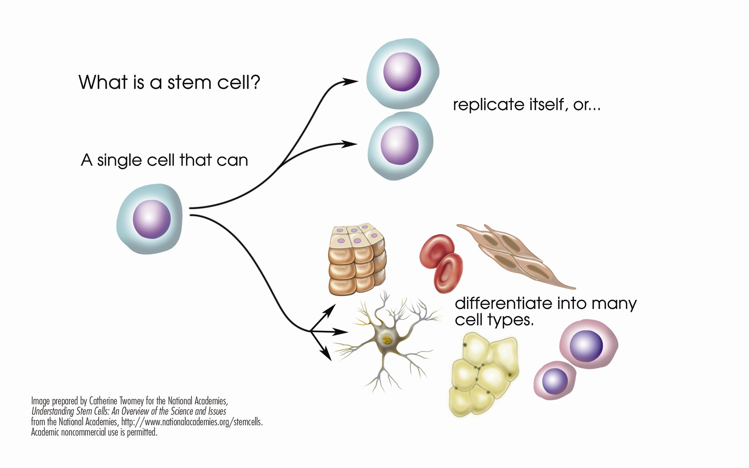
https://www.youtube.com/watch?v=xiHc2E3AR1o
https://www.cbsnews.com/video/special-stem-cell-treatment-for-spinal-cord-injuries-shows-promise/

