Slide 1
Cells!

Slide 2
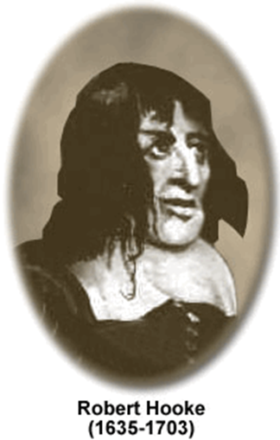
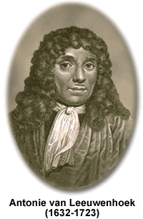
History of the Cell
English scientist
Used early compound microscope
Looked at thin pieces of cork (dead plant)
Observed tiny chamber he called "cells."
Named them cells
Dutch scientist
Invented the simple microscope
Looked at pond water
Observed tiny moving organisms he called "animalcules."

Slide 3
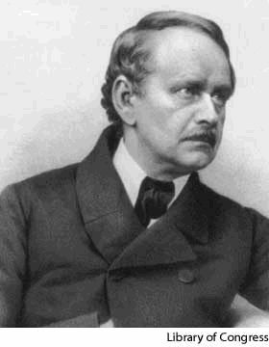
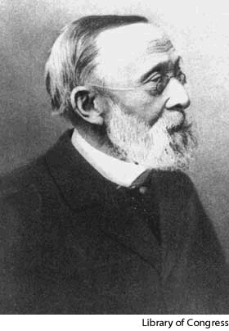
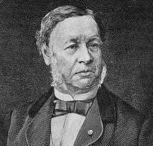
Matthias Schleiden, 1838,
concluded that all plants
are made of cells.
Theodor Schwann, 1839, concluded that all animals are made of cells.
Rudolph Virchow, 1855, concluded that all cells come from existing cells.

Slide 4
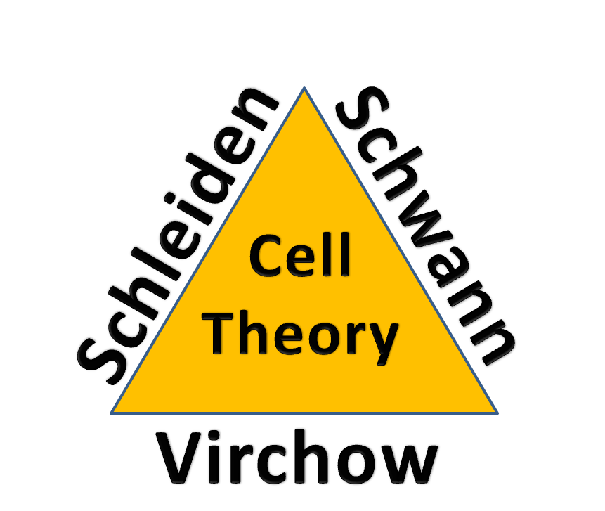

Slide 5
Which lead to…. THE CELL THEORY!
all living things are made of cells
cells are the basic unit of structure and function
new cells come from existing cells
https://www.sciencedirect.com/topics/agricultural-and-biological-sciences/cell-theory

Slide 6
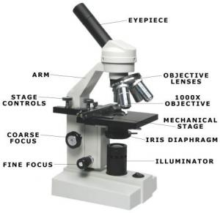
Types of Microscopes
Simple Microscope: Made of only 1 lens, similar to a magnifying glass
Compound Microscope: Made of two or more lenses

Slide 7
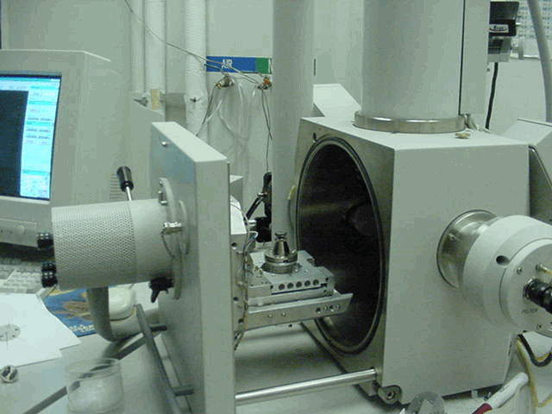
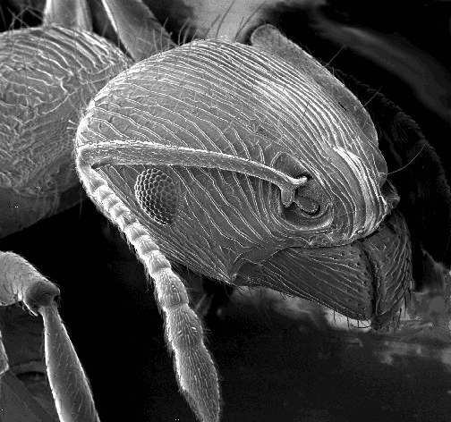
Scanning Electron Microscope
https://www.youtube.com/watch?v=yutNM8AIkkk
https://www.nikonsmallworld.com/galleries/photomicrography-competition
The scanning electron microscope, SEM, passes a beam of electrons over the surface of a specimen.
SEM
SEM viewing of an ant's head
Also cannot be used to view living specimen

Slide 8
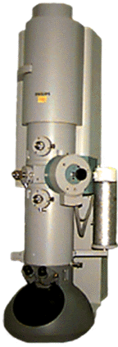
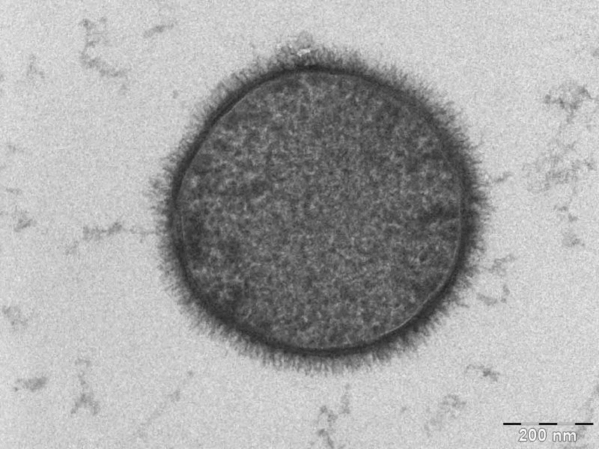
Transmission Electron Microscope
The transmission electron microscope, TEM, passes a beam of electrons through thin slices of a specimen.
TEM viewing of a bacterium
TEM
Cannot view living organisms

Slide 9
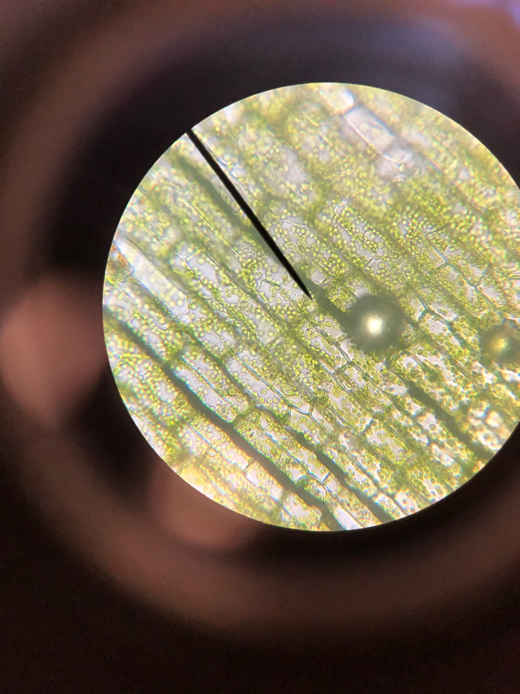
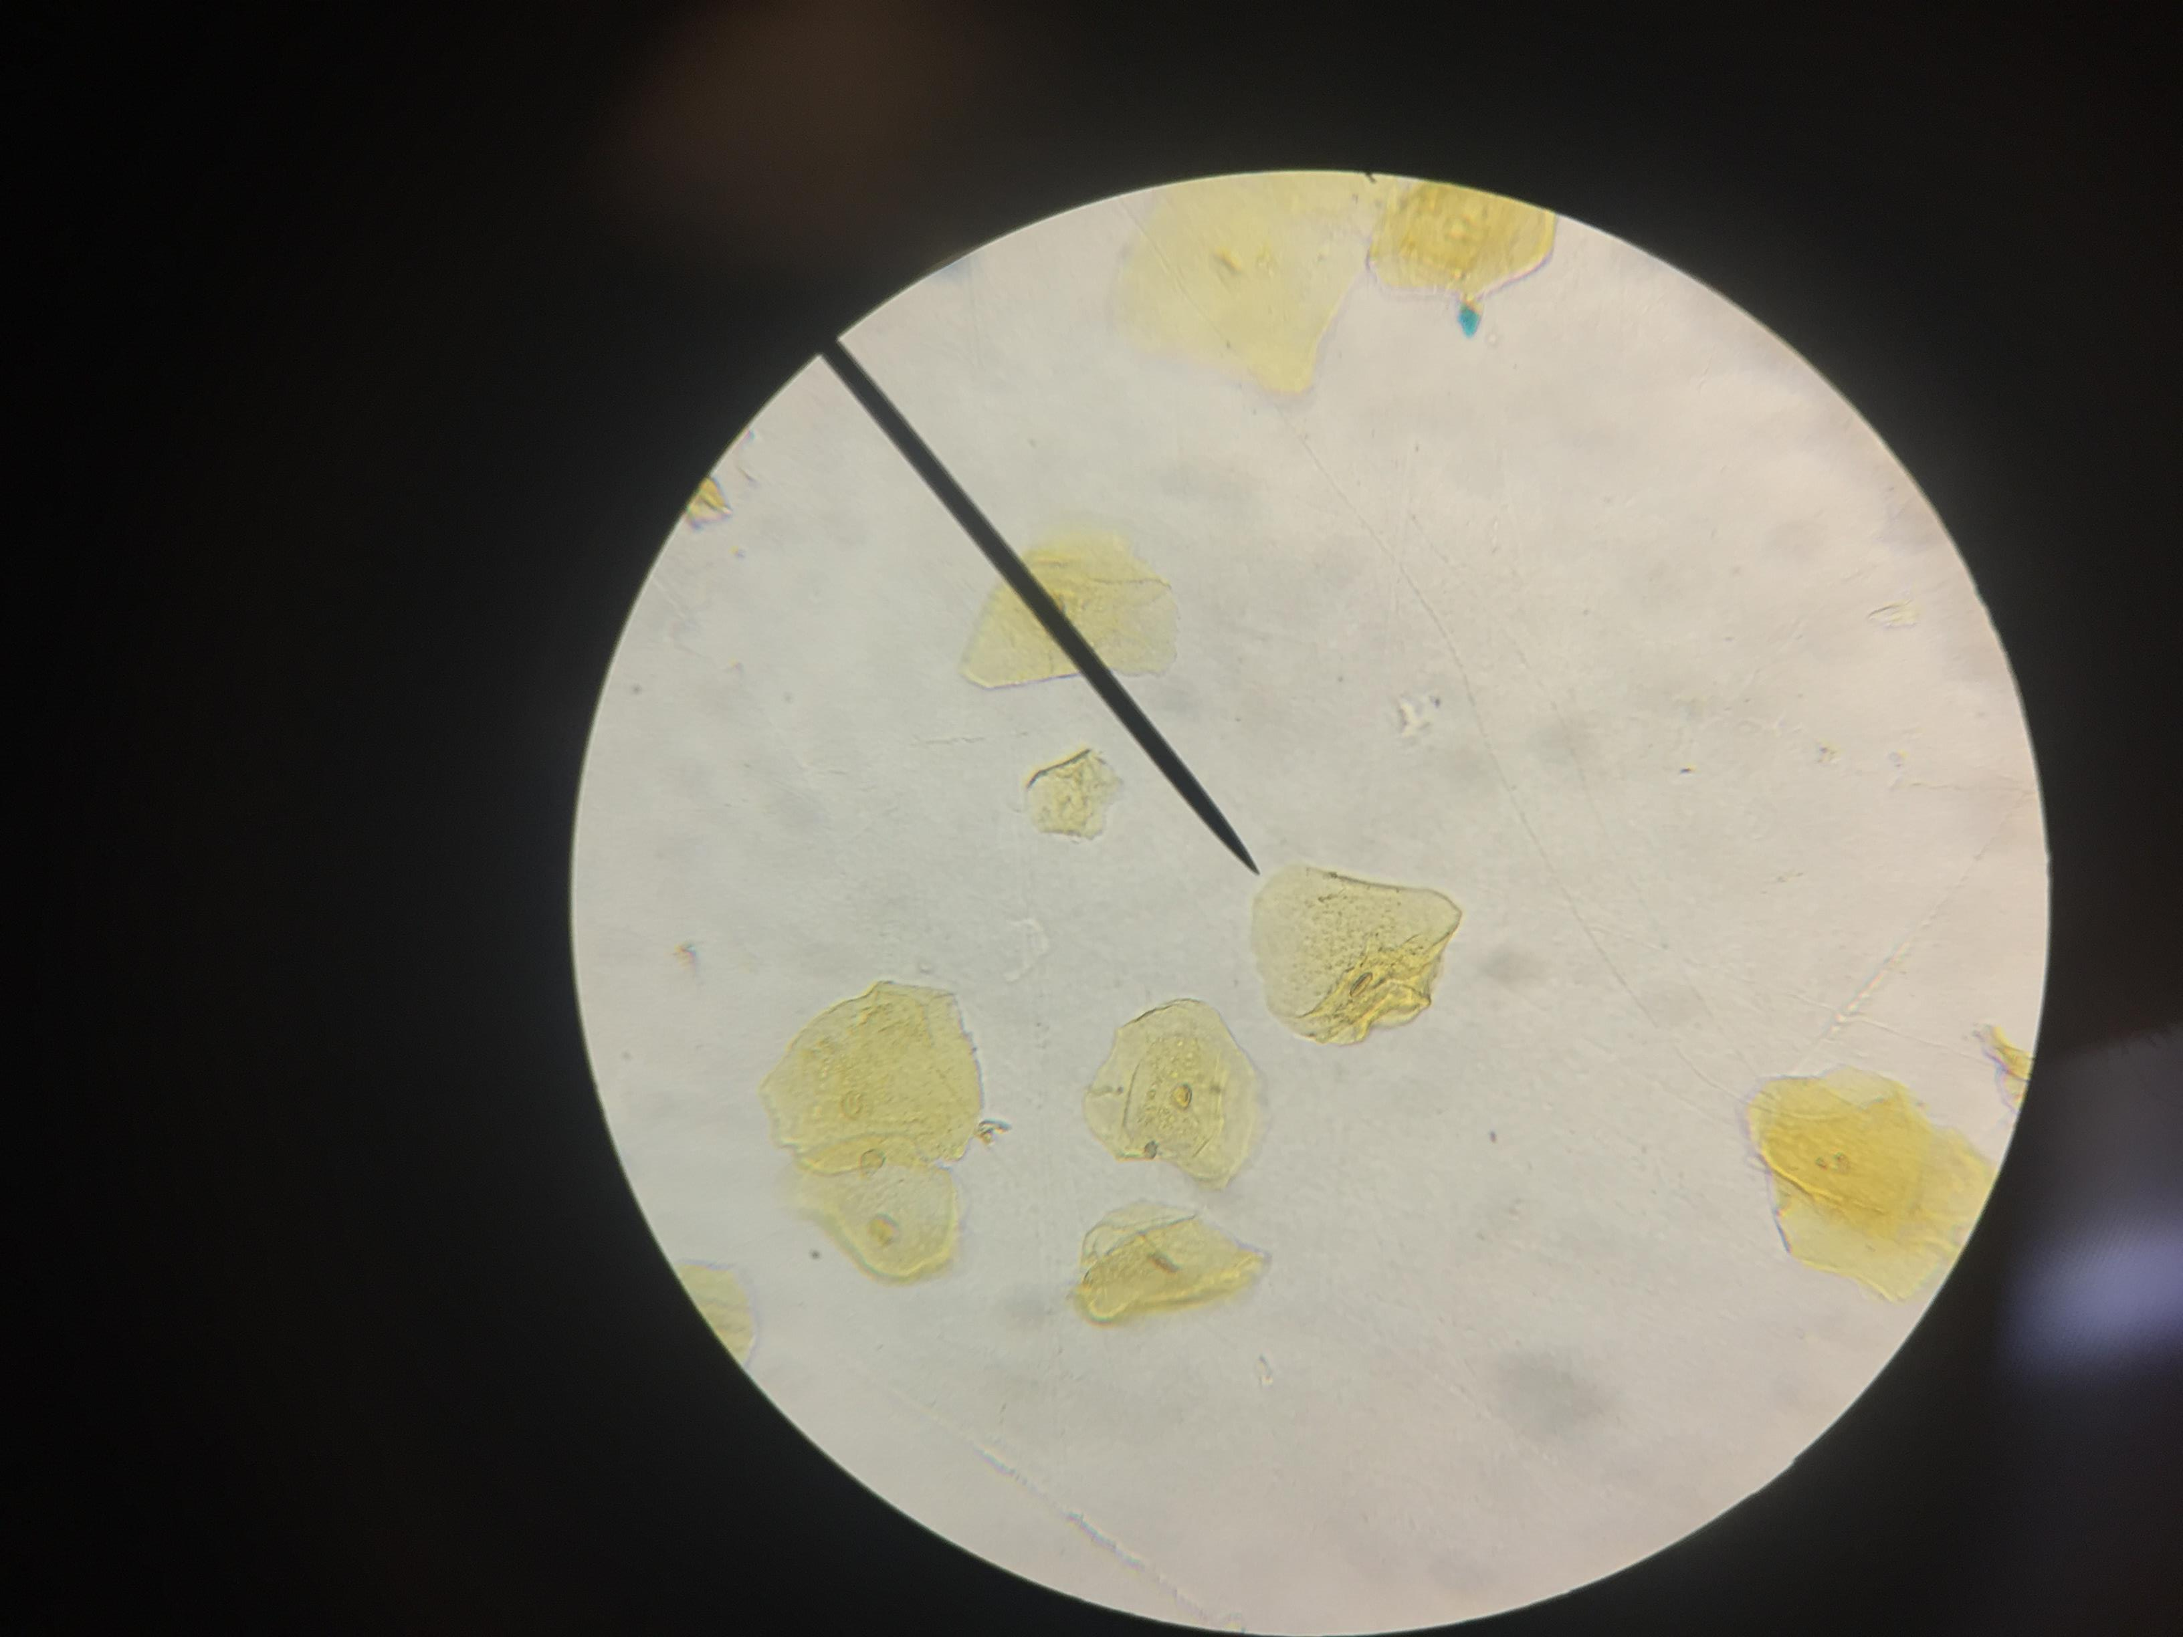

Slide 10
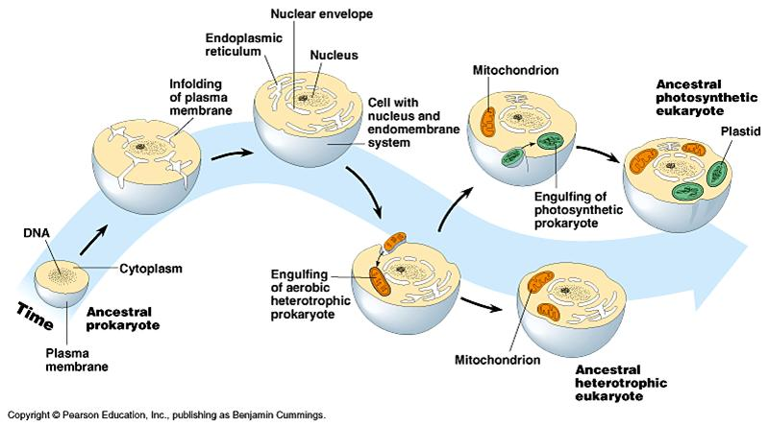
Other Scientists
https://www.youtube.com/watch?v=q71DWYJD-dI
https://sciencing.com/evidence-proves-prokaryotes-existed-before-eukaryotes-18397.html
Lynn Margulis- Endosymbiotic Theory
Certain organells were once free-living cells

Slide 11
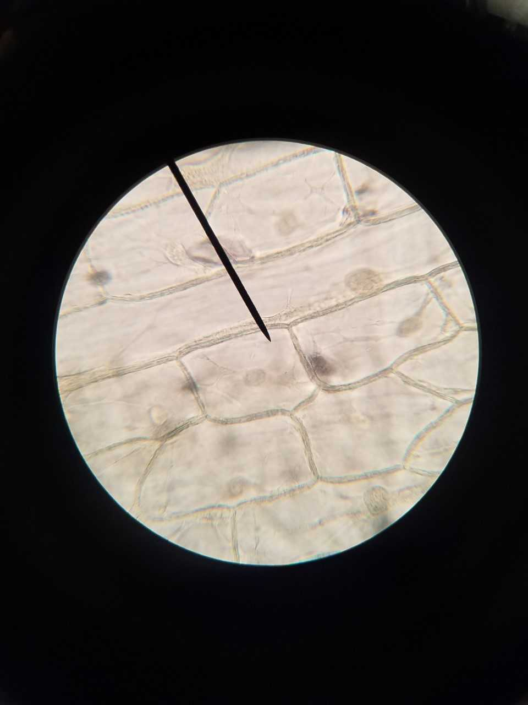
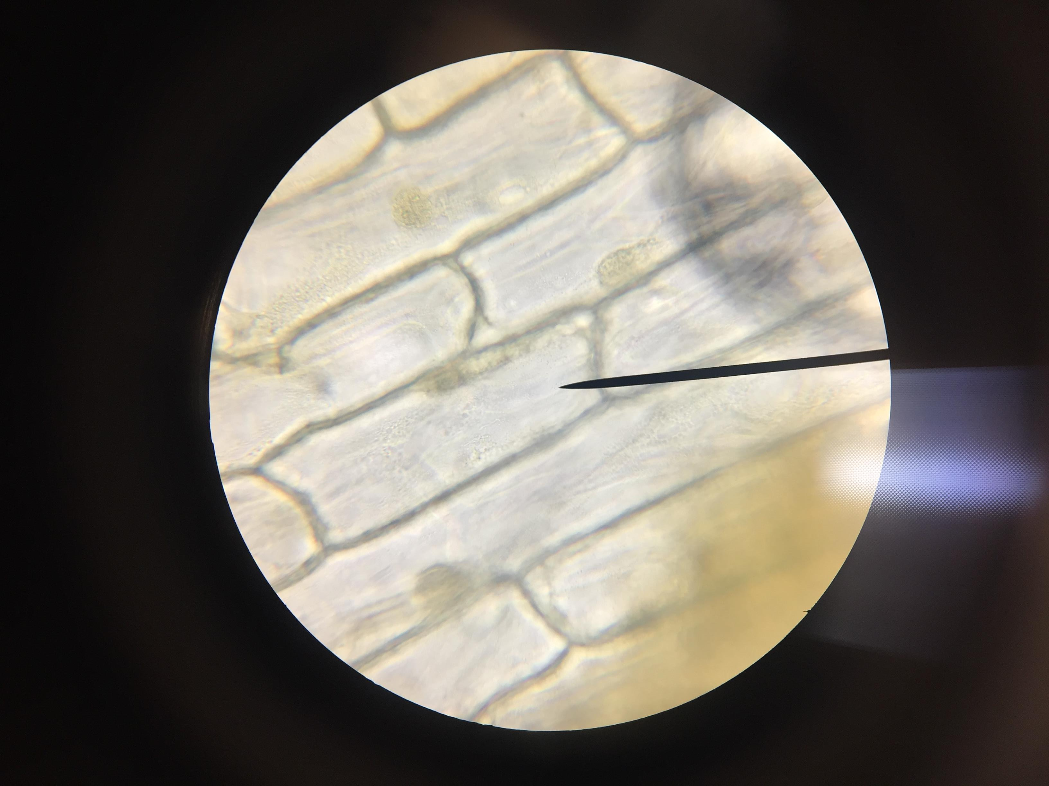

Slide 12
Prokaryotes vs. Eukaryotes
Prokaryotic | Eukaryotic
Have: Ribosomes DNA (circular) Contained in Cytoplasm Very Small Do Not Have: Nucleus Membrane Bound Organelles Only form Unicellular Organisms | Have: Ribosomes Organelles DNA (Linear) In the nucleus Can be multicellular and Unicellular (Yeast) Includes all Protists, Fungi, Plants, and Animals
PRO - NO EU - YES

Slide 13
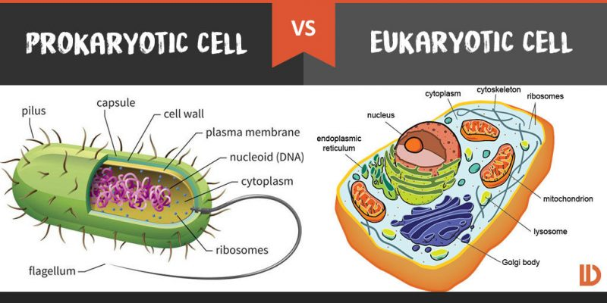
https://ed.ted.com/lessons/the-wacky-history-of-cell-theory#watch
What might a prokaryotic cell look like?

