Slide 1
Patterns of Inheritance and Karyotyping
Predict offspring ratios based on a variety of inheritance patterns (Mendelian/dominance, incomplete dominance, co-dominance, sex-linked, and multiple alleles)

Slide 2
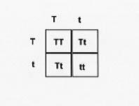
Punnett squares-Quick check
In the Punnett Square, “T” represents the allele for a tall plants and “t” represents the allele for short plants.
Which allele represents dominance?
Which allele represents recessive?
Identify the genotypes of the parents.
Identify the phenotypes of the parents.
What are the genotypes and phenotypes of the offspring?

Slide 3
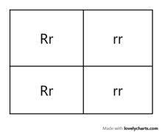
Determine the parental genotypes: __ __ x __ __

Slide 4
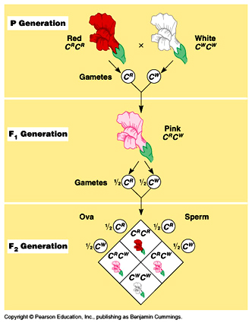
Incomplete dominance
Type of inheritance where neither allele as dominant
Chance (probability) that the resulting offspring could show a blended phenotype
Noted as:
RR x WW or
RR x R’R’
https://www.youtube.com/watch?v=GW9EamEmPU4

Slide 5
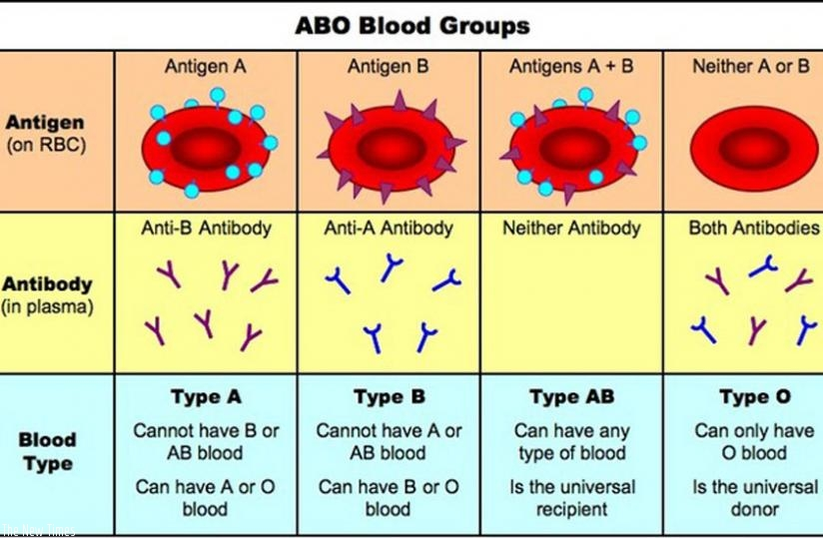
codominance
Type of inheritance where both alleles are dominant.
Resulting phenotype shows a mixture of both alleles.
https://www.youtube.com/watch?v=_sWbQadFCso

Slide 6
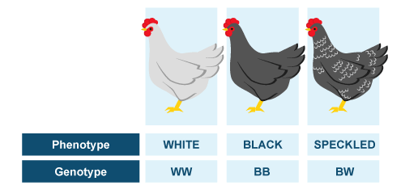

Slide 7
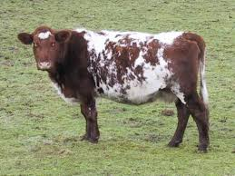
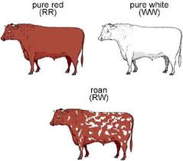

Slide 8
Incomplete dominance or codominant?? Quick check

Slide 9
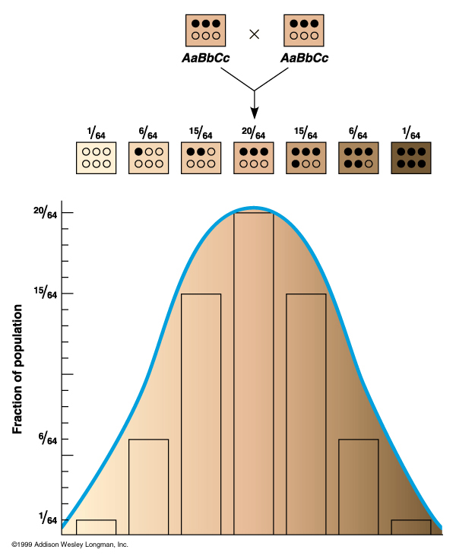
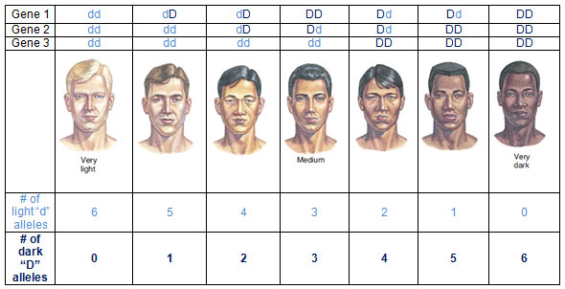
Polygenic traits
Single trait is controlled by 2 or more sets of genes and their alleles.

Slide 11
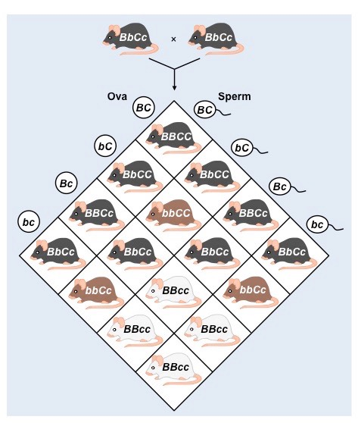
Epistasis
http://www.bio.miami.edu/dana/250/250S11_6.html
The term epistasis describes a certain relationship between genes, where an allele of one gene (e.g., 'spread') hides or masks the visible output, or phenotype, of another gene (e.g., pattern).

Slide 12
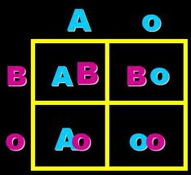
Blood typing
https://www.nobelprize.org/educational/medicine/bloodtypinggame/gamev2/index.html
https://www.google.com/search?rlz=1C1GGRV_enUS758US758&ei=_nkqWrb-LOHi_QaZ45fADw&q=amoeba+sisters+multiple+alleles&oq=amoeba+sisters+multiple+alleles&gs_l=psy-ab.3..0l5j0i22i30k1l2.1443.9328.0.9490.17.17.0.0.0.0.145.1464.15j1.16.0....0...1.1.64.psy-ab..1.16.1457...0i131i67k1j0i67k1j0i131k1.0.Pqgm68EQO18&safe=active&ssui=on
Determined by both parents
Type of codominance inheritance
Blood types: A, B, AB, and O

Slide 13
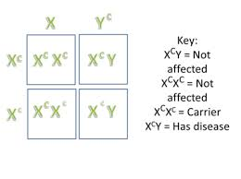
Sex-linked traits
Female-XX
Male-XY
No sex-linked trait found on the Y chromosome
QUICK CHECK
Why are males more likely to express a sex-linked trait?

Slide 14
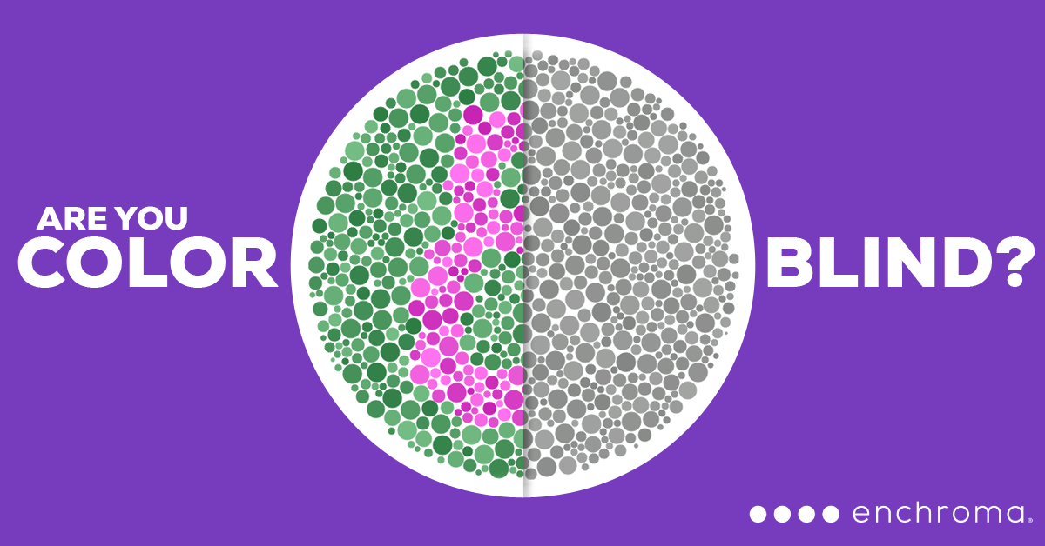
https://www.youtube.com/watch?v=Jxwx_QTkmpY

Slide 15
Name that disease

Slide 16
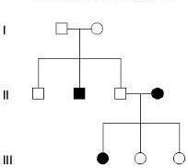
Pedigrees
Chart of an individual's ancestors used to analyze Mendelian inheritance of certain traits, especially of genetic diseases or disorders.
Females are represented by a circle
Males are represented by a square
Ex. Genotype of Generation I: female
Rr
Genotype of Generation I: male
Rr
How do we know?
What are the genotypes of the individuals in generation II who have 3 children? Is the inheritance dominant or recessive? Explain your answer.

Slide 17
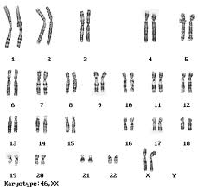
Karyotype
Number and appearance of chromosomes in the nucleus of a eukaryotic cell.
In normal humans, there are 46 chromosomes
23 pair of chromosomes
One chromosome from each parent
22 pair of autosomes
1 pair of sex chromosome
XX (female)
XY (male)
Can help determine genetic disorders based on the number of chromosomes. Ex. Down’s Syndrome, Turner Syndrome, Klinefelter’s Syndrome

Slide 18
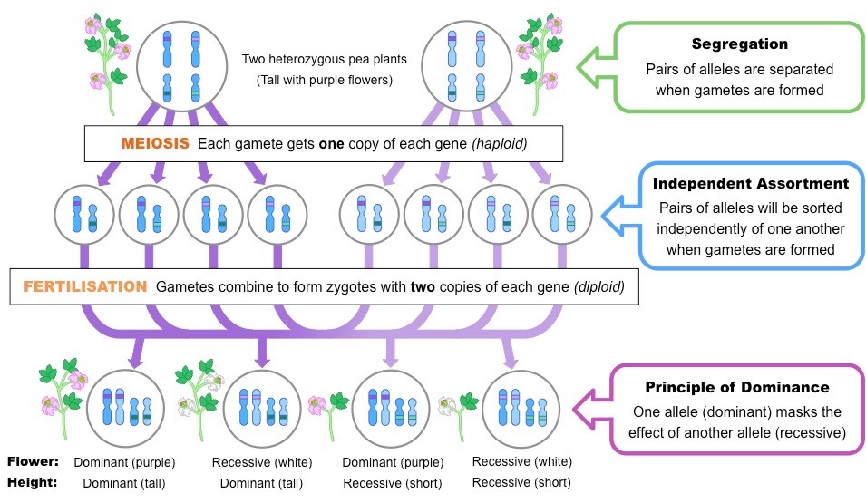

Slide 19
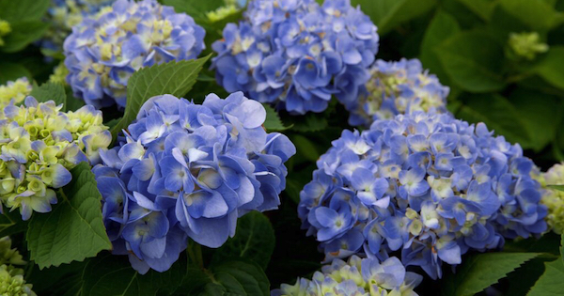
Epigenetics
http://www.slate.com/articles/health_and_science/science/2015/05/inherit_stress_from_parents_snowshoe_hares_provide_new_research_video.html

