Slide 1
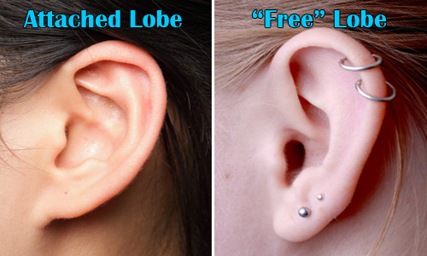
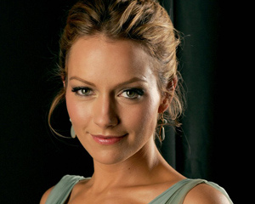
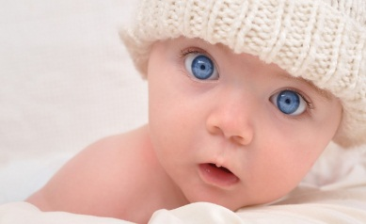
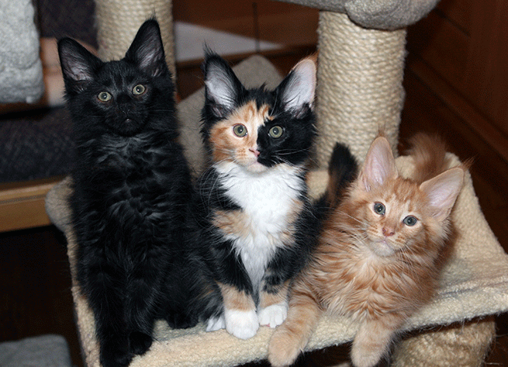
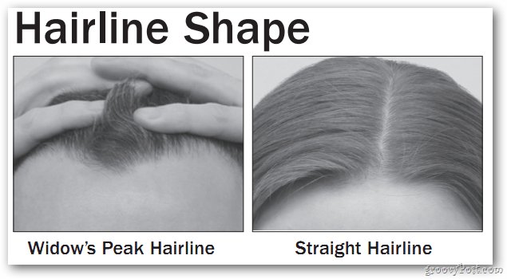
Genetics

Slide 2
https://www.youtube.com/watch?v=5MQdXjRPHmQ

Slide 6
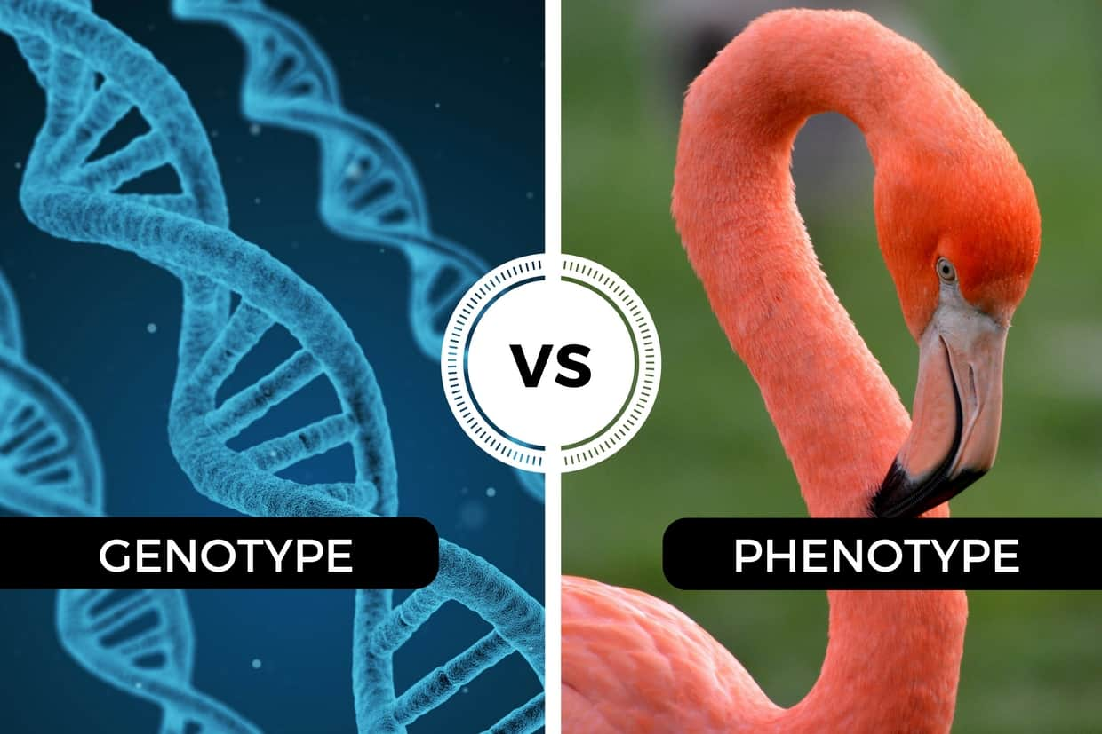

Slide 7
I. What is Genetics?

Slide 8
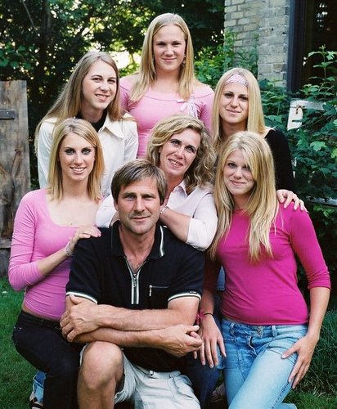
I. What is Genetics?
Scientific study of inheritance of traits.
Inheritance is understanding how genes are passed on from parents to their offspring.

Slide 9
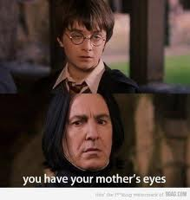
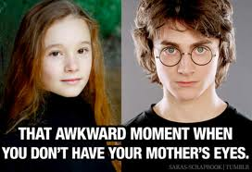

Slide 10
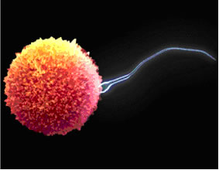
I. What is genetics?
Offspring receive one set of genes from mom and one set from dad
Genes are combined during fertilization of gametes (sperm & egg/Haploid)
Mom’s Genes
Dad’s Genes

Slide 11
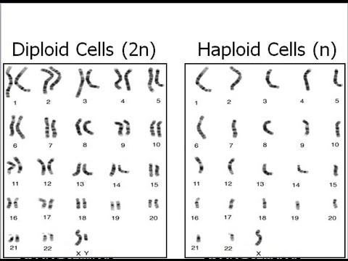

Slide 12
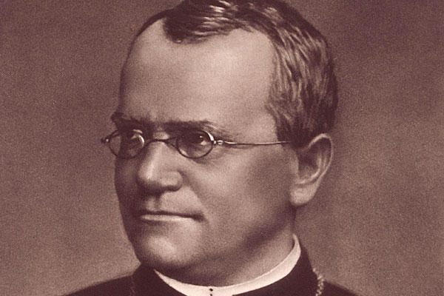
https://www.youtube.com/watch?v=EGzFsme22s8
II. Gregor Mendel

Slide 13
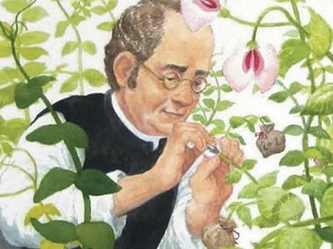
Gregor Mendel
II. Father of Modern Genetics: *Gregor Mendel* (1822-1884)
Mendel was a monk and a gardener (a strange combination for someone who made such important discoveries about Genetics.)

Slide 14
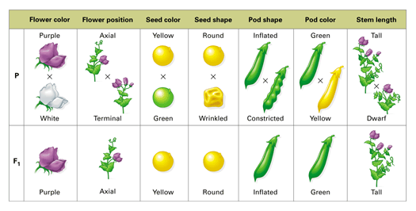
Gregor Mendel
What he discovered: Mendel worked out the probability that certain “factors/traits” will be inherited in an offspring

Slide 15
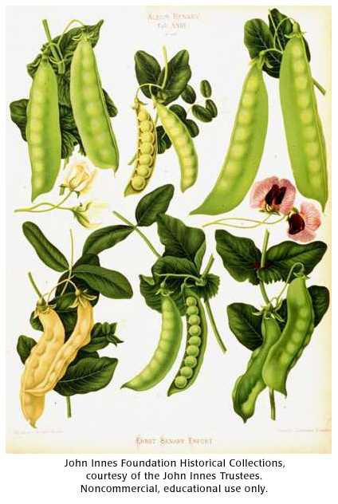
Pea Plants
Mendel used pea plants for his research.
WHY pea plants?

Slide 16
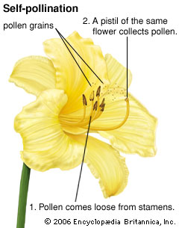
Pea Plants
WHY pea plants?
They can self-pollinate or pollinate other plants because they produce both eggs and pollen (sperm) in the same flower.

Slide 17
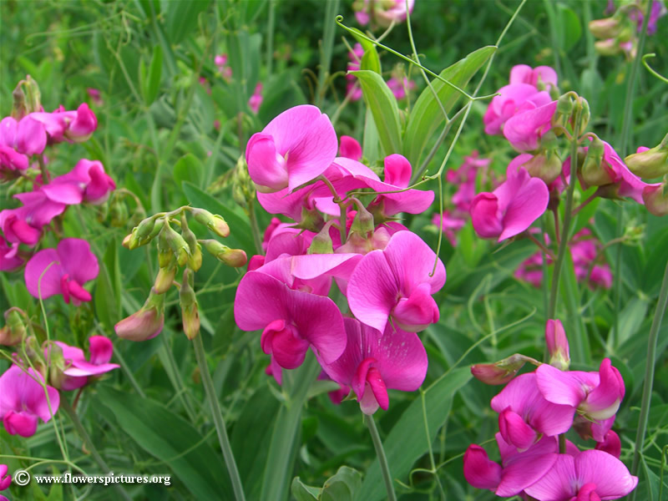
Pea Plants
WHY pea plants?
They are small, easy to grow, and have many offspring.

Slide 18
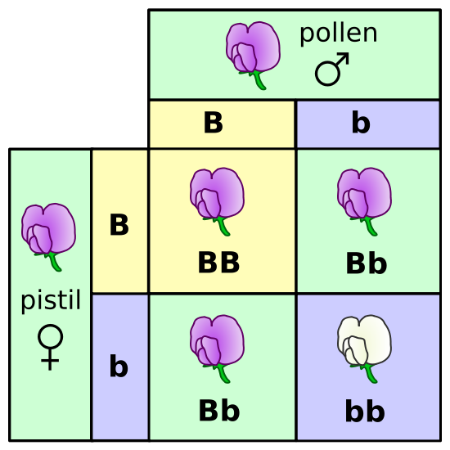
Pea Plants
https://goo.gl/vBKbOh
He crossed (mated) plants with different traits to see what traits the offspring received
(he calculated the probability of each trait).
Ex: ¾ were purple
(75%)

Slide 19
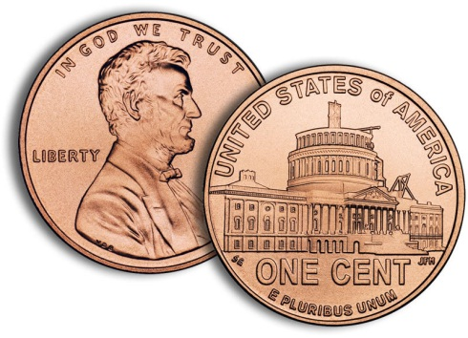
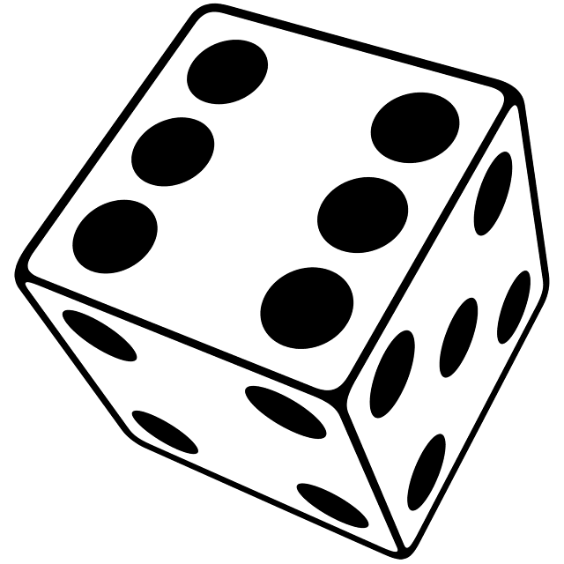
Probability
Probability: likelihood (% chance) that an event will occur
Ex: the probability of flipping heads is 1/2 (50%)
The probability of rolling a 6 on a die is 1/6 (16.7%)

Slide 20
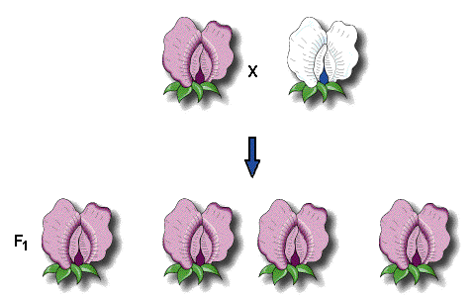
Dominant and Recessive
Mendel noticed that some traits were stronger and seemed to hide other traits.
He called these dominant traits.

Slide 21
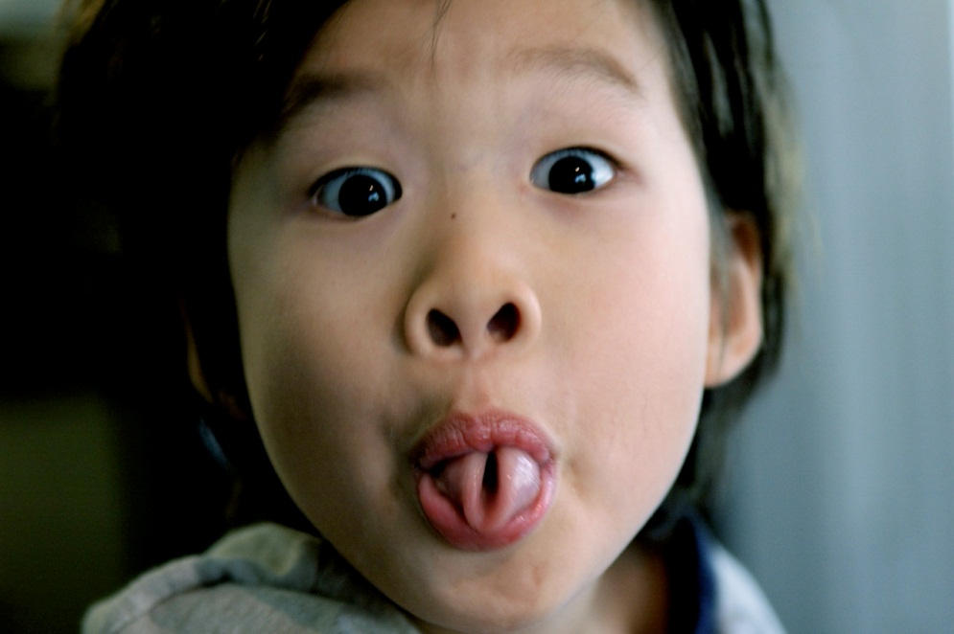
Dominant Human Traits
Hitchiker’s Thumb
Tongue-Rolling
Free Earlobes

Slide 22
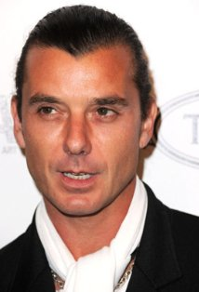
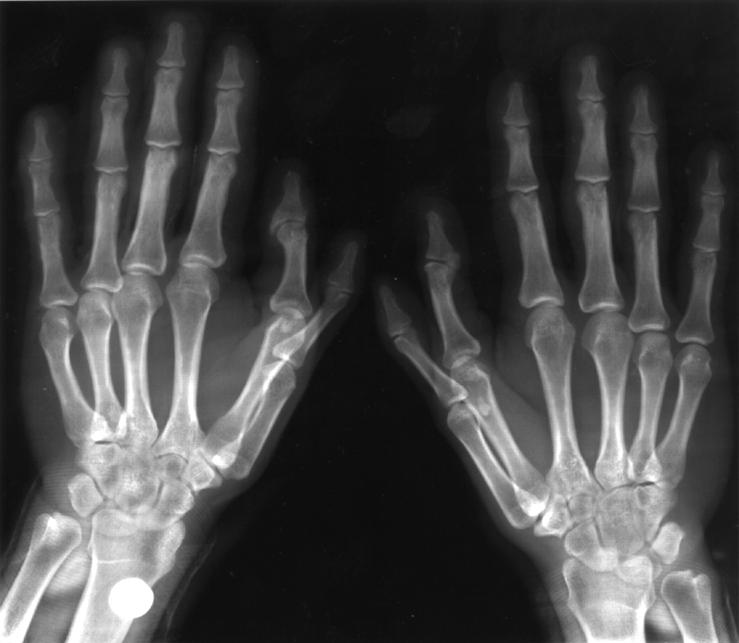
More Dominant Traits
Widow’s Peak Hairline
Polydactyly—6 fingers
Brown Hair & Brown Eyes
Melanin in Skin & Hair

Slide 23
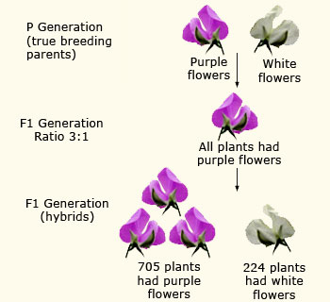
Dominant and Recessive
Other traits appeared less often and seemed to be more rare in a population.
Mendel called these recessive traits. *Recessive means “hidden”

Slide 24
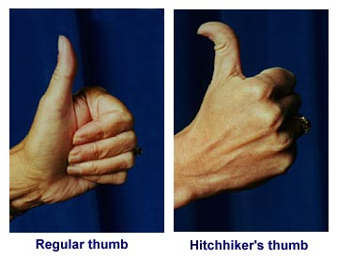
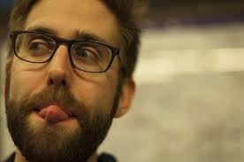
Recessive Human Traits
Non-Tongue-Rolling
StraightThumb
Attached Earlobes

Slide 25
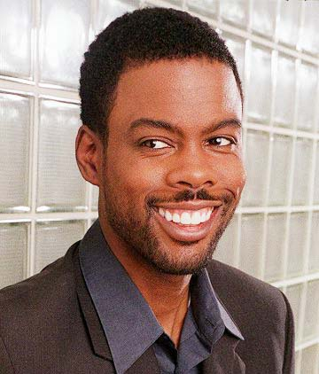
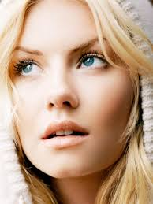
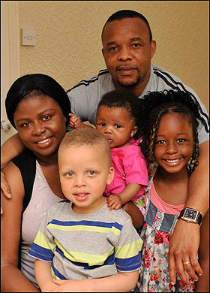
More Recessive Traits
No Widow’s Peak
Blonde Hair &
BlueEyes
Albinism
(No Melanin)
5 Fingers

Slide 26
Example of Mendel’s Results
P
F1
F2

Slide 27
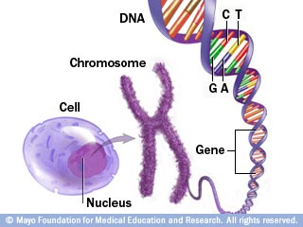
Mendel’s Conclusions:
“Factors” controlled which traits offspring “expressed” (showed)
We call these “factors” genes.
Make a note: *Each Trait (what you are like) is controlled by a Gene (in your DNA).*

Slide 28
Mendel’s Laws:
Law of Dominance: DOMINANT genes will mask recessive genes (recessive genes are hidden).
a recessive gene may
remain hidden in several
generations
Albinism skipped a
generation in this family.

Slide 29
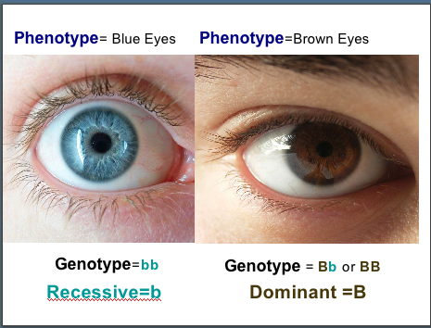
Example of dominant / recessive gene:
Brown vs. Blue Eye Color
Brown is the dominant
gene (B)
Blue is the recessive
gene (b)
When a person gets a brown gene from one parent and a blue from the other, the brown gene completely hides the blue gene. So, the eyes will be brown.

Slide 30
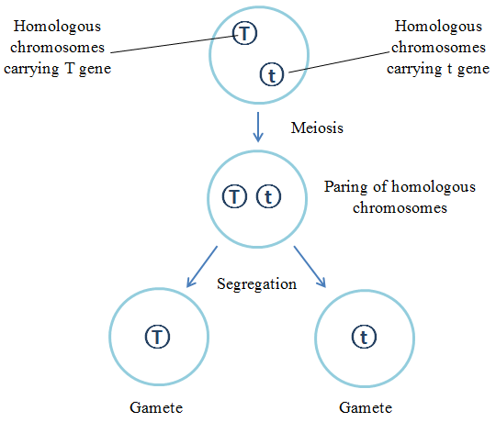

Slide 31
Mendel’s Laws:
Law of Independent Assortment
In other words, if a parent has Aa for its genes,
then the offspring has a 50 % chance of inheriting A
and a 50 % chance of inheriting a.
a
MEIOSIS
A
DNA Replication
AA aa
Aa
a
A

Slide 32
What is the probability of the A trait being passed down?
MEIOSIS
DNA Replication
AA

Slide 33
A
MEIOSIS
A
DNA Replication
AA AA
AA
A
A

Slide 34
What are the chances the child will receive the Y gene?
MEIOSIS
DNA Replication
XY

Slide 35
X
MEIOSIS
Y
DNA Replication
XX YY
XY
X
Y

Slide 36
III. The Language of Genetics

Slide 37
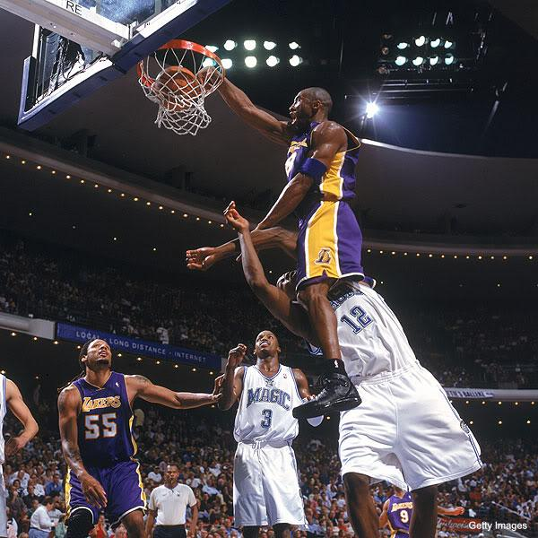
Key Vocabulary
To “ Dominate” =
To overpower
Dominant: ­­­­­­­­stronger trait, usually more common—hides recessive traits
Use CAPITAL or BIG letters
Ex: B stands for a brown gene

Slide 38
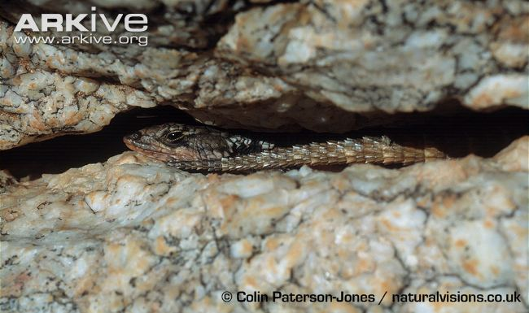
Key Vocabulary
Recessive: weaker trait; hidden when paired with a dominant trait
Use lower-case or little letters
Ex: b stands for a blue gene
“Recess” = crack
Or crevice where
Something can hide

Slide 39
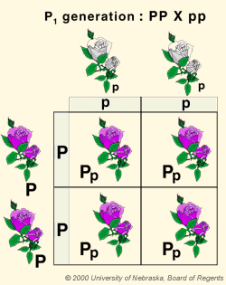
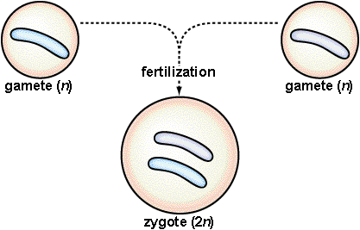
Key Vocabulary
Genotype: the two genes an individual has for one trait
Ex: PP, Bb, XY, aa
A
a
Sperm
Egg
a
Genotype:
Aa
A

Slide 40
Key Vocabulary
Phenotype: the trait that is “expressed”
(can be seen)
Ex: Purple Flower,
Brown Eyes

Slide 41
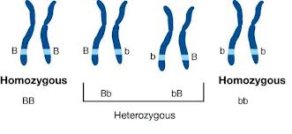
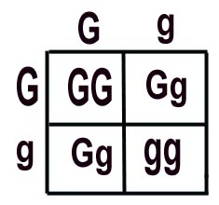
Key Vocabulary
Homozygous: genotype is two of the SAME letters
Ex: BB, bb, XX
Which genotypes
are homozygous?

Slide 42
Key Vocabulary
Heterozygous: genotype is two DIFFERENT letters (hybrid)
Ex: Bb, XY, RW
Which genotypes
are heterozygous?
Hybrids

Slide 43
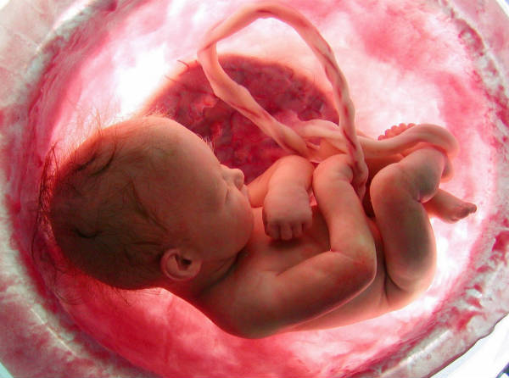
The miracle of life!!
https://www.youtube.com/watch?v=lM2-8se6pp8

