Slide 1
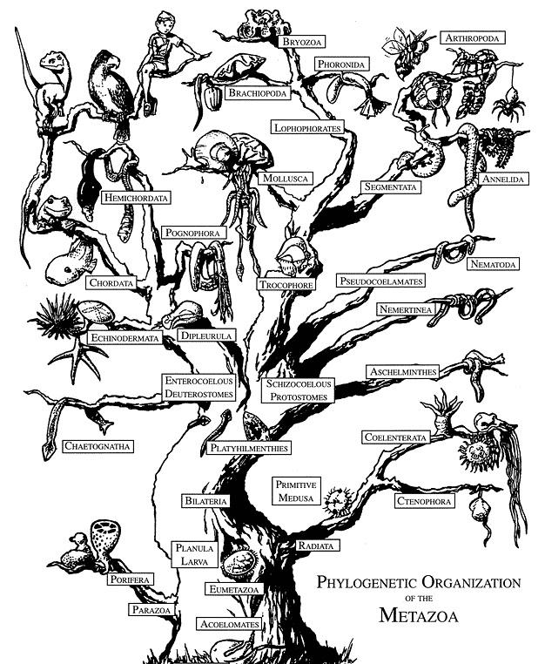
EVOLUTION

Slide 2
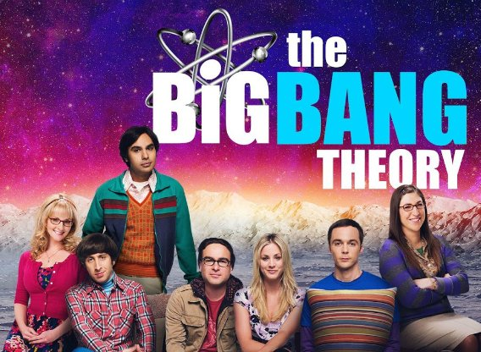
https://www.youtube.com/watch?v=tq6be-CZJ3w

Slide 3
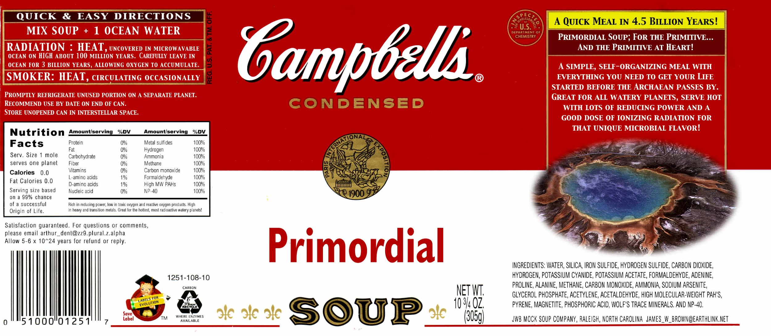
https://goo.gl/gt35o1
https://www.youtube.com/watch?v=tq6be-CZJ3w

Slide 4
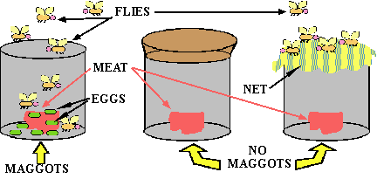
The Origin of Life:
Spontaneous Generation vs. Biogenesis
A few hundred years ago, people believed in spontaneous generation (a.k.a. abiogenesis) of organisms. They thought living things could just appear out of nowhere. Francesco Redi’s fly experiment disproved this theory.
Proved biogenesis: living things only come from other living things.

Slide 5
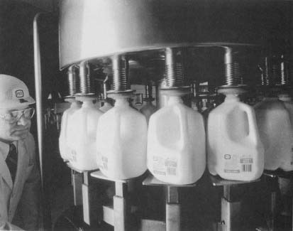
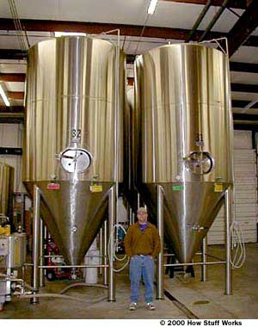
Louis Pasteur → helped disprove spontaneous generation
Pasteurization: kills the germs (bacteria) in your milk
Once the germs are dead, they cannot grow back.
“It takes life to make life.” (Biogenesis)
(Cell theory: cells come from pre-existing cells.)

Slide 6
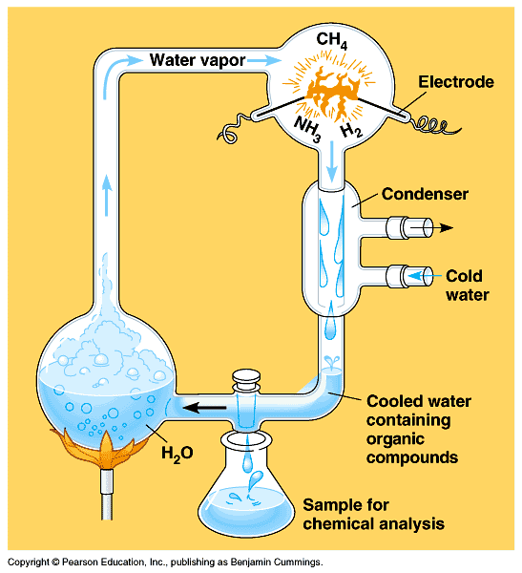
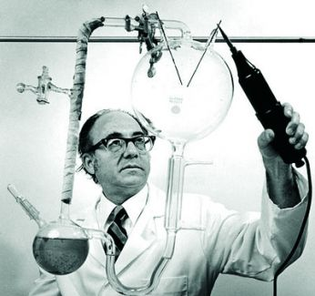
**Stanley Miller and Harold Urey → created a system that simulated the environment of early earth. It contained water to simulate the oceans, and a mix of ammonia (NH3), methane (CH4), and CO2 to simulate the atmosphere.

Slide 7
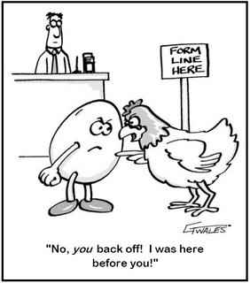
Ask yourself:
Where did life come from?
How did all different kinds of life develop?

Slide 8
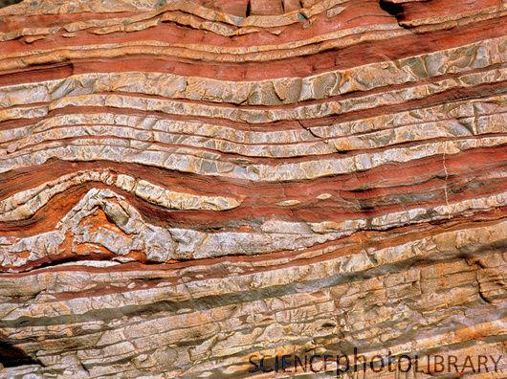
The History of Life – Geologic Time Scale
Based on the evidence that geologists have found in the earth, our planet is approximately 4.6 billion years old.
That’s 4,600,000,000 years.
(Think of 4 million years, then time that by a thousand!)

Slide 9
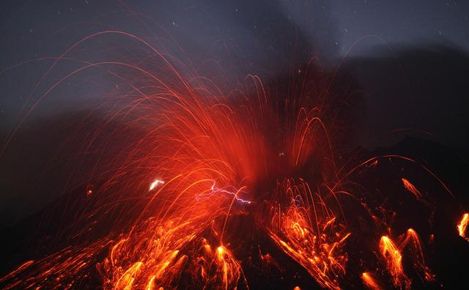
The History of Life – Geologic Time Scale
At the beginning, earth had no oxygen or life.

Slide 10
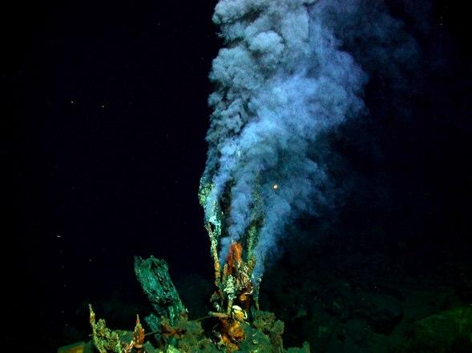
Where did life begin?
https://video.nationalgeographic.com/video/hydrothermal-vents
Hydrothermal Vents: Many scientists now believe that life first began with ancient bacteria that used the heat and chemicals spewing from within the earth to create energy. (Life started in underwater!)

Slide 12
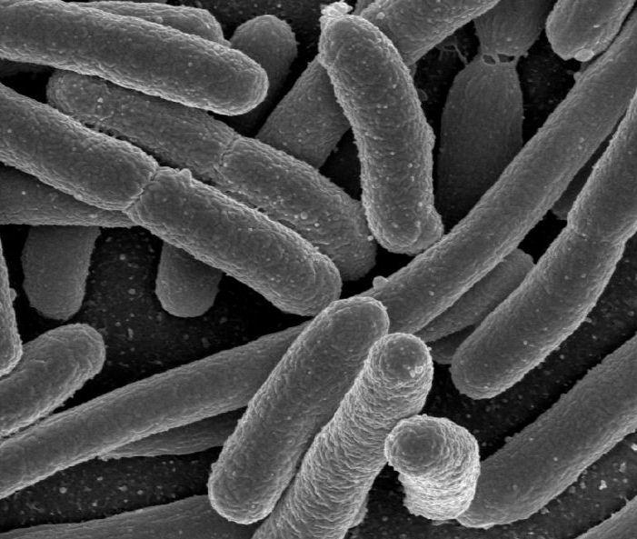
The History of Life – Geologic Time Scale
Bacteria (anaerobic) were the first organism on earth. They first appeared about 3.6 billion years ago.
Before that RNA https://www.youtube.com/watch?v=VYQQD0KNOis
“Chemosynthetic”:
Ate Poisonous Chemicals
(like sulfur)
Breathed out Oxygen

Slide 14
The History of Life – Geologic Time Scale
Bacteria: Prokaryotes (made of only one cell with
no nucleus and anaerobic they did not need oxygen. Instead, they made oxygen that would allow future life to be able to breathe (like us!).
“Chemosynthetic”:
Ate Poisonous Chemicals
(like sulfur)
Breathed out Oxygen

Slide 15
Geologic Time Line:
History of the Earth

Slide 16
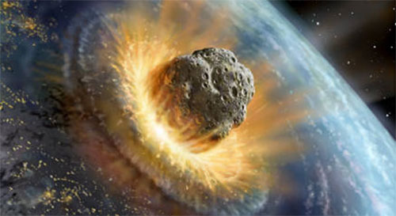
Geologic Time Line: History of the Earth
Earth’s history is divided into eras.
Each era ends or begins with big events like mass extinctions.
b.y.a. = billion years ago
m.y.a. = million years ago

Slide 17
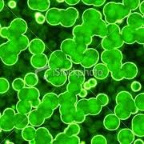
Precambrian Era: 4.6 bya – 580 mya
Formation of atmosphere, land, and oceans.
1st organism → chemosynthetic bacteria
(ate chemicals)
2nd organism →photosynthetic bacteria
(used sunlight)

Slide 18
Endosymbiosis

Slide 19
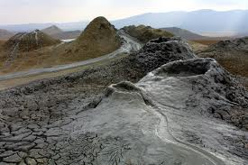
Precambrian Era: 4.6 bya – 580 mya
87% of Earth’s history (lasted 4 billion years)
Not much life on earth for the first 4 billion years
Eukaryotes appear 1.8 bya→ Precambrian ends with the Cambrian Explosion.

Slide 20
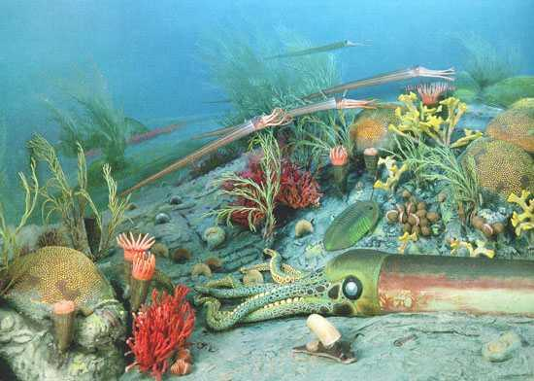
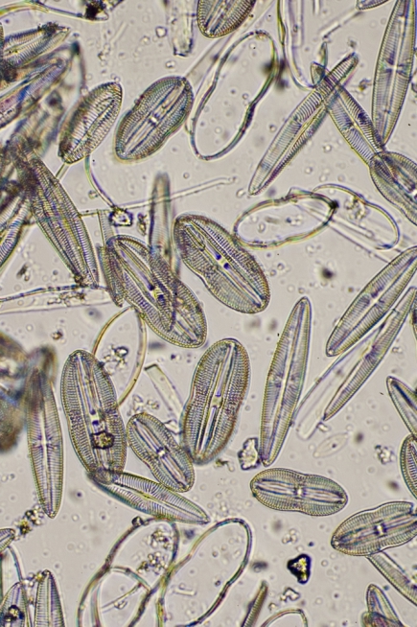
Paleozoic Era: 580 mya – 245 mya
Started with the Cambrian Explosion: development of thousands of new species that formed around the same time.

Slide 21
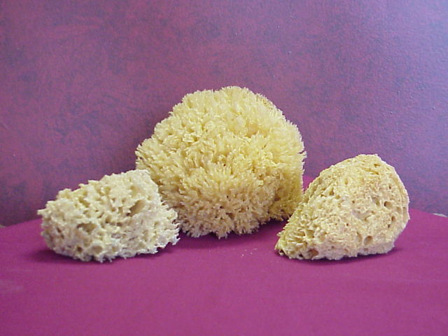
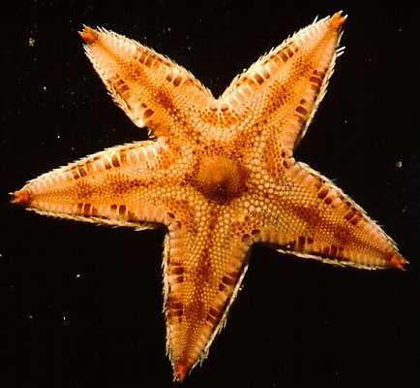
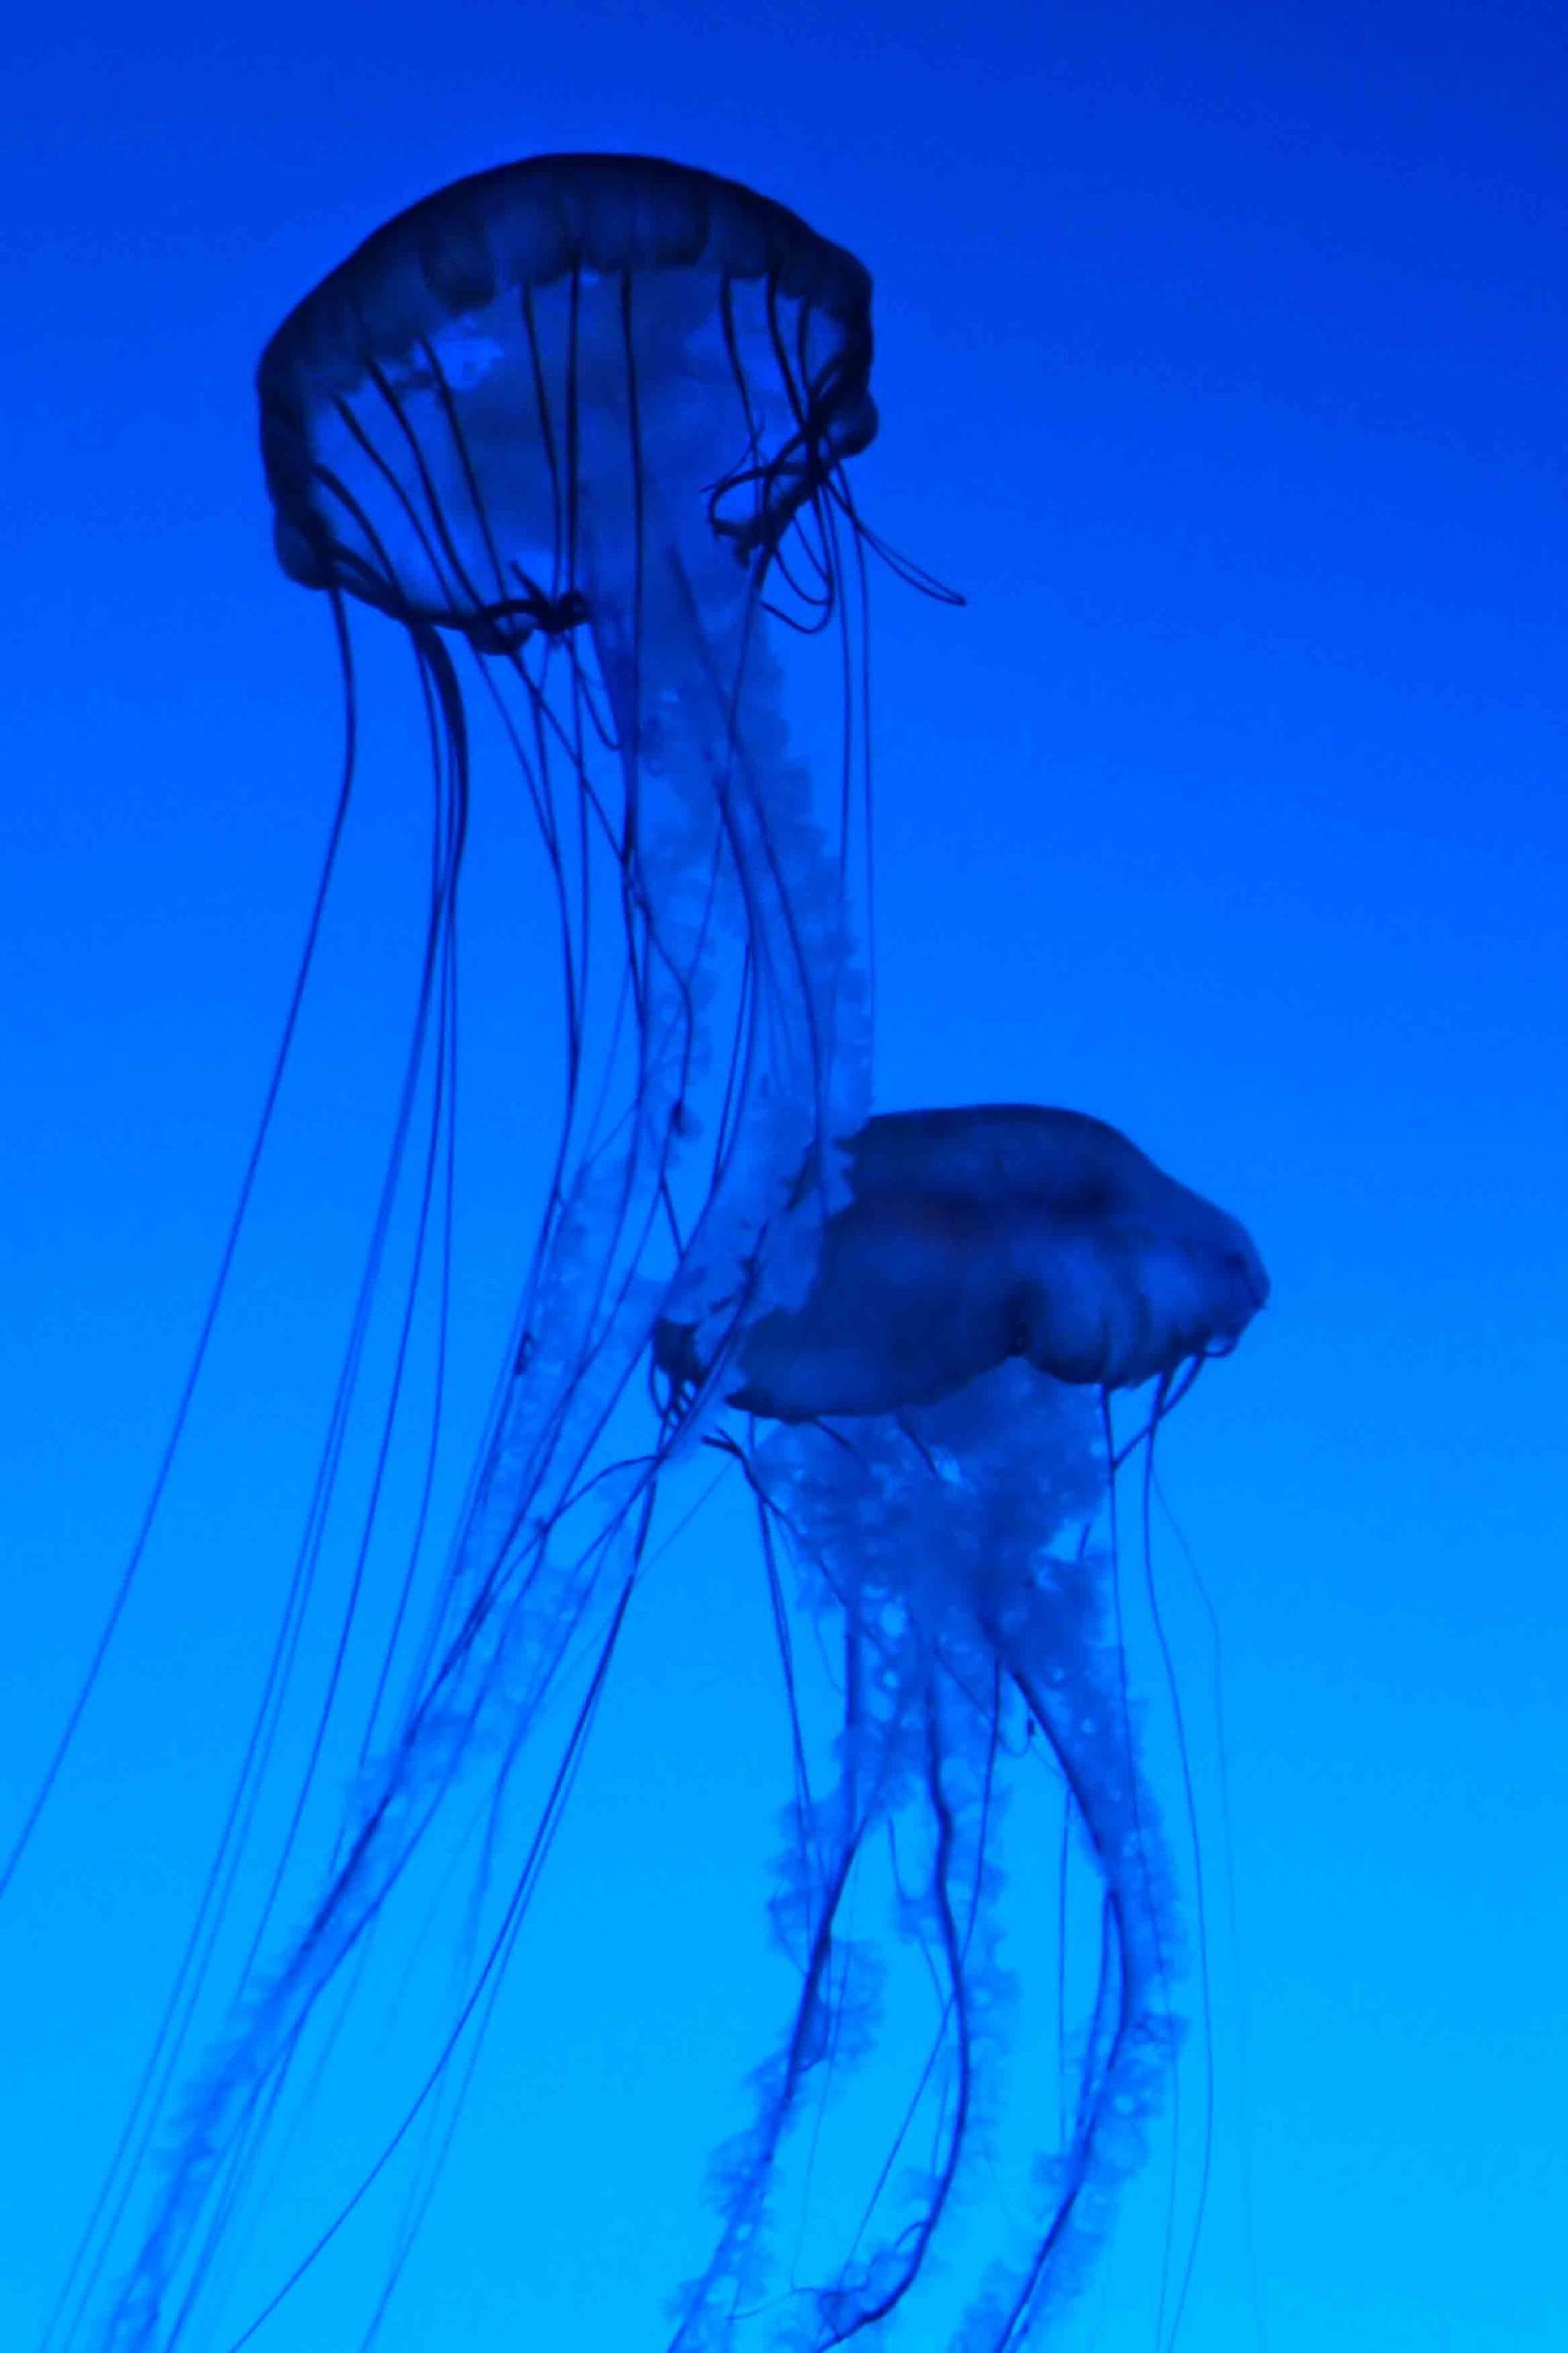
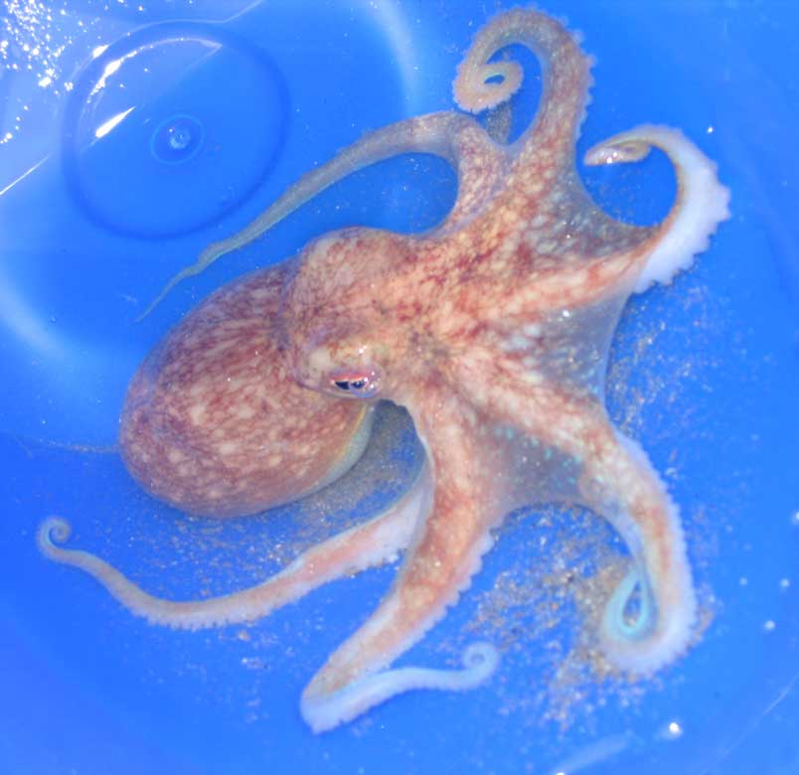
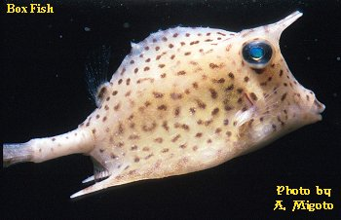
Paleozoic Era: 580 mya – 245 mya
Sponges, Starfish, and then fish in ocean

Slide 22
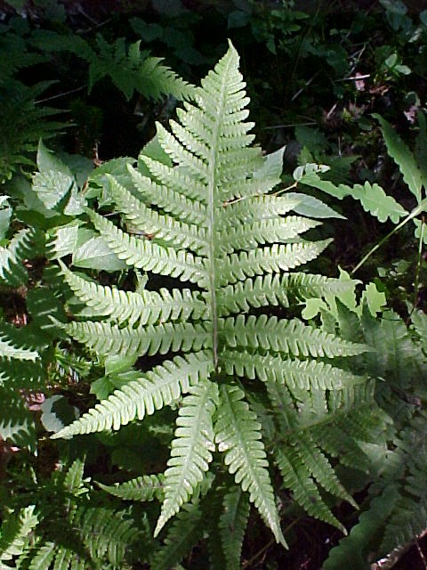
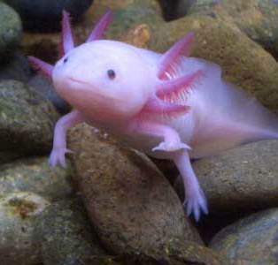
Paleozoic Era: 580 mya – 245 mya
Fish develop into amphibians
(like frogs) that move to land.
Plants (like ferns) on land
mass extinction of terrestrial(land) marine (sea) life
-Volcanoes caused a mass climate change

Slide 23
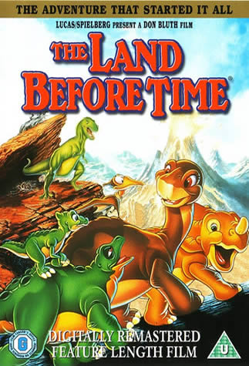
Mesozoic Era 245 mya - 65 mya
Dinosaurs appear → age of Reptiles starts Mammals, Birds, and Flowering plants appear
Plant life gets bigger and bigger → forests of trees

Slide 24
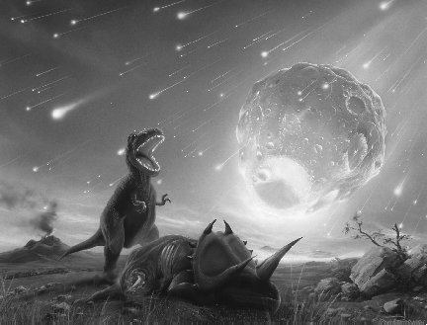
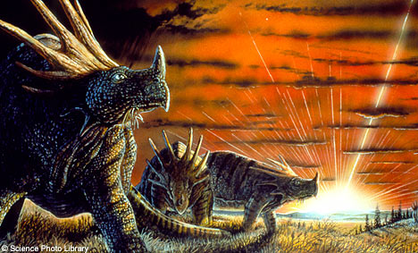
Mesozoic Era 245 mya - 65 mya
mass extinction of Dinosaurs→ What caused it?

Slide 25
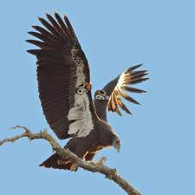
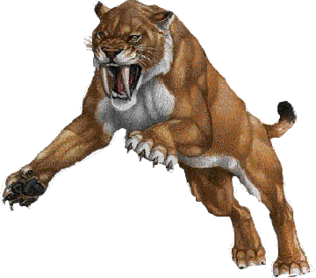
Cenozoic Era 65 mya – present (now!)
Birds and Mammals take place of dinosaurs
Primitive Humans appear
then us: Homo Sapiens (our species name!)

Slide 26
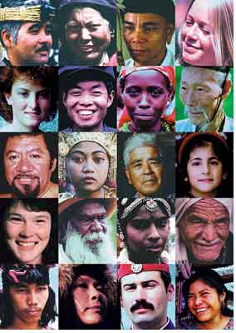
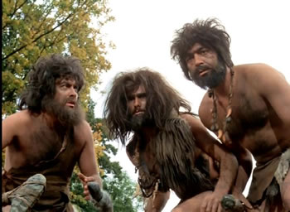
Cenozoic Era 65 mya – present (now!)
Primitive Humans appear
then us: Homo Sapiens
(our species name!)

Slide 27
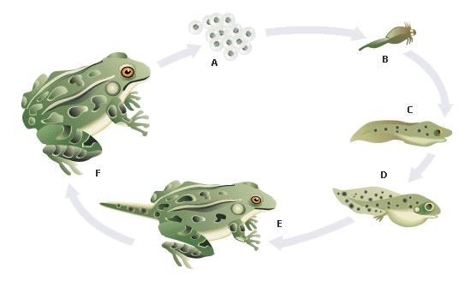
“It takes life to make life.” (Biogenesis)
(Cell theory: cells come from pre-existing cells.)

Slide 28
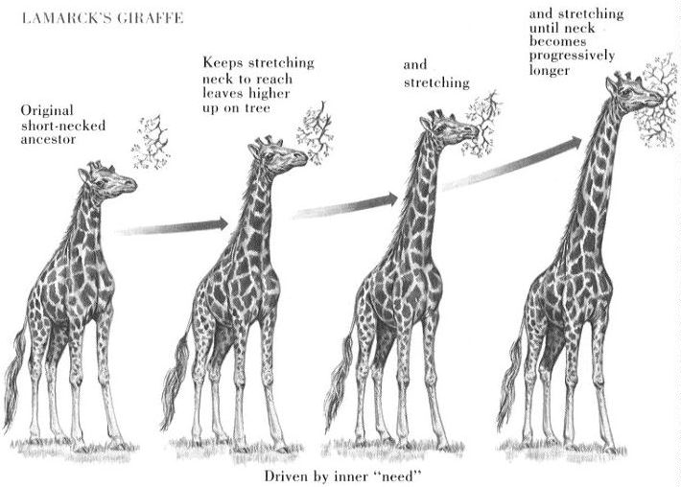
Evolution: organisms’ traits change over time.
-The traits of a population change because its DNA changes

Slide 29
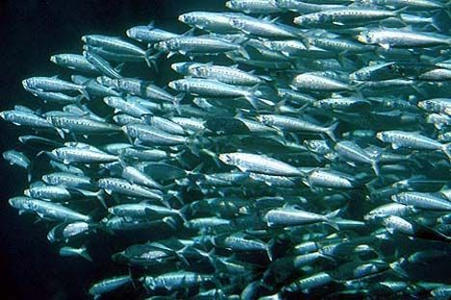
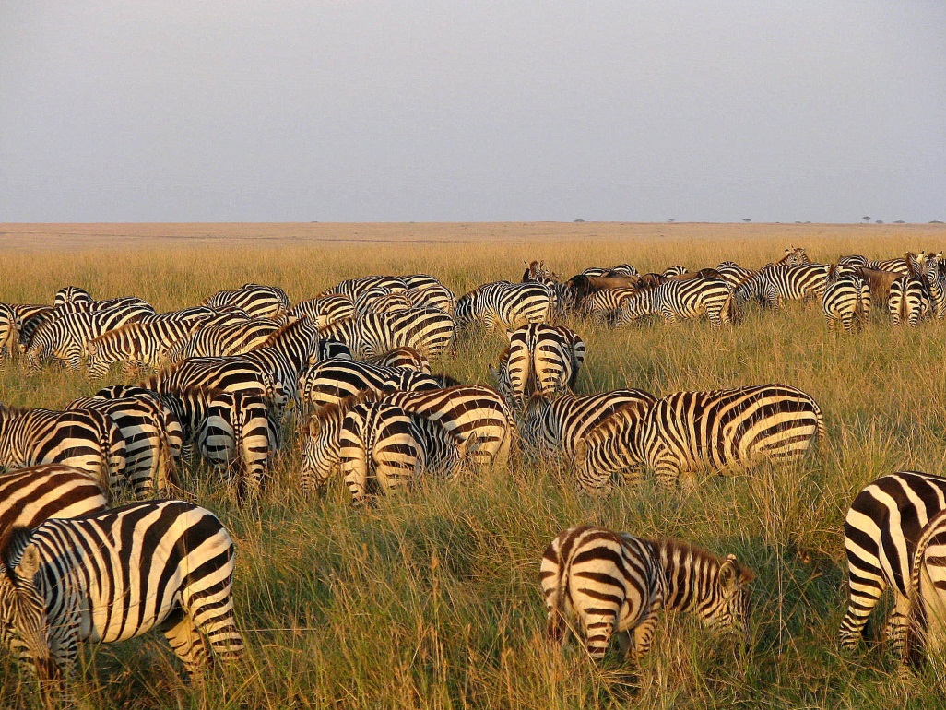
Evolution means the whole population changes, not just one individual…what is a population?
Population – group of organisms of the same species that live in the same area and interbreed.
https://www.youtube.com/watch?v=GhHOjC4oxh8

Slide 30
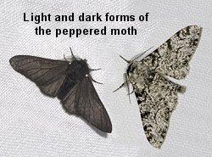
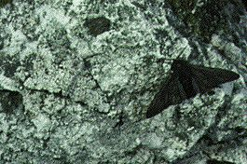
-What causes evolution? → NATURAL SELECTION
Natural Selection is the theory that organisms who are best fit to live in an environment survive (weaker traits die out.)
https://www.youtube.com/watch?v=0SCjhI86grU

Slide 31
-“Nature Chooses” which traits die out and which are passed on (only applies to genetic traits)
-Natural Selection is also known as
“survival of the fittest”

Slide 32
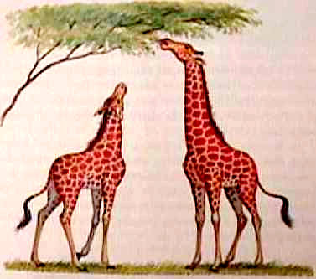
Darwin vs. Lamarck
Lamarck—
Thought animals could acquire traits during their lifetime through their effort and pass them on.
Ex: Giraffe stretches neck, so it gets longer and longer.

Slide 33
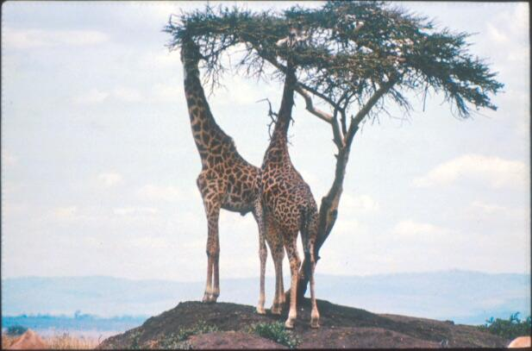
Darwin vs. Lamarck
Darwin:
babies inherit the parents’ DNA
Ex: Giraffes got their long necks because those who could reach the leaves (longer necks) survived to pass on their traits.

Slide 34
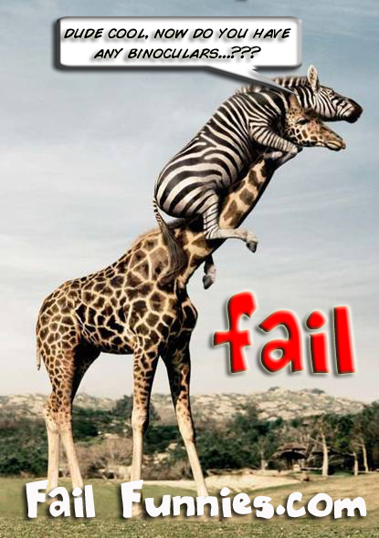

Slide 35
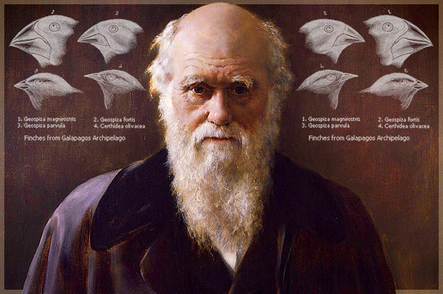
Charles Darwin
https://www.cbsnews.com/video/why-are-there-goats-in-the-trees/
first came up with the theory that the changes seen in organisms happened because of natural selection.
Darwin:
“The Evolution Guy”

Slide 36
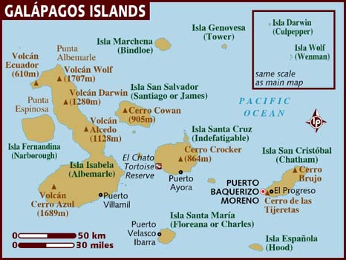
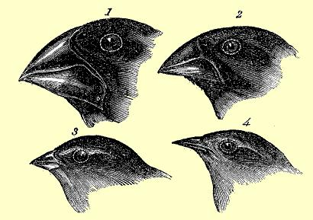
Charles Darwin
https://www.youtube.com/watch?v=mcM23M-CCog&app=desktop
Some of his most famous data was collected from the Galapagos Islands. The finches on each island were found to have different beak shapes that matched the different food sources on each island.

Slide 37
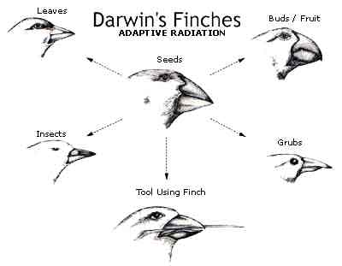
Charles Darwin
Because the birds’ traits were similar in other ways, Darwin hypothesized that all of these finch species evolved from a common ancestor.
Common Ancestor: earlier species that two or more species descended from

Slide 38
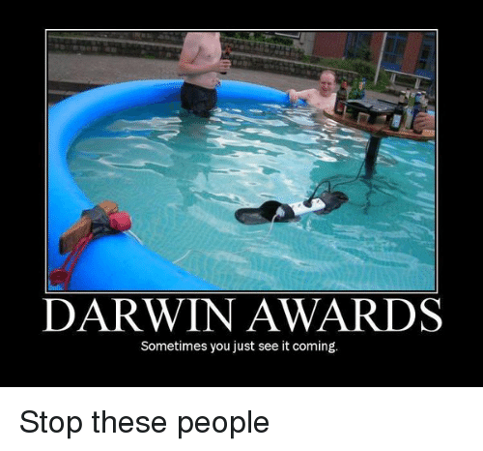
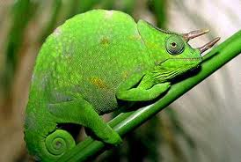
https://www.youtube.com/watch?v=XOiUZ3ycZwU
https://www.youtube.com/watch?v=GhHOjC4oxh8
Darwin’s famous book: The Origin of Species
Adaptation: to better “fit” in your environment (this means you change to be able to survive better.)

Slide 39
6 important points
Variation exists among individuals in a species
Individuals of a species will compete for a resource
Competition leads to death of some individuals while others survive
Individuals are more likely to reproduce and pass their traits to their offspring
Over time the species evolves
Organisms produce more offspring than that can survive
Selection is not random

Slide 40
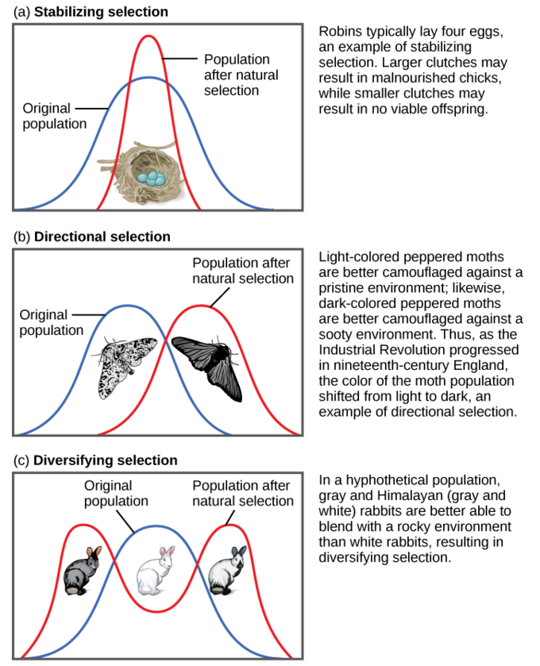
Modes of Selection
(Disruptive)

Slide 41
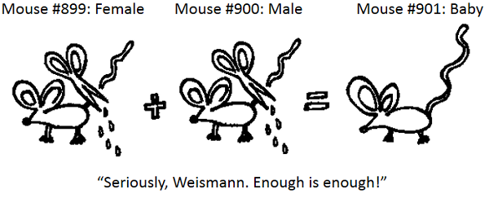

Slide 42
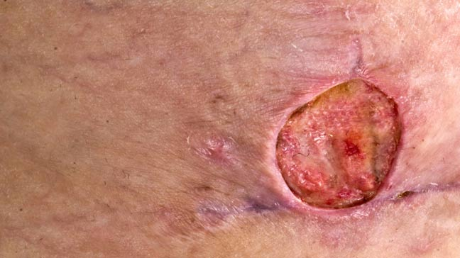
How do we see it today?
https://www.webmd.com/skin-problems-and-treatments/understanding-mrsa#1

Slide 45
ADAPTATIONS
Mimicry → adapting to look like another organism (copy cat)
Coral Snake—venomous King Snake—Harmless
(predators can’t tell the difference, so they leave the king snake alone even though it’s not dangerous.)

Slide 46
ADAPTATIONS
Camouflage → adapting to blend in with your environment
See how hard it is to see these camouflaged animals?

Slide 47
CAMOUFLAGE OR MIMICRY?

Slide 48
Both! It’s copy-catting a leaf (mimicry) to blend in with its environment (camouflage)!

Slide 49
https://www.youtube.com/watch?v=udZUaNKXbJA

Slide 50
Speciation (caused by reproductive Isolation)
Loss of Gene flow

Slide 51
Genetic Isolation – isolation of genes
Geographic isolation:
– individuals separated by landforms

Slide 52
Reproductive– individuals separated by differences in mating
https://www.youtube.com/watch?v=hgE6GwnzQMU

Slide 54
https://www.youtube.com/watch?v=lk4_aIocyHc
http://evolution.berkeley.edu/evolibrary/article/0_0_0/evoscales_04

Slide 55
http://www.amoebasisters.com/uploads/2/1/9/0/21902384/video_recap_of_genetic_drift_by_amoeba_sisters_v3.pdf
https://www.youtube.com/watch?v=mjQ_yN5znyk

Slide 56
Natural selection Vs Genetic Drift

Slide 57
What are the Evidences of Evolution?
Fossils: preserved remains of organisms
We can tell when organisms lived based on how deep in the soil the fossil is found.
Preserved tissue—amber, ice, tar (keeps it from deteriorating)
Preserved trace—imprint, mold, cast (mold filled with minerals)

Slide 58
Determining Fossil Age
https://www.youtube.com/watch?v=54e5Bz7m3do
Deeper Fossils = Older
Most recent (newest)—upper layer of rock
Earliest (oldest)—lower layer of rock
Radiocarbon dating: chemical analysis that tells how old organic material is.
uses half-life—amount of time it takes for ½ of radioactive element to decay (carbon dating)

Slide 61
Anatomy of Living Organisms
Homologous Structures —very different animals have structures with similar bone structure even though they may have different uses.
Evidence of a recent common ancestor
Ex: Human arm, whale fin, pig leg

Slide 62
Anatomy of Living Organisms
Analogous Structures –different bone structure; similar function; evidence of a very distant relationship (not closely related)
Ex: Bird wing vs. Bat wing

Slide 63
Vestigial Structures
Vestigial structures→ left-over structure that is no longer useful. Ex: Whale back leg bones

Slide 64
Embryology and Biochemistry
Embryology—similar development shows that two species are related

Slide 65
Embryology and Biochemistry
Biochemical similarities →Similar DNA & proteins shows that two species have a common ancestor.
This is the best (most accurate) way to determine how related two species are.
Which two organisms below do you think are most closely related?
Tiger: A T G C T C G A T C T A C T G C
Lion: A T G C G C G A T A T A C T G C
Snake: G A T A T A C T G C G C G A T A

Slide 66
Types of Evolution
Convergent—unrelated organisms develop similar characteristics.
Ex: Whale and fish both developing fins
Divergent—related organisms become more different (adaptive radiation)

Slide 67
Whale → related to the wolf or to the fish?

Slide 68
Example: Convergent Evolution
They evolved separately to become more similar
This is because they were adapting to the same environment
Form analogous structures

Slide 69
Example: Divergent Evolution
Both are mammals!...Started out similar.
evolved to become different.
Form homologous structures

Slide 70
https://www.livescience.com/24745-archaeopteryx.html

Slide 71
Evolution and Genetics
Gene Pool – all of the genes in a population.
Genetic mutations – change in the sequence of genes or chromosomes.

Slide 72
**Add to notes** Rate of Evolution?
Gradualism—(Darwin) evolution happens very slowly (thousands-millions of generations)
Evolution occurs “gradually”

Slide 73
Rate of Evolution?
Punctuated Equilibrium—evolution occurs quickly, followed by long periods of equilibrium (little or no change)
Usually occurs due to rapid changes in the environment
Food source getting wiped out; A new predator in your habitat
A disease spreading in the population; A natural disaster

Slide 77
Cladogram
https://www.youtube.com/watch?v=ouZ9zEkxGWg

