Slide 1
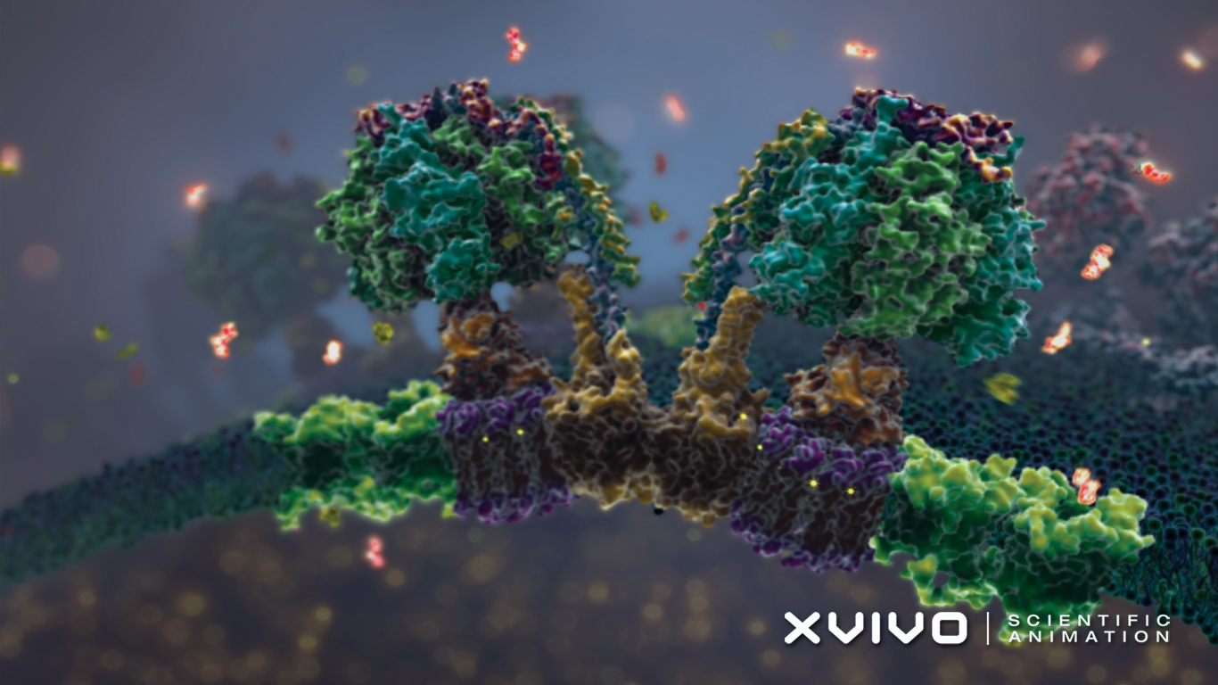
ENZYMES
The most important protein?

Slide 2
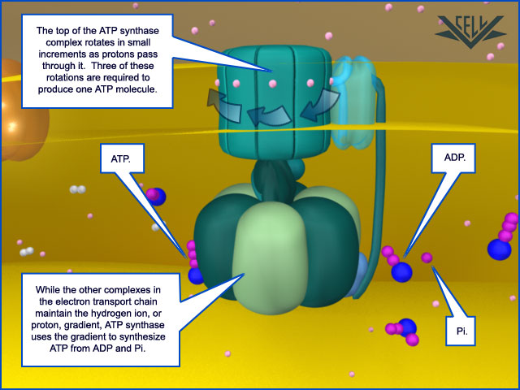
https://www.youtube.com/watch?v=CN2XOe_c0iM

Slide 3
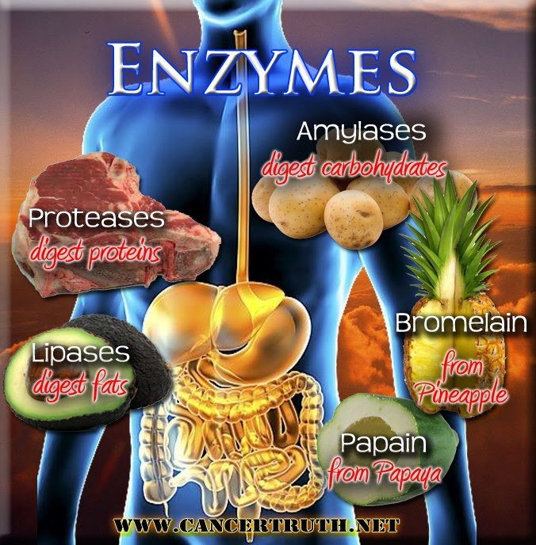
The Basics of ENZYMES
Enzymes are proteins that speed up or increase the rate of chemical reactions in our bodies.

Slide 4
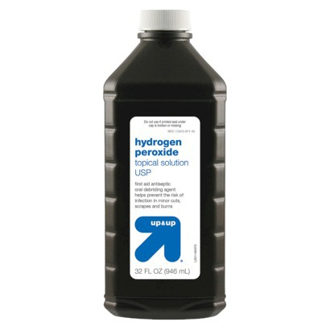
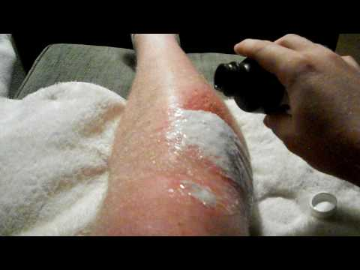
The Basics of ENZYMES
https://www.youtube.com/watch?v=R93BXXnkrRs
Enzymes are biological catalysts.
(Catalyst: substance that increases the rate of a chemical reaction.)

Slide 5
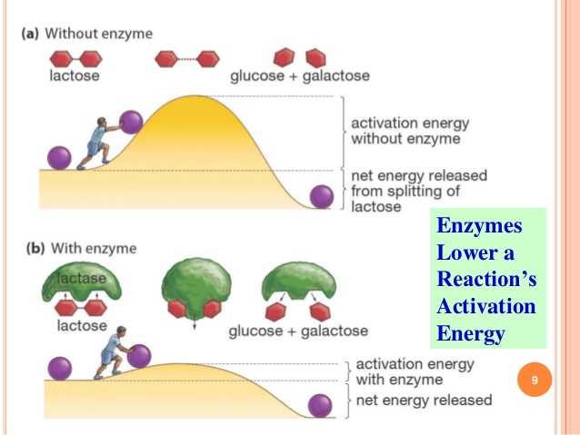
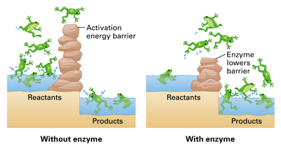
Activation Energy

Slide 6
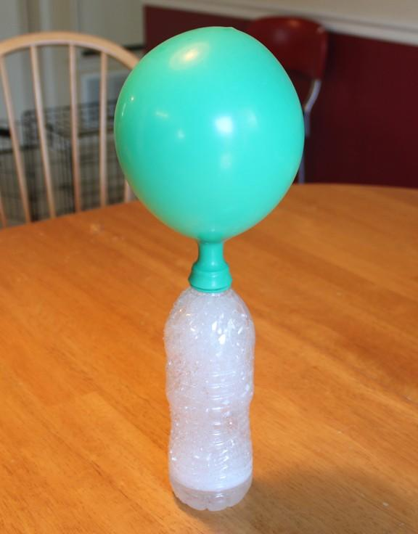
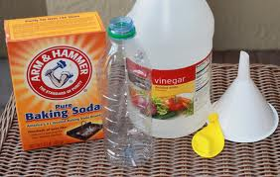
Chemical Reaction
What goes in What comes out
Reactants Products

Slide 7
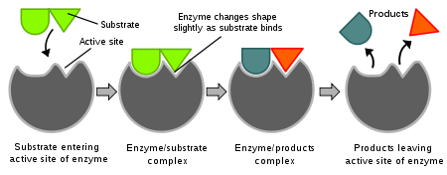
The Basics of ENZYMES
Enzymes are not consumed in a reaction, so they can be reused many times.

Slide 8
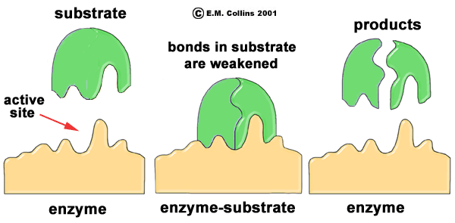
How Enzymes Work (drawing)
Enzymes bind to molecules called substrates to break them down.
Active Site

Slide 9
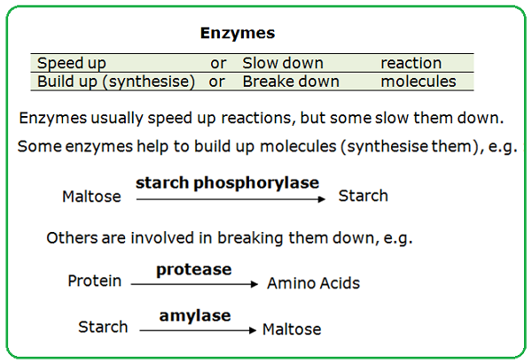
The Basics of ENZYMES
Many enzymes end in –ase. (Lactase breaks down lactose, sucrase breaks down sucrose.)

Slide 10
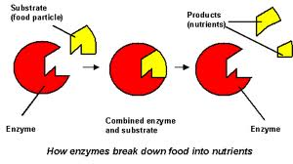
The Properties of ENZYMES
Substrate: molecule that is affected by an enzyme.
Sometimes a substrate is broken down into smaller molecules.
Ex: digesting food

Slide 11
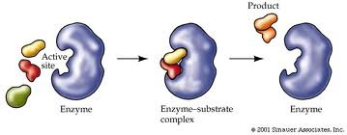
The Properties of ENZYMES
2. Substrate: molecule that is affected by an enzyme.
Other times substrates are linked together to form larger molecules.
Ex: making proteins to build muscle

Slide 12
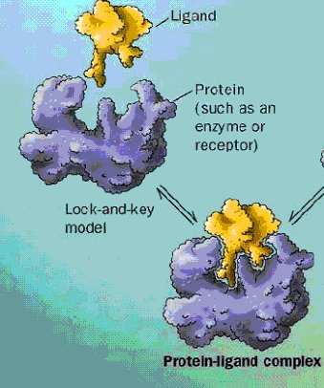
The Properties of ENZYMES
SHAPE matters! Enzymes work like a lock and key.

Slide 13
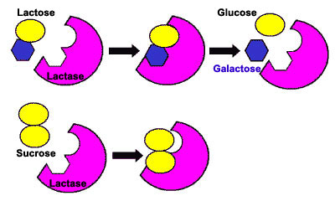
The Properties of ENZYMES
Enzymes are very selective; each enzyme only breaks down the substrate that matches its shape.
Example: The enzyme lactase breaks down the substrate lactose (milk sugar).

Slide 14
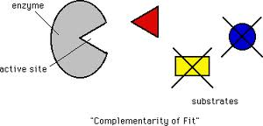
The Properties of ENZYMES
Active Site: the place where the enzyme and substrate fit together. (label in picture)
When they bind, the reaction begins.

Slide 15
The Properties of ENZYMES
If the enzyme shape changes, then the enzyme is denatured.
-When denatured, the enzyme stops working (like a melted key.)

Slide 16
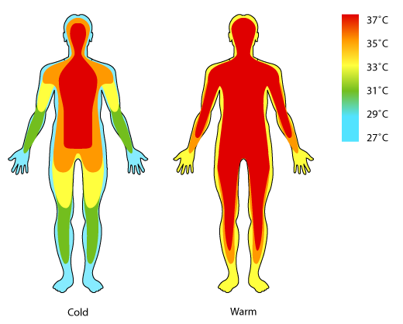
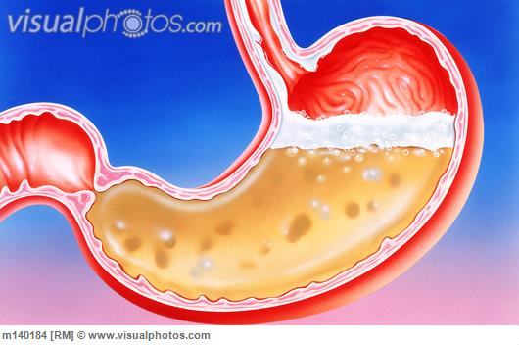
Enzymes work best at optimal temperature and pH!
“Optimal”: best (conditions where the enzyme gets the most work done)
*time to draw some graphs! *

Slide 17
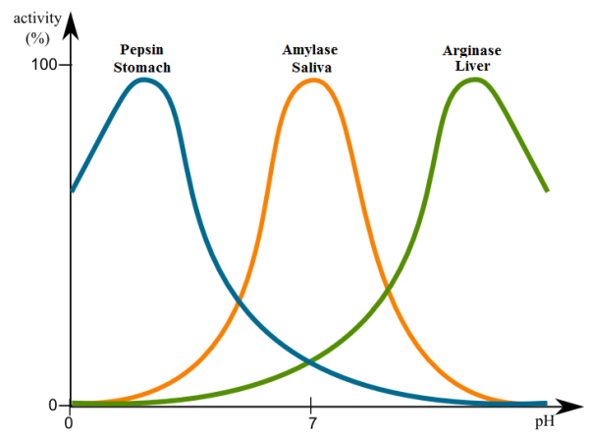
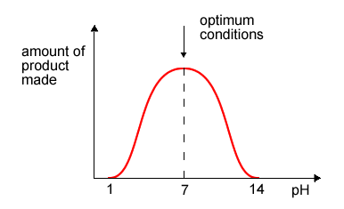
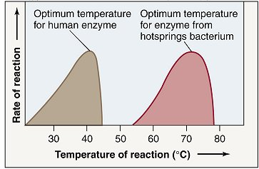
Optimal Conditions

Slide 18
*Enzymes are affected by three factors:
2. pH

Slide 19
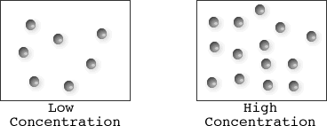
*Enzymes are affected by three factors:
3. Concentration of the substrate
https://www.youtube.com/watch?v=XTUm-75-PL4

Slide 20
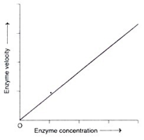
4. Enzyme Concentration

Slide 21
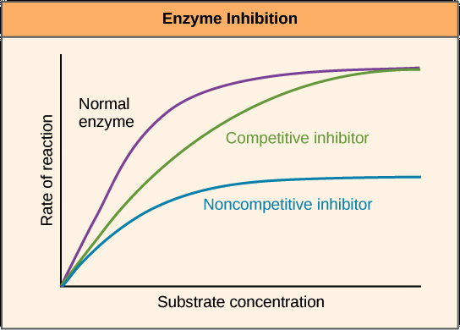
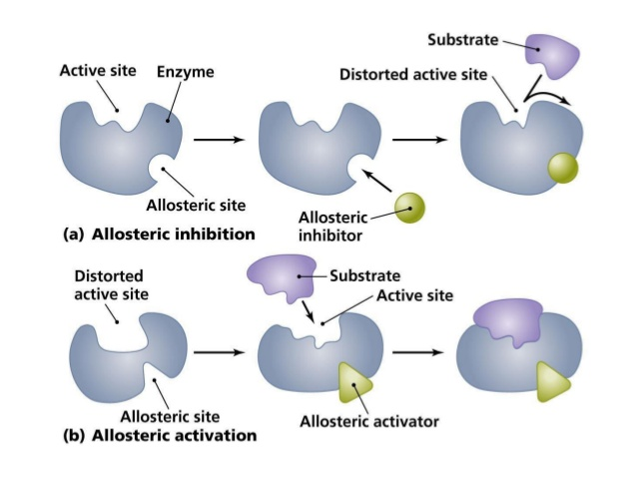
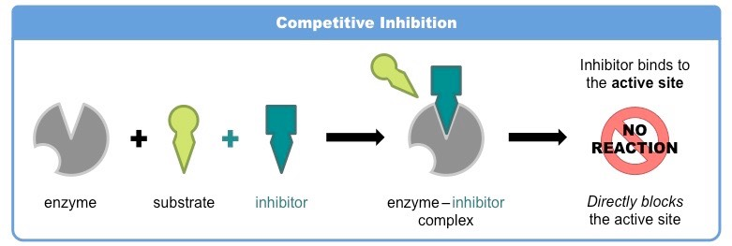
5. Presence of inhibitors
https://www.rxlist.com/consumer_lisinopril_zestoretic/drugs-condition.htm

Slide 22
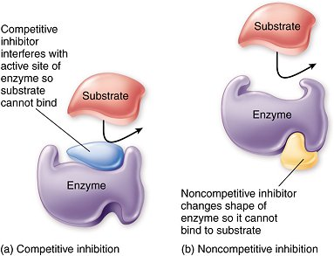
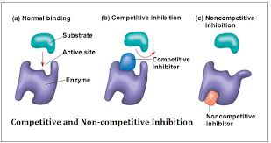

Slide 23
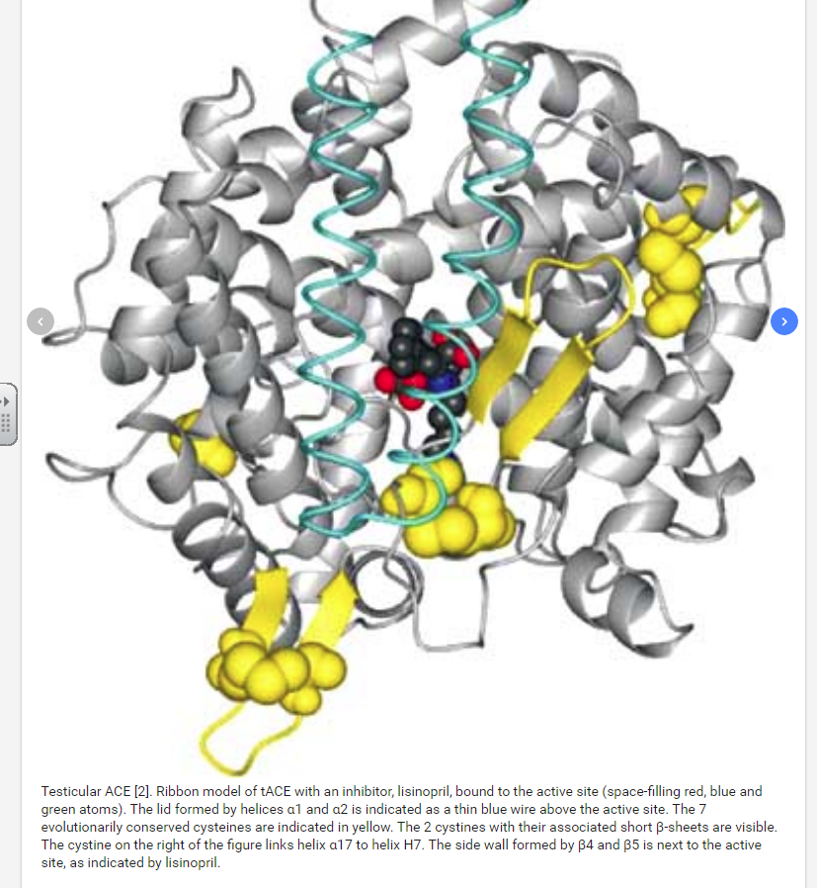
Lisinopril
https://www.drugbank.ca/drugs/DB00722
https://www.verywellhealth.com/lisinopril-causes-cough-1124151
https://www.researchgate.net/figure/Fig-1-Testicular-ACE-2-Ribbon-model-of-tACE-with-an-inhibitor-lisinopril-bound_fig1_8334598

Slide 24
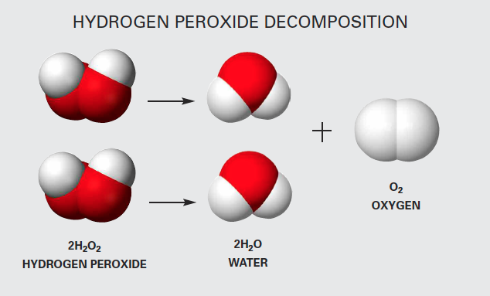
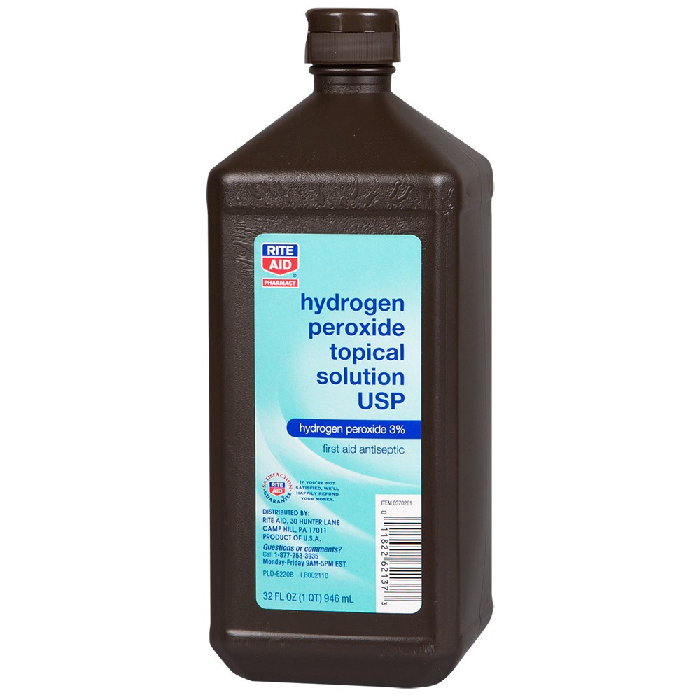
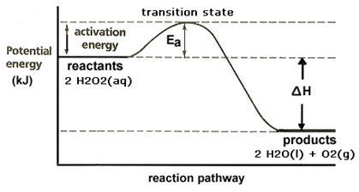

Slide 25
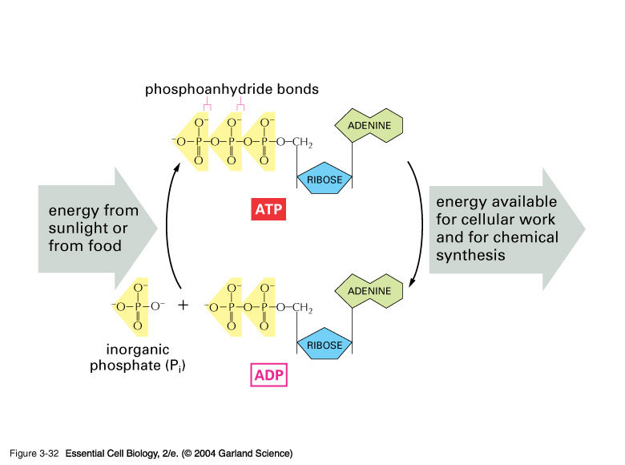

Slide 26
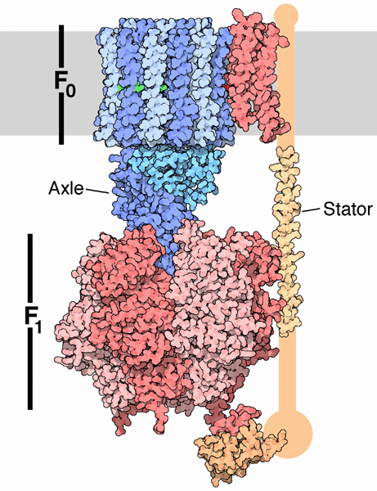
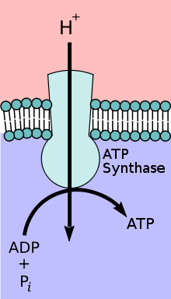
https://www.youtube.com/watch?v=W3KxU63gcF4

