Slide 1
DNA Extraction Lab Activity
Online Version
By: Liz brandon

Slide 2
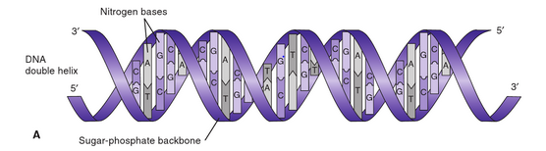
What is DNA?
Deoxyribonucleic Acid (DNA) is a macromolecule of carbon, oxygen, phosphorous, and hydrogen atoms
Comprised of nucleotides containing a phosphorylated ribose sugar and a nitrogen base
  Adenine, cytosine, guanine, thymine
  Phosphate group provides an overall negative charge
Double helix structure of DNA results from the physiochemical affects of the specific sequence of nucleotides in the strand
Diagram by: Buckingham (2012)

Slide 3
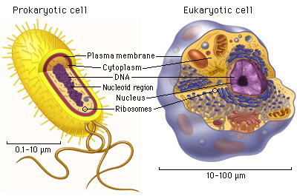
Where is DNA found?
DNA may be isolated from:
  Animals, plants, fungi, bacteria, parasites, viruses
DNA is found in the nucleus of eukaryotic (animal, plant, fungal, parasitic) cells and in the nucleus of prokaryotic (bacterial) cells
DNA is found in the nucleocapsid of some viral cells
  Other viruses are RNA-based only
Diagram by: Pearson Education

Slide 4
Purpose of DNA Extraction
To extract deoxyribonucleic acid (DNA) from cells for further testing
Further testing may include genetic research, genotyping, disease identification, paternity testing, and forensic identification
Extracted DNA can be used for PCR, sequence analysis, or other laboratory tests, however we will not do other testing in this lab activity

Slide 5
Sample Type and Storage
Different DNA Isolation kits are specific for different sample types
In human cells, DNA can be isolated from:
  Squamous epithelial cells (skin, cheek swab, saliva)
  Hair sample with the root end (root end contains epithelial cells, while hair shaft contains degraded DNA)
  EDTA Whole Blood
    Fresh
    Stored at 4 deg C
    Stored at -70 deg C
The best sample is EDTA whole blood, because it has the most stable storage capacity and contains the most molecules of DNA per microliter of sample
In this lab, we will use a simple mouth wash containing buccal (cheek) cells and extract our DNA from squamous epithelial cells

Slide 6
Supplies and Reagents
Supplies
Reagents
Clean plastic cup
Distilled water
Disposable pipettes
Glass stirring rod
Large glass test tube
Small glass test tube
Test tube rack
95% Ethyl Alcohol, ice cold
EDTA solution
8% Sodium Chloride
10% Sodium Dodecyl Sulfate (SDS)

Slide 8
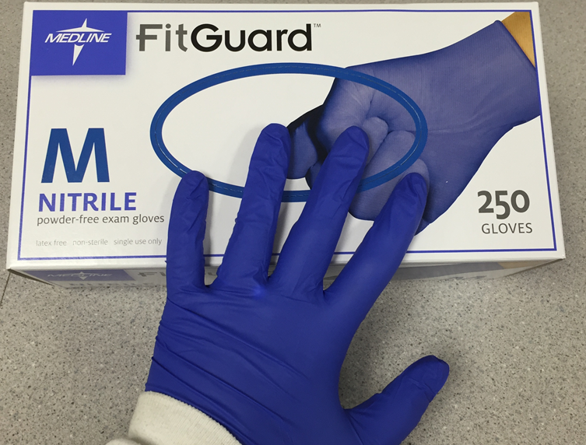
Safety
Personal Protective Equipment is Required
  Gloves and goggles
  Tie back long hair
Safety items located around the lab
  Emergency Eye Wash Station
  Sharps container with Biohazard label for disposal of glass test tubes
  Reagent Safety Data Sheets provided at instructor’s table
  No open flames allowed in the laboratory when working with alcohol
Keep your DNA collection cup and samples away from others
  Properly label your specimen

Slide 9
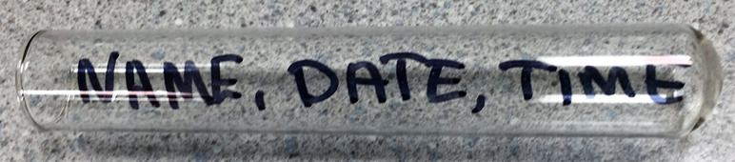
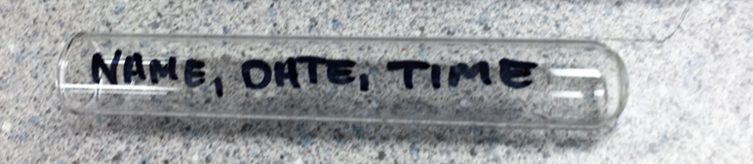
Preparation
In any lab, sample identification is extremely important.
  Label your DNA collection cup, small test tube, and large test tube with your name, the date, and the time of collection
Ensure your reagents are intact and stored at the right temperature
  95% Ethyl Alcohol is ice cold
Read through the entire protocol before beginning
  Do you have the necessary supplies and reagents?
  Pay attention to steps stating “Do not shake, mix gently” or “Do not mix”
  Pay attention to incubation temperatures and times
    None in this lab, but incubation steps at various temperatures are common in other methods

Slide 10
Part 1: DNA Collection
Proper PPE is required
Do not eat or drink 15 minutes before sample collection.
Confirm the subject’s mouth is empty of any contaminating substances.
Perform DNA Collection:
  Pour 5-10mL of water into a clean plastic drinking cup.
  Pour the 5-10mL of water into your mouth and “swish” the water around between your cheeks and gums for 60 seconds.
  You may “scrape” the inside of your cheeks with your teeth to help slough off cheek cells to increase DNA yield.
  Spit all of the water back into the plastic cup.
Your plastic cup now contains cells from your cheeks, called buccal cells. These cells still contain an intact nucleus, where the DNA is found.

Slide 11
Parts 2 and 3: Cell Lysis and Acidification
These steps are done in a quick succession to preserve integrity of DNA.
Prepare your DNA sample for extraction. Lyse your buccal cells and acidify your DNA.
  Add 20 drops of 8% sodium chloride solution to the large test tube.
  Pour several mL of the DNA sample (cheek cell water) into the large test tube containing the salt solution.
  Add 20 drops of the SDS solution and 20 drops of the EDTA solution to the cheek mixture in the test tube.
  Stopper the test tube and mix by inverting gently.
  Do not shake the test tube. Excess shaking can break the long strands of DNA, making it harder to see and collect when precipitated.

Slide 12
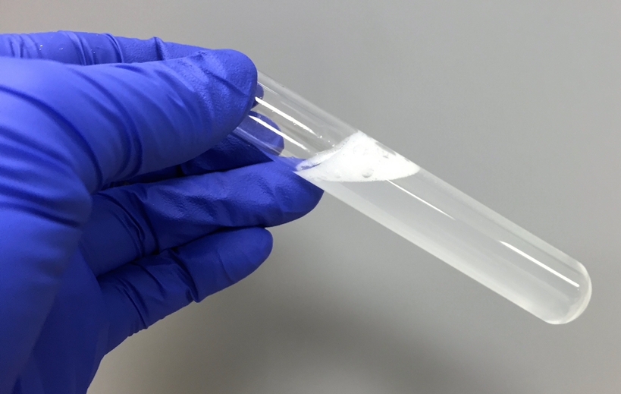
Cheek cell wash mixture
Note: bubbles may form

Slide 13
Why is salt so important?
Sodium chloride neutralizes the charge of the DNA sugar phosphate backbone, making it less hydrophilic in water.
  Positively charged sodium ions neutralize the negatively charged phosphate group on the backbone of DNA
Essentially, this causes the phosphate ends of the DNA to come closer together, making it easier to precipitate the DNA in the ethyl alcohol solution.
The salt also attracts impurities, such as proteins and carbohydrates, to render the DNA more pure.

Slide 14
What is happening to the cells and DNA in the test tube?
SDS is a detergent that breaks down the lipids and proteins that make up the cell membrane, thus releasing the DNA into the salt solution.
  Soap and other detergents act in the same way by creating rifts between the lipid bilayer of the cell membrane, causing it to rupture
EDTA destroys any nuclease enzymes present in the cells. Once the DNA is released from cells, it is free to come in contact with any cellular materials, including nucleases. These enzymes, normally present in the cellular cytoplasm, can digest the DNA and break it down into smaller segments, making extraction more difficult. Thus we destroy these enzymes so we can easily spool our long DNA strands.
  Using ice-cold reagents also helps slow down the enzymes

Slide 15
Part 4: Precipitation
Precipitate your DNA out of the cheek cell mixture with the alcohol.
  Holding the test tube at a slight angle, carefully add 5mL of the ice-cold 95% ethyl alcohol down the side of the test tube so it forms a layer over the cheek cell mixture. Do not mix the water and ethanol layers.
  Hold the test tube upright for 60 seconds and observe what happens at the interface between the ethyl alcohol and the cheek cell solution.
  The clouds of white strands are the DNA. While the DNA is soluble in water, it is not soluble in the ethyl alcohol solution and thus precipitates where the two liquids meet.

Slide 16
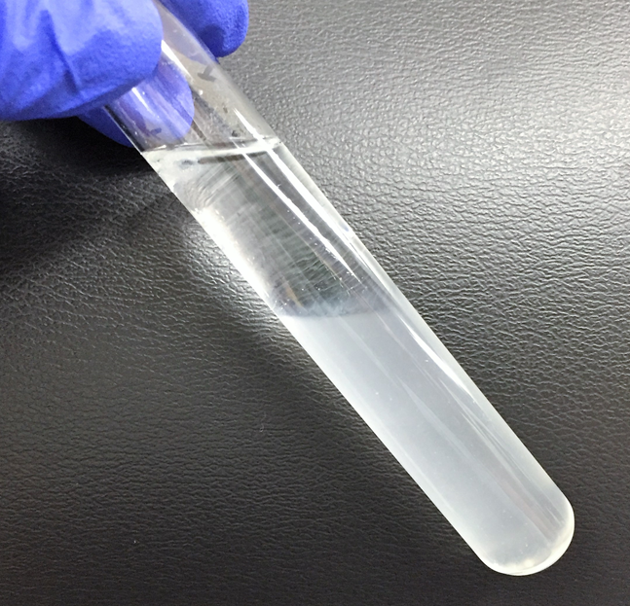
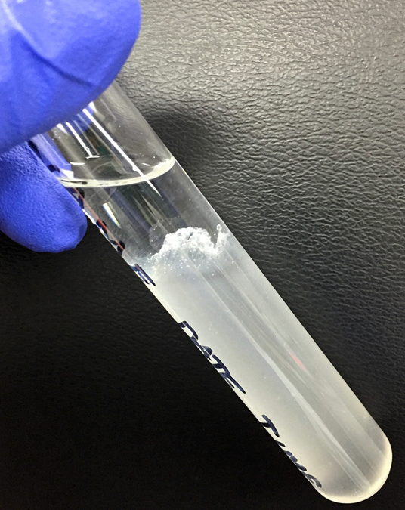
Observe the DNA form at the interface between the two liquids.

Slide 17
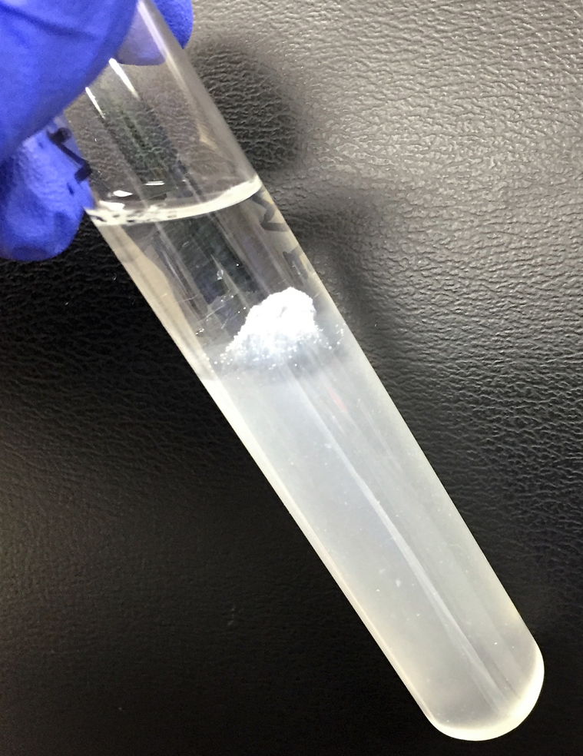
Part 5: Extraction
Remove your DNA strands from the cheek cell solution and ethyl alcohol mixture and isolate it from the other cellular materials.
  Add 20 drops of ice-cold 95% ethyl alcohol to the smaller, empty test tube.
  Place a clean glass stirring rod in the large test tube containing the DNA. Collect the DNA by turning the rod in one direction and thus winding the DNA strands around the rod.
  Carefully remove the rod and DNA from the solution and transfer it to the smaller test tube containing the 95% ethyl alcohol. Observe the DNA floating in the alcohol.
DNA!

Slide 18
Part 6: DNA Storage and Further Testing
Expected yield from a buccal cell wash on average is 1-10ug DNA from an adult
  DNA yield contains a small bit of RNA
Yield can be increased by increasing the original sample concentration, increase incubation times, and evaluate the optimal temperature at each step.
DNA sample is now ready for use in further testing such as amplification, sequencing, PCR, and other laboratory methods.
  PCR followed by gel electrophoresis is a useful confirmatory method to ensure you have extracted DNA, as you can visualize the DNA
Extracted DNA sample may be stored at 4 deg C for short term storage (6 months) or -20 deg C for long term storage (4 years)

Slide 19
References
Buckingham, L. (2012). DNA, DNA extraction methods. In Molecular Diagnostics: Fundamentals, Methods, and Clinical Applications (2nd ed., pp. 2-5, 70-77). Philadelphia, PA: F.A. Davis Company.
Flinn Scientific DNA Isolation Kit, Catalog No. FB2065, 2012.
Pearson Education. (n.d.). The Biology Place. In Pearson Education. Retrieved September 13 2016, from http://www.phschool.com/
science/biology_place/biocoach/cells/common.html

