Slide 1
Human Impact
How is North Carolina affected by human activity?
https://www.ted.com/talks/paul_gilding_the_earth_is_full

Slide 2
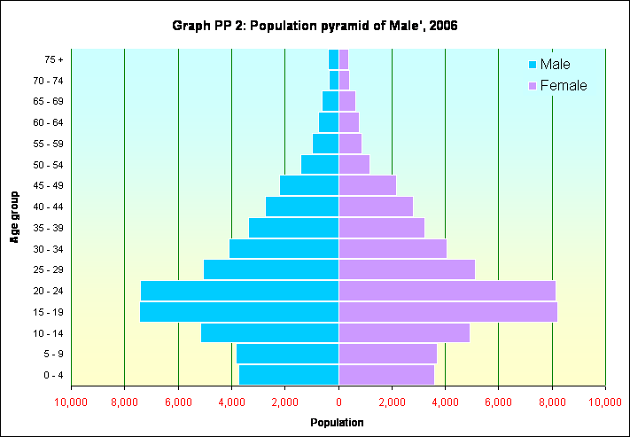
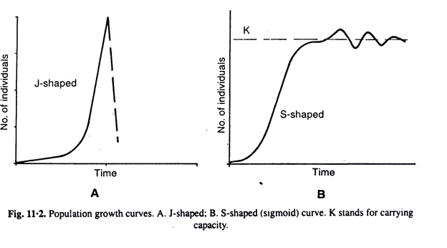
Those Pesky Humans!
Humans have a large impact on the environment and the organisms we share it with.
This is due to our
Ever increasing population size.
Ever increasing use of both renewable and non-renewable resources.

Slide 3
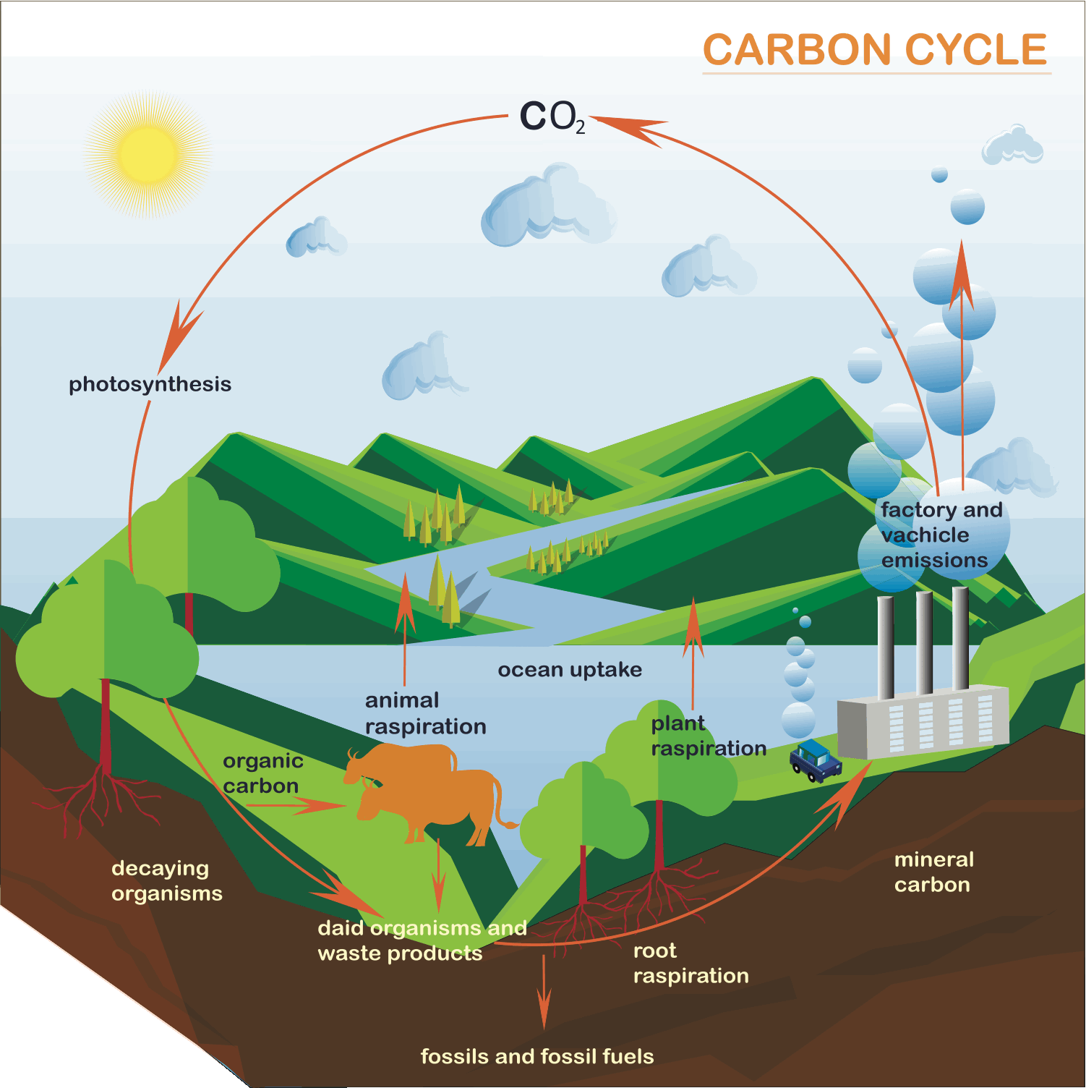
GLOBAL CLIMATE CHANGE AND ACID RAIN

Slide 4
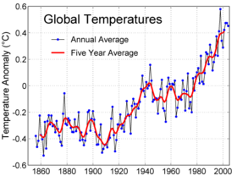
FACTS WE KNOW
Global temperatures have increased 0.5-1.0°F since the late 19th century.
http://content.answers.com/main/content/wp/en/thumb/8/87/280px-Instrumental_Temperature_Record.png

Slide 5
Human Activity and the Carbon Cycle
We are releasing CO₂ and other related forms of carbon into the atmosphere at a much faster rate than they are absorbed.
This is due to the ever increasing rate at which we:
Clear-cut and burn forests for housing and farming
Burn fossil fuels
These activities have resulted in the phenomenon of global warming.

Slide 6
Global Warming
Cause: excessive greenhouse gases such as CO₂ and CH₄ in the atmosphere trap heat, leading to an abnormal increase in earth’s surface temperature

Slide 7
Global Warming
CO₂ comes from burning fossil fuels in power plants, factories, and cars.

Slide 8
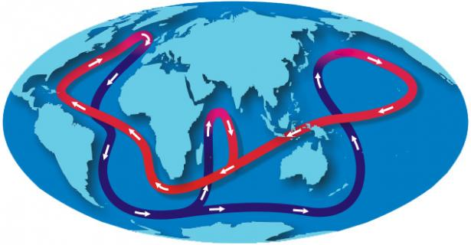
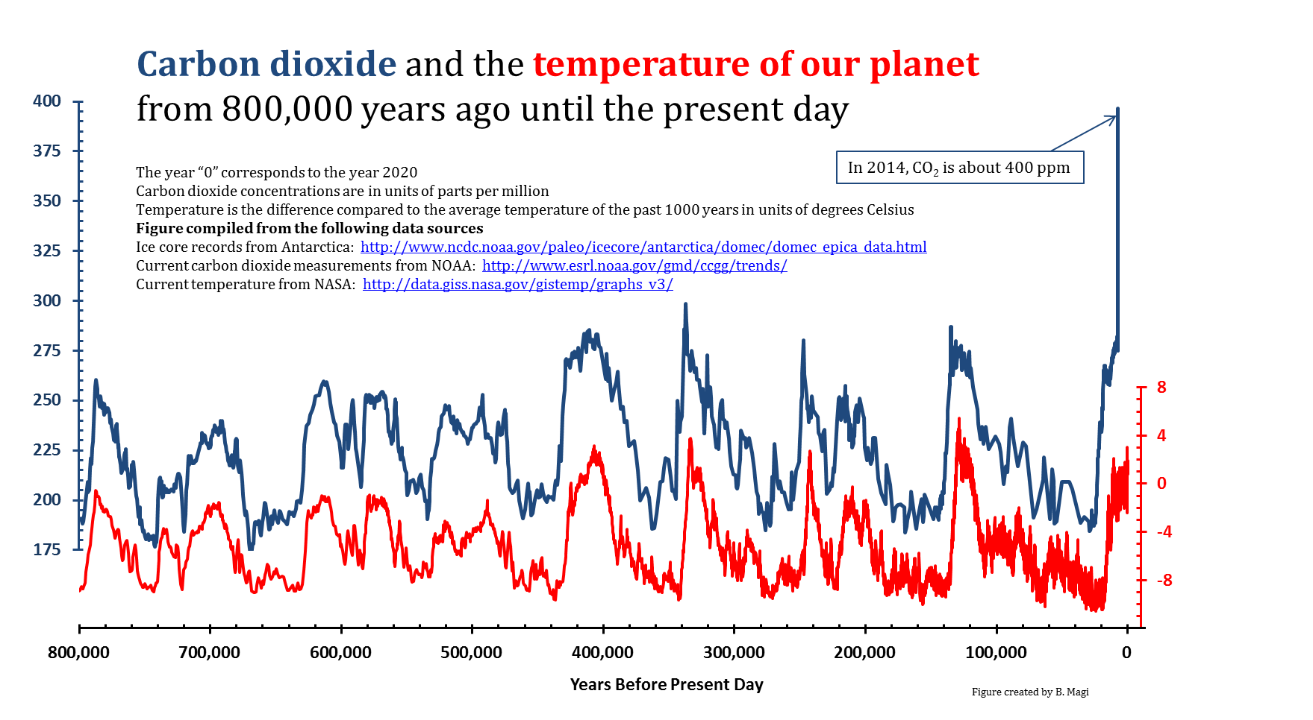

Slide 9
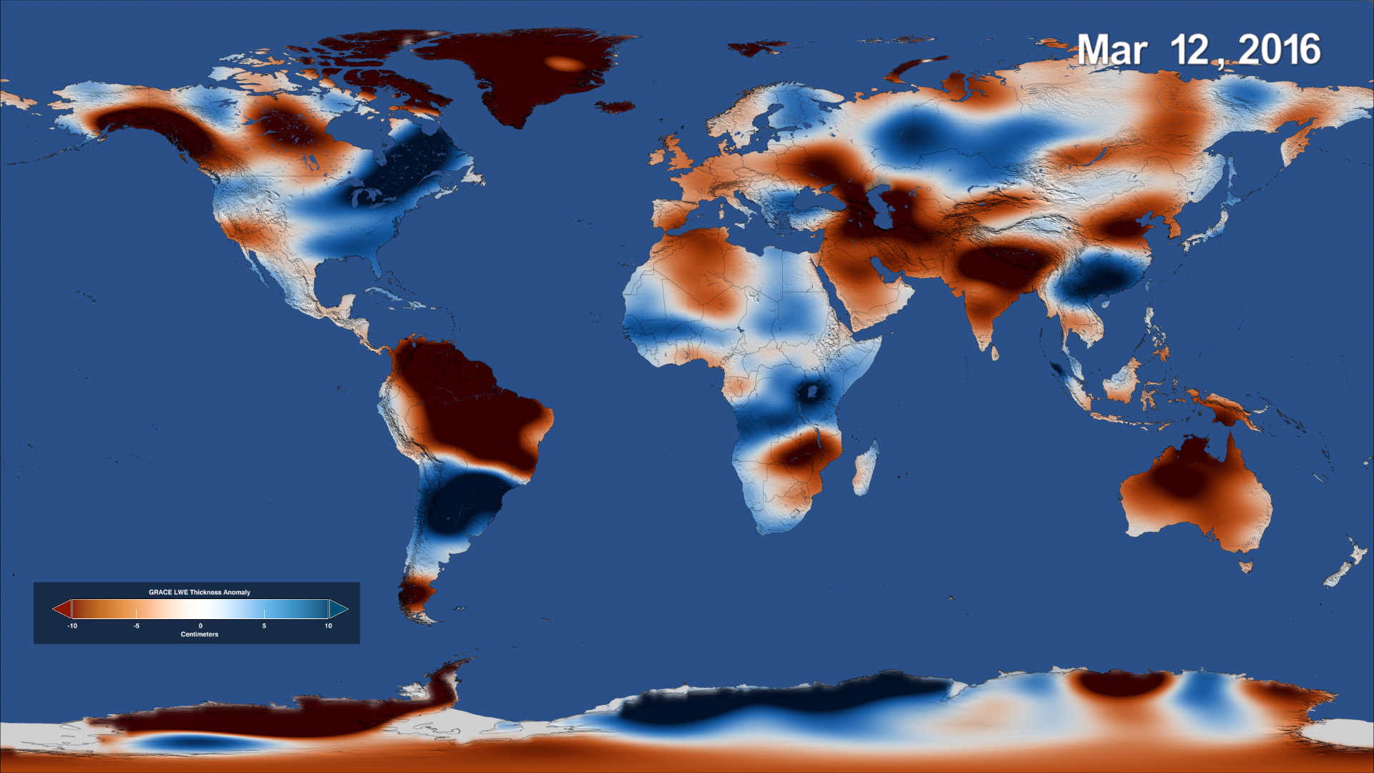
Global Warming
Effects: with just a small increase in temperature weather patterns change worldwide.
https://www.nasa.gov/press-release/nasa-satellites-reveal-major-shifts-in-global-freshwater

Slide 10
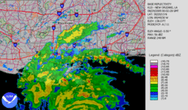
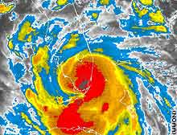
What’s so bad about warming up a little?
http://en.wikipedia.org/wiki/Hurricane_Katrina
More severe storms
http://i.a.cnn.net/cnn/2005/WEATHER/08/25/tropical.storm/story.katrina.915p.jpg

Slide 11
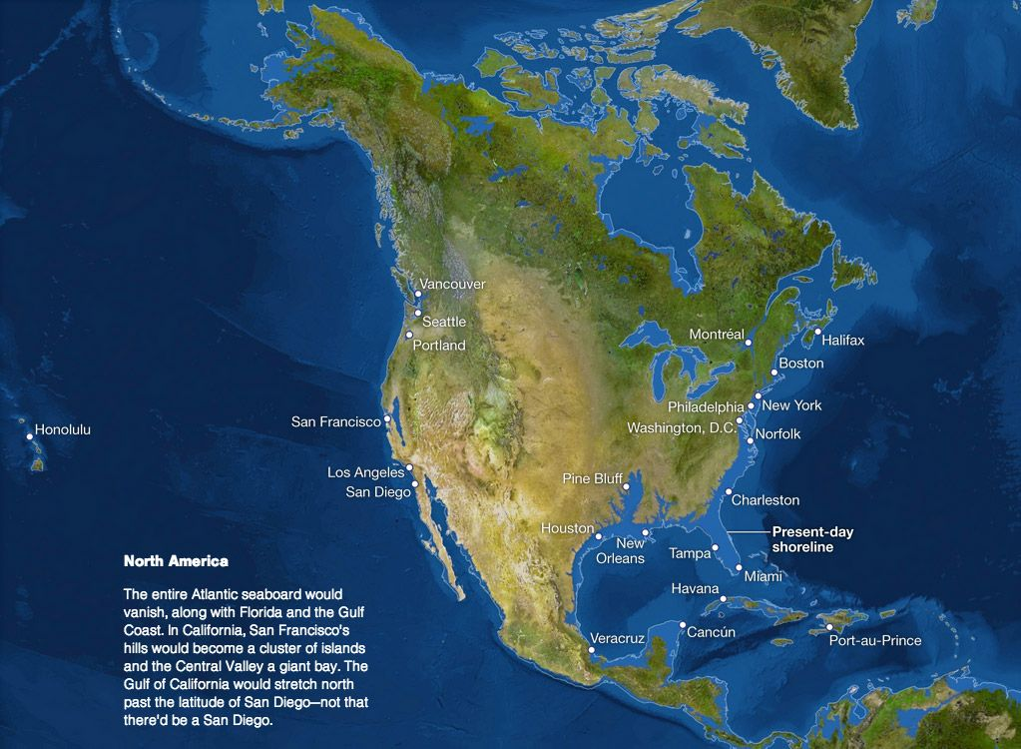
Global Warming
http://video.nationalgeographic.com/video/101-videos/global-warming-101
Polar ice caps may melt and thermal expansion occurs, flooding coastal cities

Slide 12
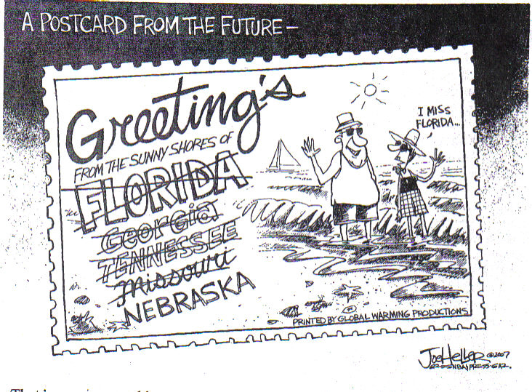
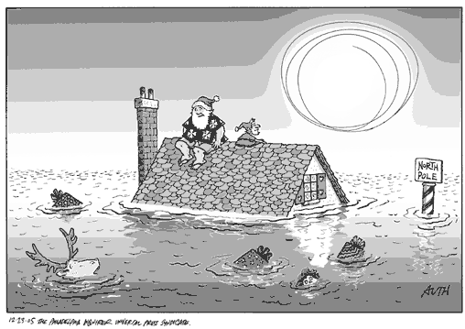
What’s so bad about warming up a little?
http://healthandenergy.com/images/global2.gif
Cartoon from Brookings Register
Coastal flooding

Slide 13
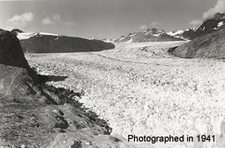
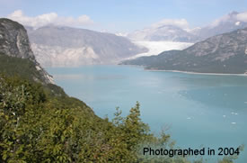
Beach erosion in North Carolina
Sea level is directly related to global climate.
In North Carolina, the sea level increase is twice the global average.

Slide 14
Beach erosion in North Carolina
Rising sea levels lead to beach erosion.
Severe storms also increase erosion.
The incidence of severe storms is increasing as a result of global climate change.

Slide 15
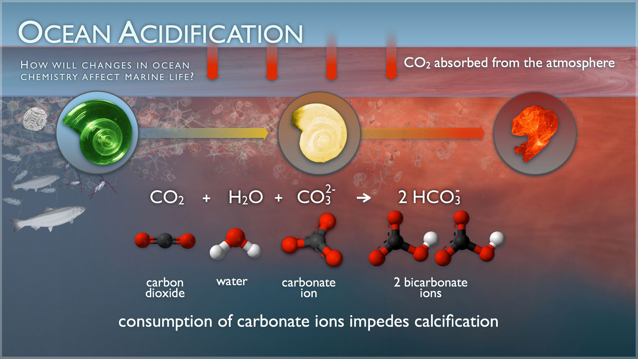
https://news.nationalgeographic.com/2018/06/ocean-acidification-underwater-drones-gliders-science-environment/

Slide 16
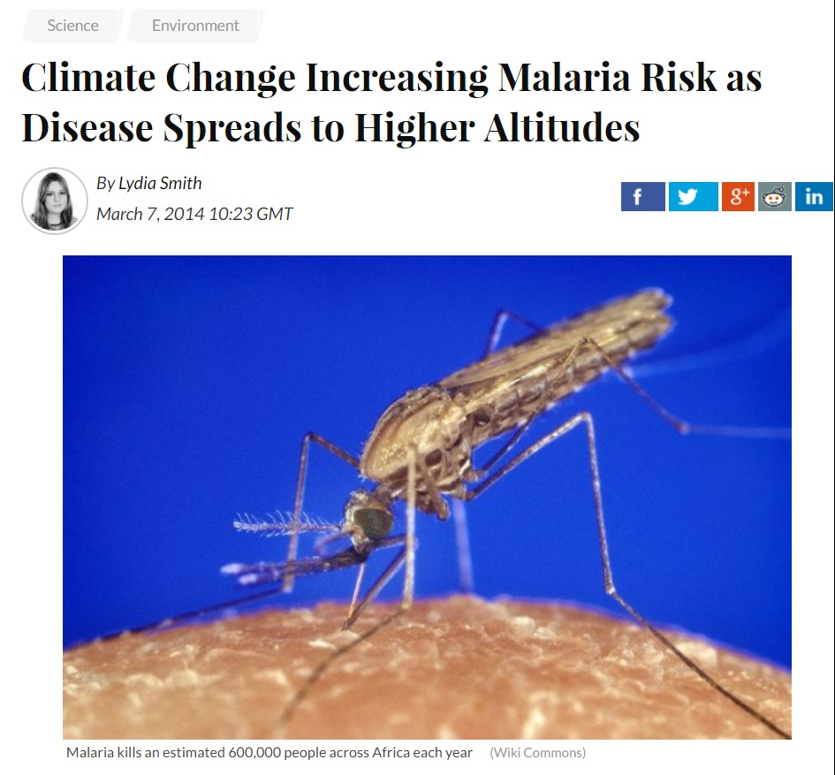

Slide 17
Fill It In …
Global Warming:
Cause -
Effect -
NC Example -

Slide 18
Water cycle

Slide 19
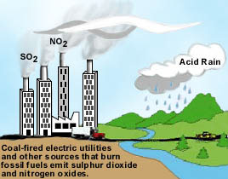
Acid Precipitation
https://www.youtube.com/watch?v=Ms4v0Ekvyuw
https://www.youtube.com/watch?v=v09KnqiYi-c
Cause: harmful emissions from cars and factories, especially nitrous oxide and sulfur oxide, react with oxygen and water to make precipitation more acidic

Slide 20
Acid Precipitation
Effect: a lowered pH disrupts aquatic ecosystems, makes soil less fertile, harms plant life, and damages human property.

Slide 21
Acid precipitation in North Carolina Mountains
Red spruce and Frasier fir trees in the mountains are dying as a result of acid precipitation, damaging the ecosystem

Slide 22
Fill It In …
Acid Precipitation:
Cause -
Effect -
NC Example -

Slide 23
Water Quality
Cause: sources of water pollution often include illegal chemical dumping, acid rain, overheated water from power plants, and raw sewage.

Slide 24
Water Quality
Effects: a lack of clean drinking water is a leading cause of disease (such as cholera, dysentery, typhoid).
Water pollution also affects many ecosystems through habitat destruction

Slide 25
Waste lagoons on North Carolina Hog Farms
https://www.youtube.com/watch?v=ayGJ1YSfDXs
There are approximately 7 million hogs on industrial farms in NC, most in eastern NC, which is a flood-prone coastal plain.
The waste is stored in lagoons, but may run-off, leak, or spill into surface water with rainfall.

Slide 26
Waste lagoons on North Carolina Hog Farms
Also, nitrogen run-off from the waste may contribute to outbreaks of Pfisteria, a single-celled alga that produces a deadly neurotoxin.
Massive fish kills have resulted, along with health problems in fishermen and other exposed. Eutrophication

Slide 27
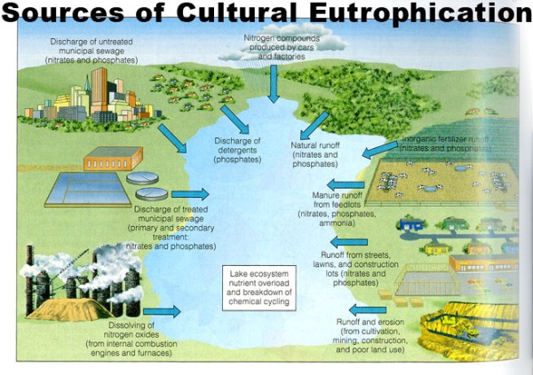
Eutrophication
https://www.youtube.com/watch?v=6LAT1gLMPu4
When soil run-off causes an overgrowth of aquatic plants
This causes the marine life to die off due to the lack of oxygen in the water

Slide 28
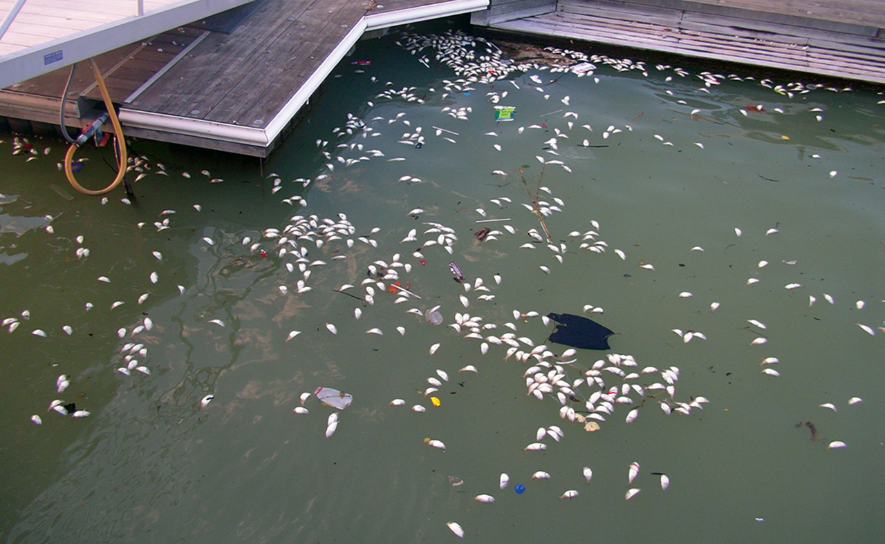

Slide 29
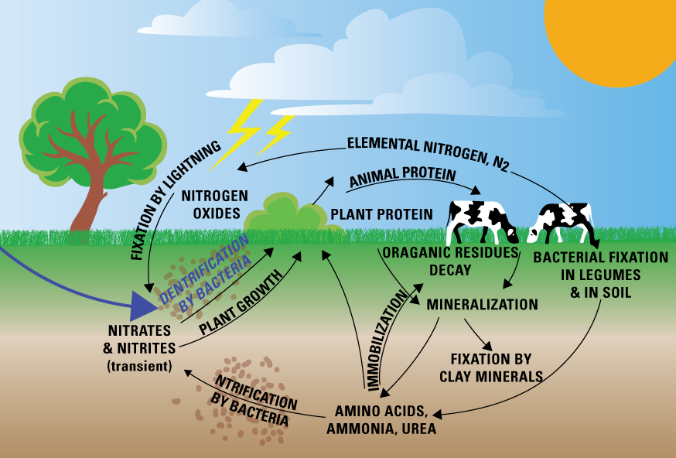

Slide 30
Fill It In …
Water Quality:
Cause -
Effect -
NC Example -

Slide 31
Check Yourself!
What are the two main greenhouse gases?
What two pollutants are responsible for acid precipitation?
What part of the water cycle carries land pollution to the water?

Slide 32
Check Yourself!
What are the two main greenhouse gases? CO₂ AND CH₄ (CARBON DIOXIDE & METHANE)
What two pollutants are responsible for acid precipitation?
What part of the water cycle carries land pollution to the water?

Slide 33
Check Yourself!
What are the two main greenhouse gases? CO₂ AND CH₄ (CARBON DIOXIDE & METHANE)
What two pollutants are responsible for acid precipitation? NITROUS OXIDE & SULFUR OXIDE
What part of the water cycle carries land pollution to the water?

Slide 34
Check Yourself!
What are the two main greenhouse gases? CO₂ AND CH₄ (CARBON DIOXIDE & METHANE)
What two pollutants are responsible for acid precipitation? NITROUS OXIDE & SULFUR OXIDE
What part of the water cycle carries land pollution to the water? RUN-OFF

Slide 35
How do humans negatively impact other species?
Biodiversity - the number of different species of organisms that exist within an area and the genetic diversity within each species.

Slide 36
BIODIVERSITY
The sum of the genetically based
variety of all the organisms in the
biosphere = ___________________
Biodiversity gives __________ to the
ecosystems that we are so dependent
on, enhances their ____________, and
provides an important source of new
_____, ________, and other _________.
stability
productivity
food
medicine
products

Slide 37
Causes of biodiversity loss:
Habitat Destruction such as deforestation and fragmentation leads to loss of biodiversity.
In NC, urban development in the Piedmont has led to biodiversity loss due to:

Slide 38
Causes of biodiversity loss:
Forests are fragmented - breaking up a large forested area into smaller zones due to construction
https://earth.google.com/web/@35.11760862,-80.71086663,245.88671164a,208106.49808634d,35y,-0h,0t,0r

Slide 39
Causes of biodiversity loss:
Clearing land for development leads to soil erosion which ultimately leads to water pollution

Slide 40
Fill It In …
Loss of Biodiversity:
Cause -
Effect -
NC Example -

Slide 41
Causes of biodiversity loss:
Introduction of non-native species, “invasive species”
Kudzu, aka “the Vine that ate the South”

Slide 42
Causes of biodiversity loss:
Kudzu vines are native to Japan.
The vines were brought to the US during the Great Depression to plant in order to stabilize hillsides, minimizing erosion.

Slide 43
Causes of biodiversity loss:
Kudzu vines have no natural predators in the U.S.
The vines can grow up to 1 foot per day in our climate.

Slide 44
Causes of biodiversity loss:
Excessive growth has engulfed forests, outcompeting native species for sunlight and soil nutrients, leading to loss of native biodiversity.

Slide 45
Causes of biodiversity loss:
Dutch Elm Disease
Dutch Elm Disease is a fungus that spread to North America on crates made from Elm wood

Slide 46
Causes of biodiversity loss:
The disease easily spreads by insects or root to root

Slide 47
Causes of biodiversity loss:
Dutch Elm Disease leads to the death of trees, impacting the environment and economy

Slide 48
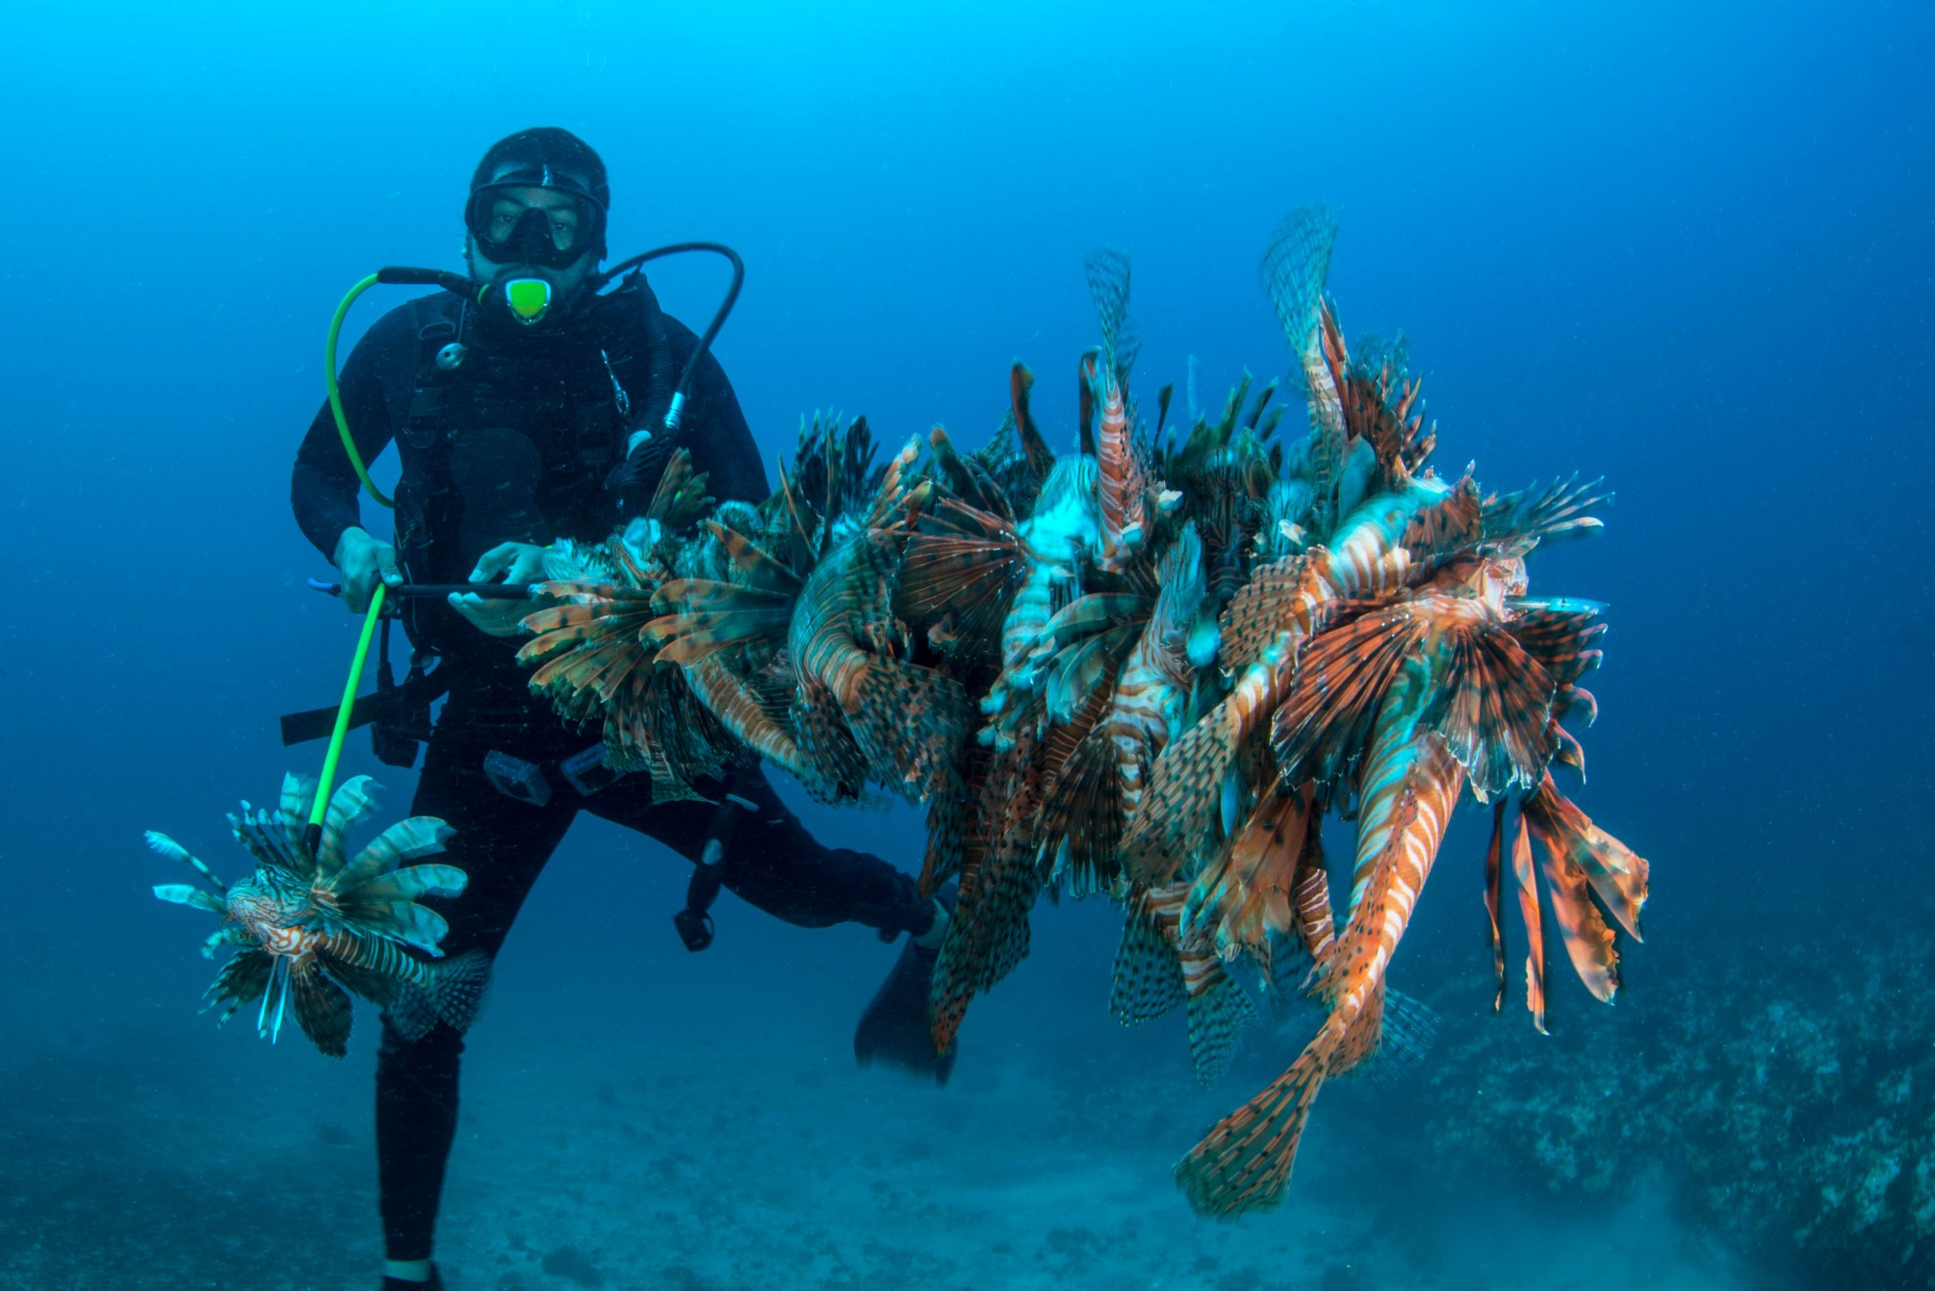

Slide 49
Causes of biodiversity loss:
Biomagnification of Pesticides
Bioaccumulation is the build up of certain pesticides in the tissues of organisms (ex. DDT in fish)

Slide 50
Causes of biodiversity loss:
Biomagnification is the increasing concentration as pesticides move up the food chain (ex. DDT in bald eagles)

Slide 51
Fill It In …
Where in the food chain do toxins, like DDT, end up the most concentrated?

Slide 52
Effects of biodiversity loss:
Endangerment/ Extinction of Species
Endangered species are at risk of becoming extinct.
Extinction refers to the loss of a particular species
Images show extinct Carolina Parakeet and Great Auk

Slide 53
Effects of biodiversity loss:
Lack of genetic variety makes crops more susceptible to disease, pests, and environmental changes

Slide 54
Check Yourself!
What is biodiversity?
What is the difference between bioaccumulation and biomagnification?

Slide 55
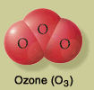
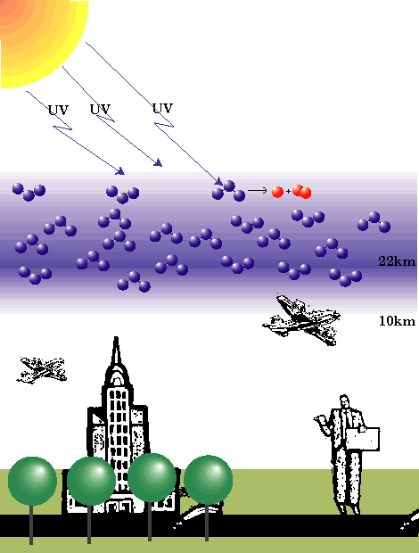
OZONE LAYER
The ozone layer protects us from UV light.
UV light causes cancer, eye damage, and can damage plant tissue
http://pubweb.bnl.gov/users/xujun/www/bnl/ozone_layer_1.gif

Slide 56
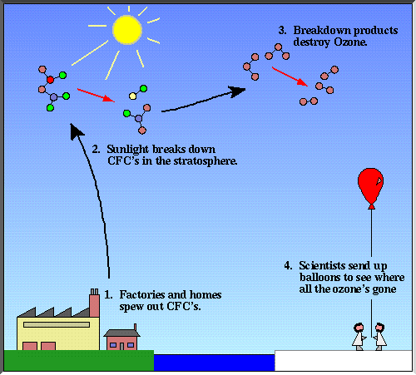
What’s the cause of Ozone Depletion?
Chlorofluorocarbon
molecules _______
released from
air conditioners,
aerosol spray cans,
fire extinguishers,
and industry
________________
(CFC’s)
destroy ozone
http://www.atm.ch.cam.ac.uk/tour/part3.html

Slide 57
http://www.footprintcalculator.org/signup

