Slide 1
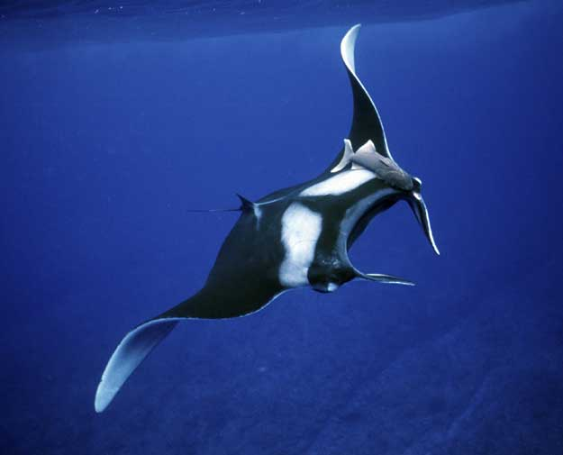
Manta Ray
Animalia
Chordata
Chondrichthyes
Rajiformes
Myliobatidae
Manta
birostris
1) What family does the Manta belong to?
2) What class does the manta belong to?
3) Write out the abbreviated scientific name for the Manta.

Slide 2
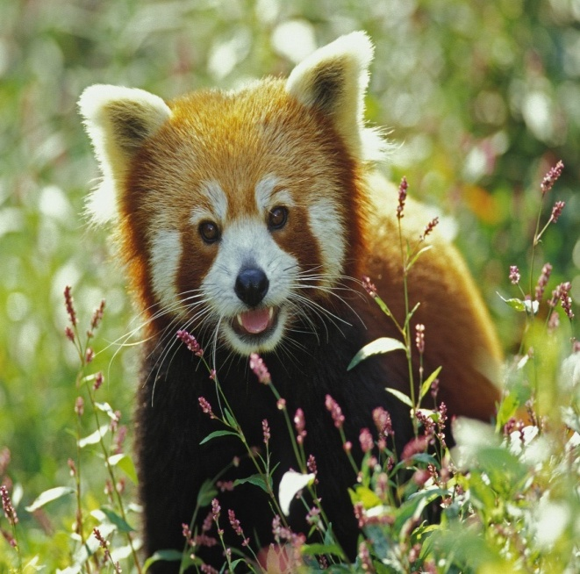
Red Panda
Animalia
Chordata
Mammalia
Carnivora
Ailuridae
Ailurus
fulgens
4) What class does the red Panda belong to?
5) How many scientific categories does the Red Panda share with the Manta?

Slide 3
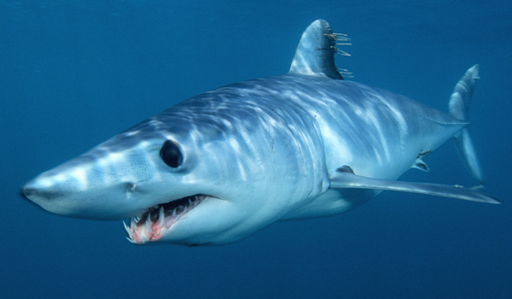
Mako Shark
Animalia
Chordata
Chondricthyes
Lamniformes
Lamnidae
Isurus
oxyrinchus
6) Write out the scientific name for the Mako Shark
7) What species on this worksheet is the closest relative of the Mako Shark

Slide 4
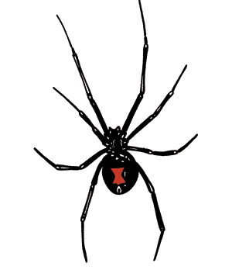
Black Widow Spider
Animalia
Arthropoda
Arachnida
Aranae
Theridiidae
Latrodectus
mactans
8) What class does the Black Widow belong to?
9) Write the scientific name for the Black Widow.

Slide 5
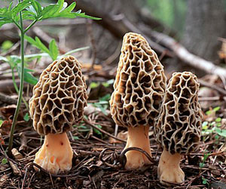
Morel Mushroom
Fungi
Ascomycota
Pezizomycetes
Pezizales
Morchellaceae
Morchella
gigas
10) What kingdom does the Morel belong to?
11) What genus does the morel belong to?
12) Write out the abbreviated scientific name for the Morel.

Slide 6
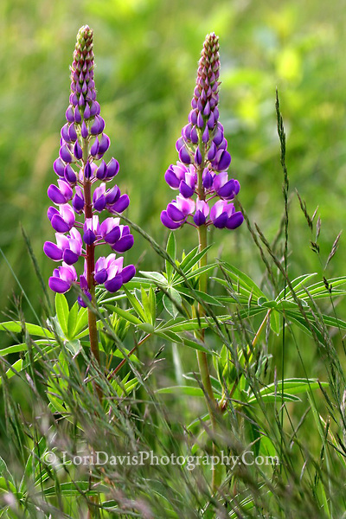
Purple Lupine
Plantae
Magnoliophyta
Magnoliosida
Fabales
Fabaceae
Lupinus
tupini
13) What phylum does Purple Lupine belong to?
14) What order does the Lupine belong to?
15) Write out the correct binomial name for the Lupine

