Slide 1
Cell Membrane AKA Plasma Membrane, Phospholipid Bilayer, Semi Permeable.

Slide 2
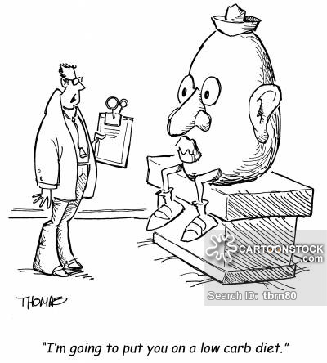
Made up of 3 organic molecules: - Lipids - Proteins - Carbohydrates Only allows certain molecules to pass through while blocking others out.

Slide 3
Structure of Phospholipids
Hydrophilic, Water-Loving, & Polar
Phospholipids contain…….
hydrophilic phosphate head &
2 hydrophobic fatty acid tails
Hydrophobic, Water-Fearing, & Non-Polar

Slide 4
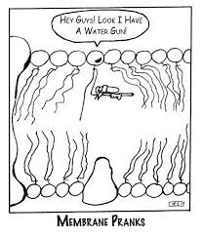
Phospholipid Bilayer
Forms due to the polarity of the phospholipids
- Phosphate heads (polar)
-> Close to the water of the cytoplasm and/or water inside the cell
-> Face outward
- Fatty acid tails
-> Face inward to avoid being near water
-> Creates a barrier b/w inside and outside of the cell

Slide 5
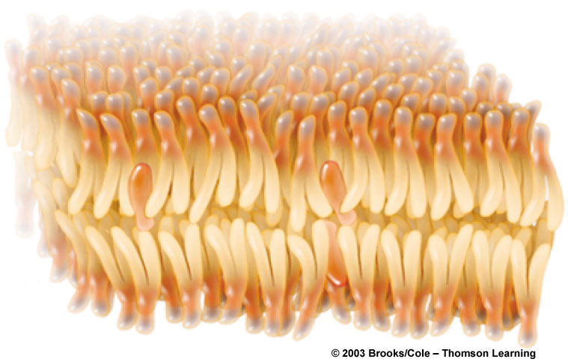
Phospholipid Bilayer
Phosphate heads
one layer
of phospholipids
Fatty acid tails
one layer
of phospholipids
Phosphate heads

Slide 6
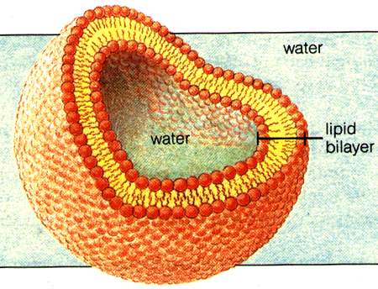

Slide 7
Homeostasis
Maintaining a constant internal balance.
Plants and animals regulate things like: pH, temperature, water, salts, glucose, etc.
The cell constantaly controls what goes into and out of the cell.

Slide 8
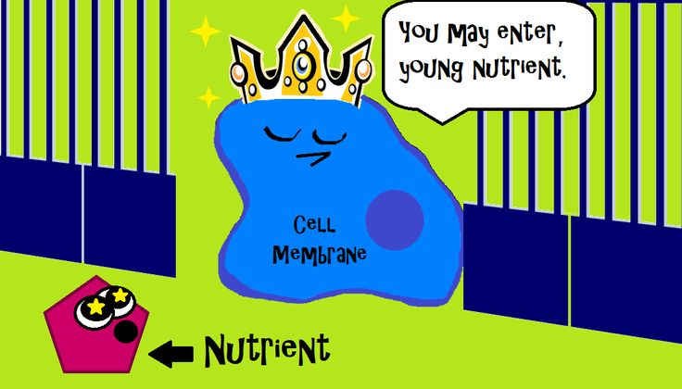
Did someone say AMOEBA SISTERS!?!?Clip
https://www.youtube.com/watch?v=6fhbbFd4icY

Slide 9
Can you answer these?

Slide 10
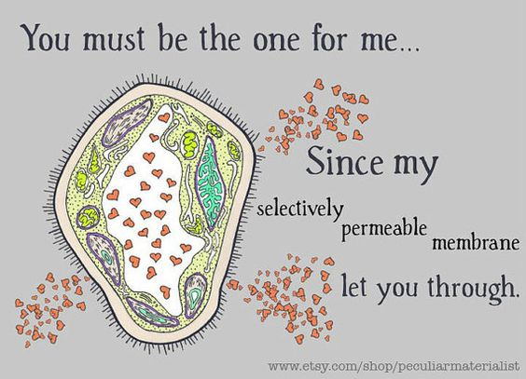
Crossing the Cell Membrane
Pass Directly Through
Need a Protein Channel
Fats
Oils
Water
Salt
Sugar

Slide 11
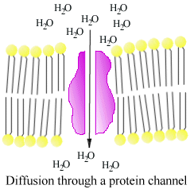
Transport Proteins
Span the phospholipid bilayer
Act as a door in the membrane
Change shape when they interact with solute
Move water-soluble substances across a membrane
May be passive or active

Slide 12
Cell Membrane Structure

Slide 13
Cell Membrane Function
Creates a barrier b/w inside & outside of cell
Proteins that pass through the entire bilayer act a channel to transport large substances OR transport substances against their gradients

Slide 14
Cell Membrane: Selectively Permeability
CAN PASS THRU MEMBRANE
-------------------------------------
O₂ and CO₂ (non-polar)
Some polar water molecules (slip through gaps in the non-polar lipid bilayer that occur when the fatty acid tails bend)
CANNOT PASS THRU MEMBRANE
-------------------------------------
Ions (charged)
Large polar molecules

Slide 15
Construct & Label a Cell Membrane

Slide 16
Cell Membrane Worksheet Side 1

Slide 17
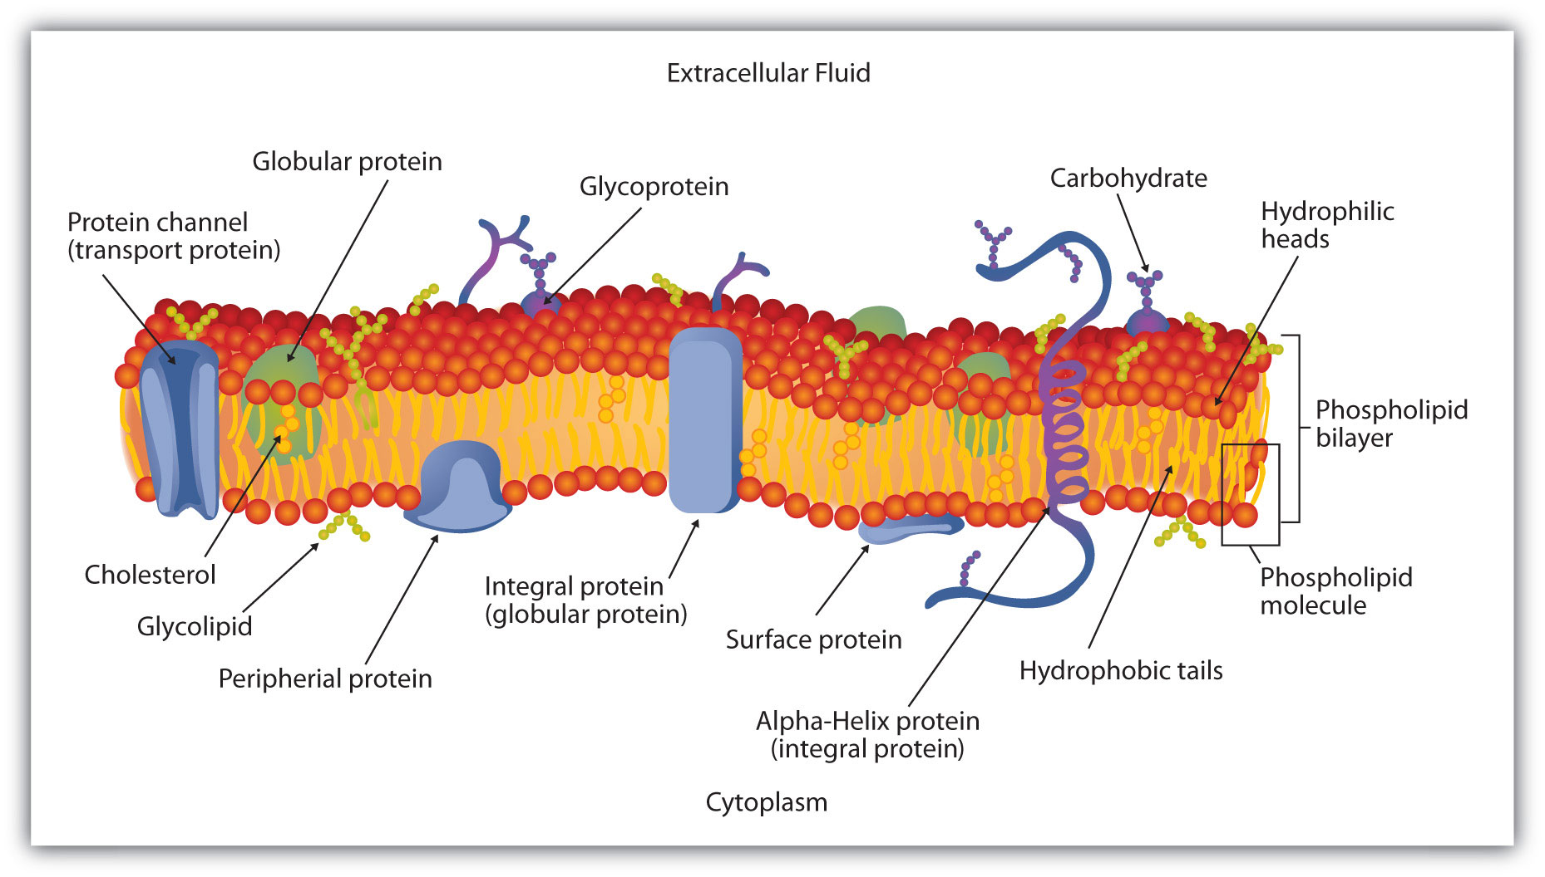
What belongs in the boxes?
#3
#1
#4
#2

Slide 18
Closure
What 3 organic molecules are the cell membrane made up of?
What two parts make up a phospholipid?
Provide an example of a concentration gradient.

