Slide 1
Cell Differentiation and Stem Cells

Slide 2
What is a gene?
Found on chromosomes- bands
Segment of genetic information (DNA) that codes for a specific trait in a living organism and can be passed along from one organism to another:
parent to offspring via vertical gene transfer
or between organisms using horizontal gene transfer (bacteria only- ie bacterial resistance genes)
Must be “turned on” for the characteristic to be manifested in the organism.
Gene regulation

Slide 3
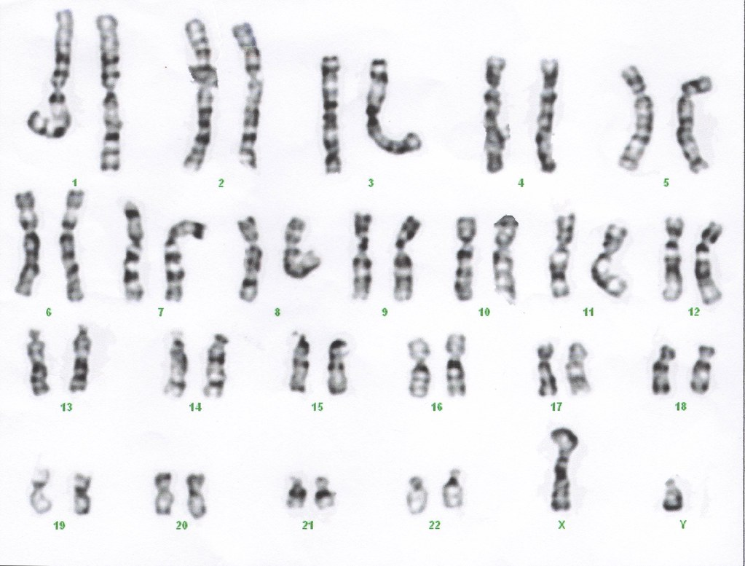
Gene Mapping
https://web.ornl.gov/sci/techresources/Human_Genome/posters/chromosome/chromo09.shtml
HGP- global scientific initiative to “map” the entirety of the human genome (all DNA).
Completed 2003
https://www.genome.gov/ for more information
Image:https://www.flickr.com/photos/47988426@N08/8252270882

Slide 4
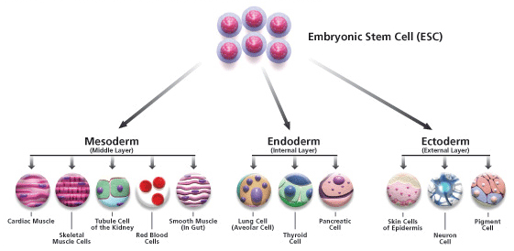
Cell Differentiation
Structure= function, but how is structure determined?
Activation of specific genes determines cellular features.
Stem Cells= undifferentiated cells
Embryonic Stem Cells (ESCs)-pluripotent
Somatic Stem Cells (SSCs)-multipotent (renewing)
https://commons.wikimedia.org/wiki/File:Figure_2._R%C3%A9sultats_de_diff%C3%A9renciation_de_cellules_souches_en_une_des_trois_diff%C3%A9rentes_cat%C3%A9gories_de_cellules_qui_se_sous-divisent_en_types_de_cellules_sp%C3%A9cifiques_avec_des_r%C3%B4les_pr%C3%A9cis7.gif

Slide 5
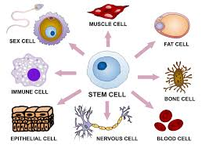
https://commons.wikimedia.org/wiki/File:Stem_cell_differentiation.svg

Slide 6
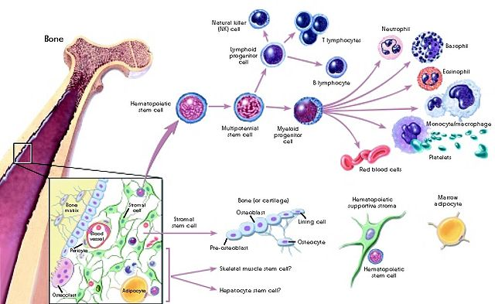
https://upload.wikimedia.org/wikipedia/commons/thumb/d/d6/Stemcelldifferentiaion.jpg/640px-Stemcelldifferentiaion.jpg

Slide 7
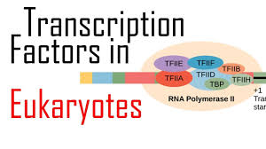
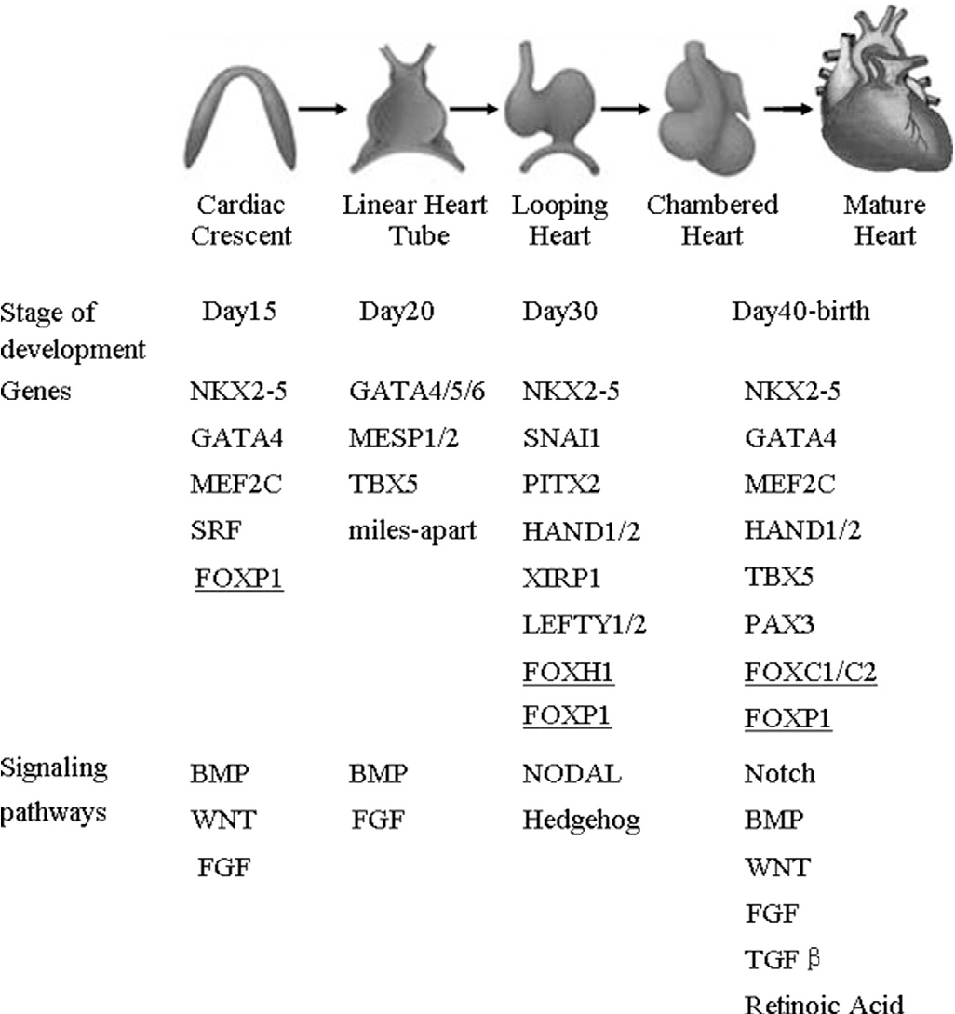
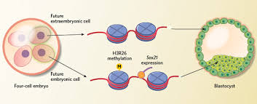
https://www.youtube.com/watch?v=9AX1XwKCYQE&app=desktop
https://www.biointeractive.org/classroom-resources/cellular-differentiation-along-concentration-gradients
https://www.biointeractive.org/classroom-resources/differentiation-and-fate-cells

Slide 8
Stem Cell Uses
Regenerative medicine
Leukemia

