Slide 1
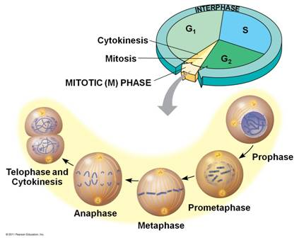
CELL CYCLE & MITOSIS
https://goo.gl/xI0jGS

Slide 2
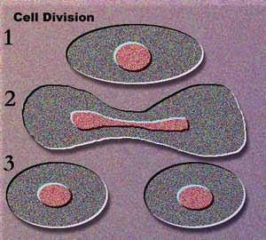
Let’s Review Cell Theory!
All cells come from PREEXISTING cells.
The CELL is the basic unit of life.
All LIVING things are composed or made up of one or more cells.
****If all cells come from pre-existing cells, then we need to figure out how cells produce other cells. This process of a cell growing and dividing to produce more cells is known as the CELL CYCLE!

Slide 3
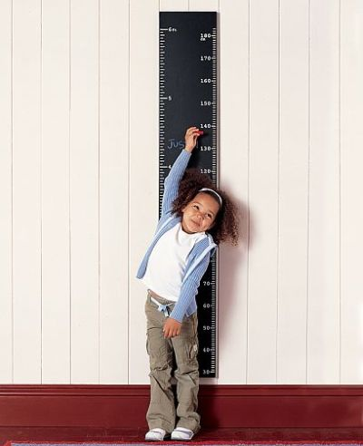
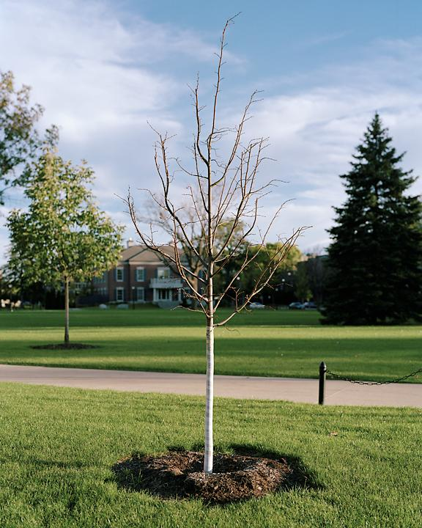
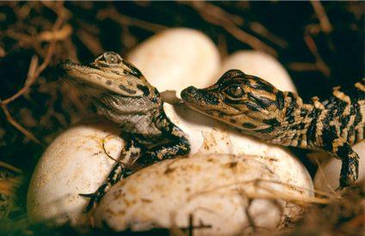
Why do cells go through CELL CYCLE?
GROWTH: Organisms need to grow (i.e. babies grow into adults, tadpoles grow into frogs, etc.); cells divide and build more tissues to provide growth for the organisms

Slide 4
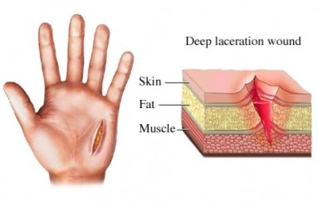
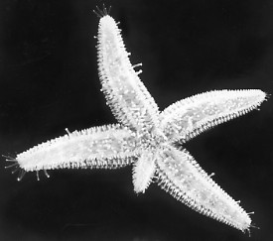
REPAIR: Organisms need new cells to replace old, worn out cells and tissues or damaged tissues

Slide 5
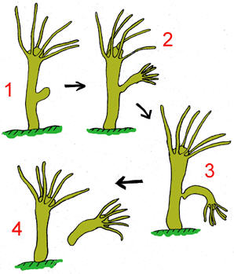
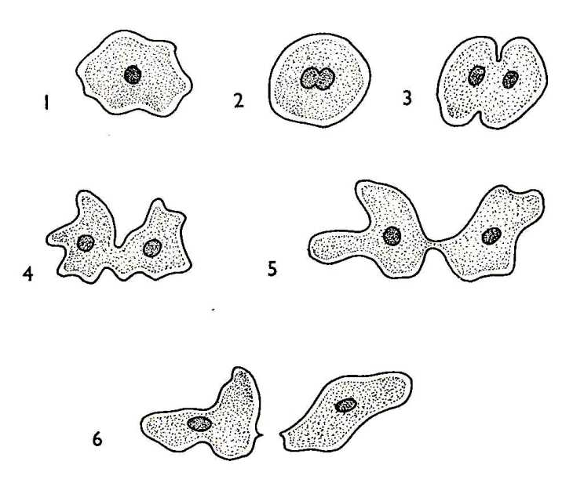
REPRODUCTION: Some organisms do not reproduce (create offspring) sexually and rely on cell division to create offspring. This form of reproduction is known as ASEXUAL REPRODUCTION.

Slide 6
Cell Size
Cells also have a limit as to how big they can get. Cells need to have a very small SURFACE to VOLUME ratio in order to ensure that the cell is getting all of its necessary nutrients and building blocks in efficient time. The cell also needs to be small enough so that the DNA can produce enough PROTEINS to adequately serve the cell’s function.

Slide 7
Cell Cycle = 2 Stages
INTERPHASE: Stage where cells spend most of their time, growing, producing proteins, making new DNA, and preparing for division
MITOSIS: Stage where the cell actually divides its DNA (CHROMOSOMES), cytoplasm, and organelles forming two new identical daughter cells.

Slide 8
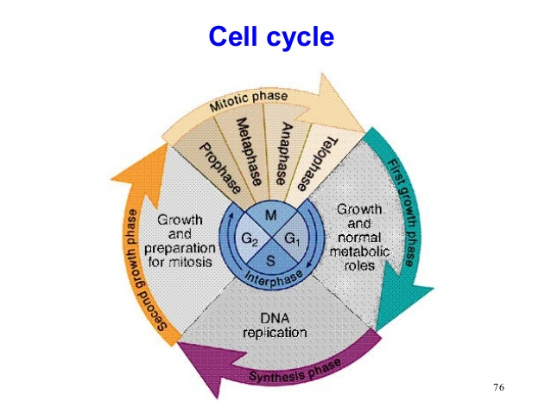

Slide 9
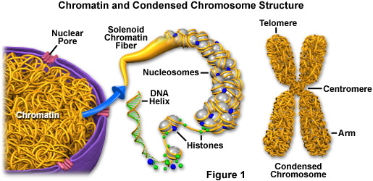
Draw and label the sister chromatid image

Slide 10
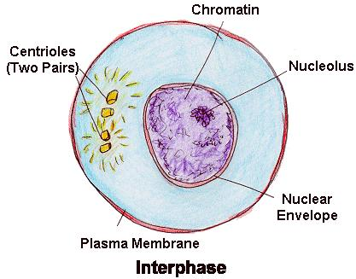
INTERPHASE
Growth 1, Synthesis, Growth 2
G1=Cell is growing, doing its job, maintaining cell metabolism
S= Cell REPLICATES or duplicates all of its DNA, which in humans is 46 chromosomes
G2=Cell continues to grow, manufactures new cell organelles, prepares for division

Slide 11
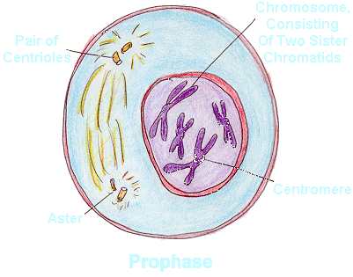
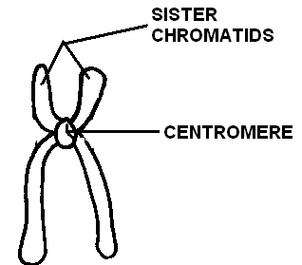
PROPHASE
Longest phase of Mitosis
Chromatin (Stringy, uncondensed DNA) coils & condenses to chromosomes
Each chromosome has two halves = SISTER CHROMATIDS
Nuclear Membrane (around Nucleus) begins to break down;nucleolus disappears
In animal cells, centrioles (which help in division) moves towards the poles of the cell
In plant and animal cells, the SPINDLE begins to form

Slide 12
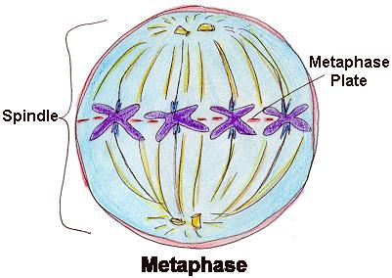
METAPHASE
Spindle fibers attach to the centromeres of chromosomes; one spindle to each sister chromatid
Chromosomes are pulled to the equator of the cell = METAPHASE PLATE

Slide 13
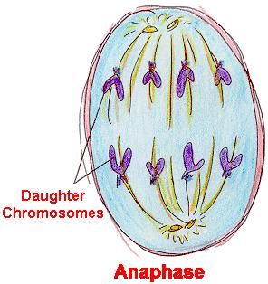
ANAPHASE
SISTER CHROMATIDS of each chromosome split apart
Spindle fibers begin to pull each sister chromatid apart towards opposite poles of the cell

Slide 14
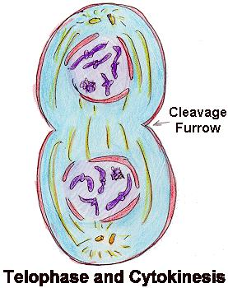
TELOPHASE
New cells are preparing for their own independent status
SISTER CHROMATIDS reach opposite ends of the cell & Chromosomes unwind and go back to their string-like chromatin
Spindle breaks down; nucleolus reappears
NUCLEAR MEMBRANE reforms around each new set of DNA

Slide 15
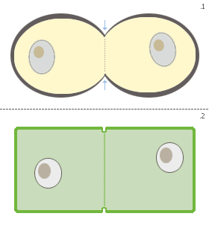
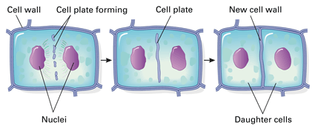
CYTOKINESIS
In ANIMALS = plasma membrane pinches in along the equator of the cell, separating the two new cells
In plant cells = since there is a cell wall , a CELL PLATE is laid down across the cell’s equator and a new cell wall and cell membrane forms around each new cell
http://highered.mcgraw-hill.com/sites/0072495855/student_view0/chapter2/animation__mitosis_and_cytokinesis.html

Slide 16
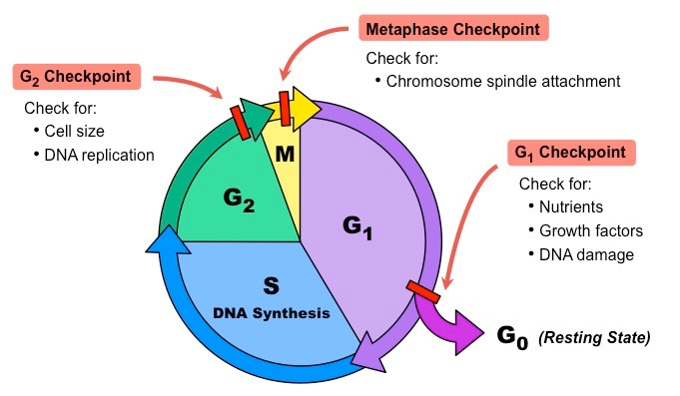
https://www.youtube.com/watch?v=46Xh7OFkkCE

Slide 17
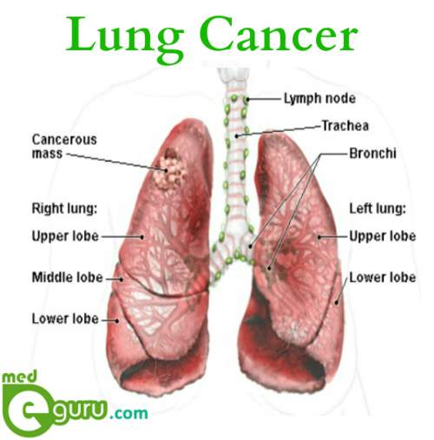
Compare Commercials from then to now.
https://www.youtube.com/watch?v=9kKN8_aa38A
https://www.youtube.com/watch?v=-fPwpymO1bs
https://www.youtube.com/watch?v=h2vuRifRQVc

Slide 18
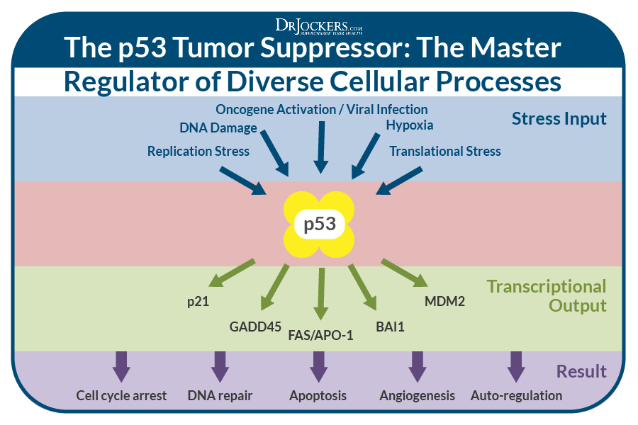
`
Carcinogens or mutagens

Slide 19
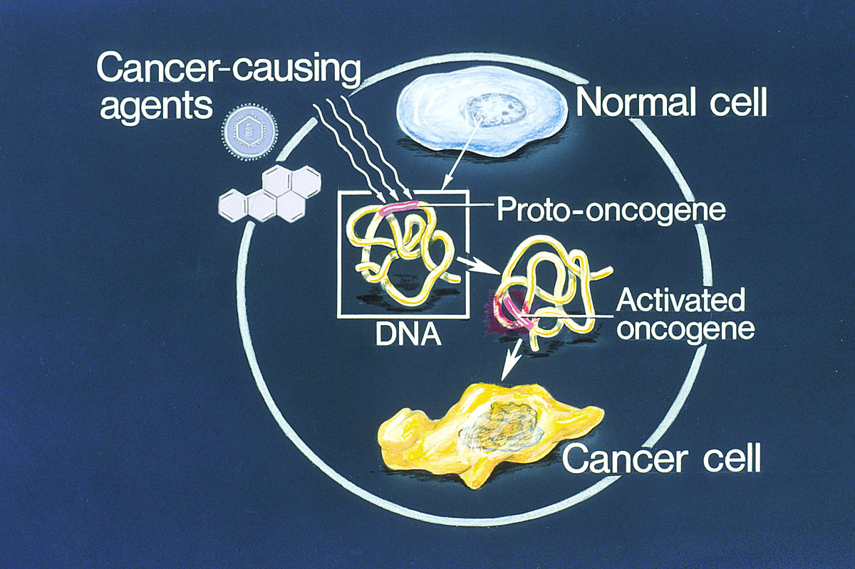

Slide 20
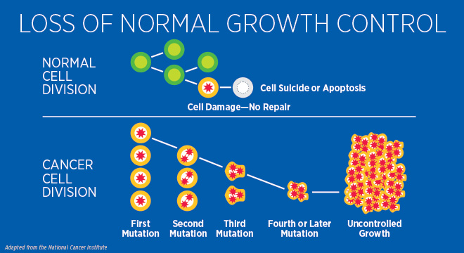
https://www.youtube.com/watch?v=46Xh7OFkkCE

Slide 22
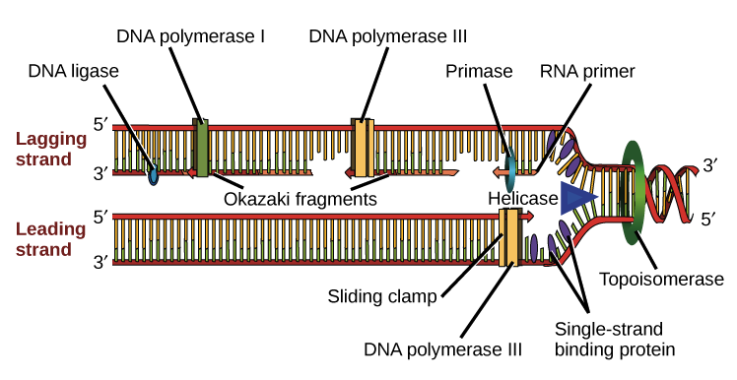
https://www.youtube.com/watch?v=TNKWgcFPHqw

Slide 23
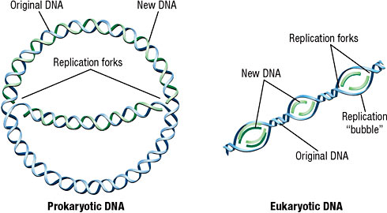

Slide 24
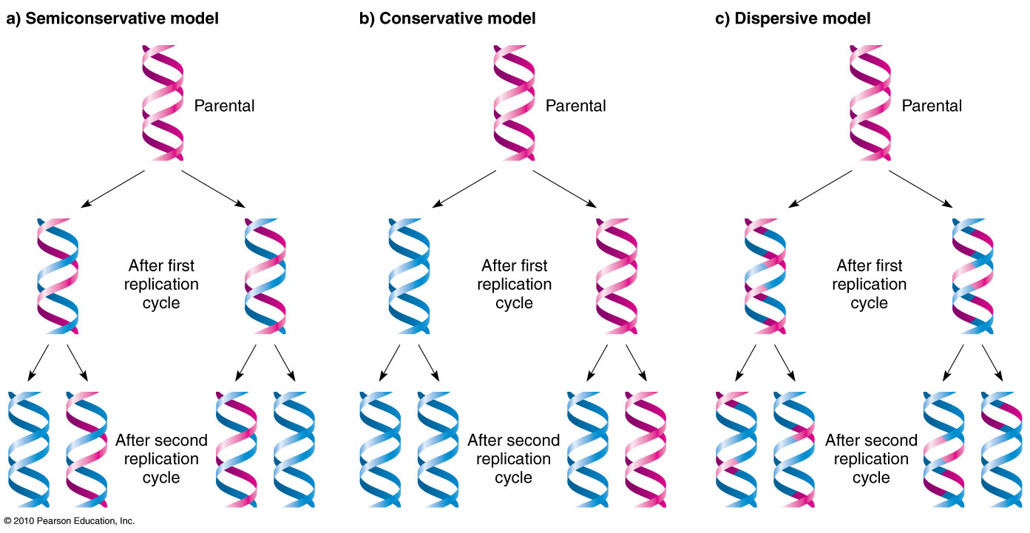
https://www.youtube.com/watch?v=JcUQ_TZCG0w&disable_polymer=true

