Slide 1
QOD:
Which relationship is most similar to the relationship below?
Book : Publisher
Truck : Factory
Key : Lock
Baker : Pie

Slide 2
Agenda March 26th:
Mutations Review
Biotechnology Notes
Human Genome Project
Biotechnology Web-Search

Slide 3
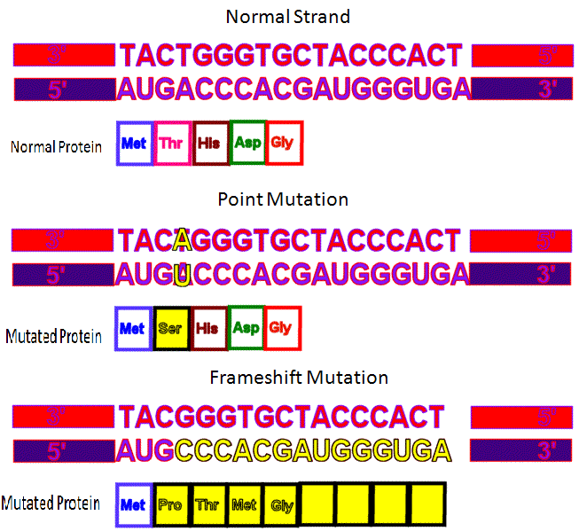

Slide 4
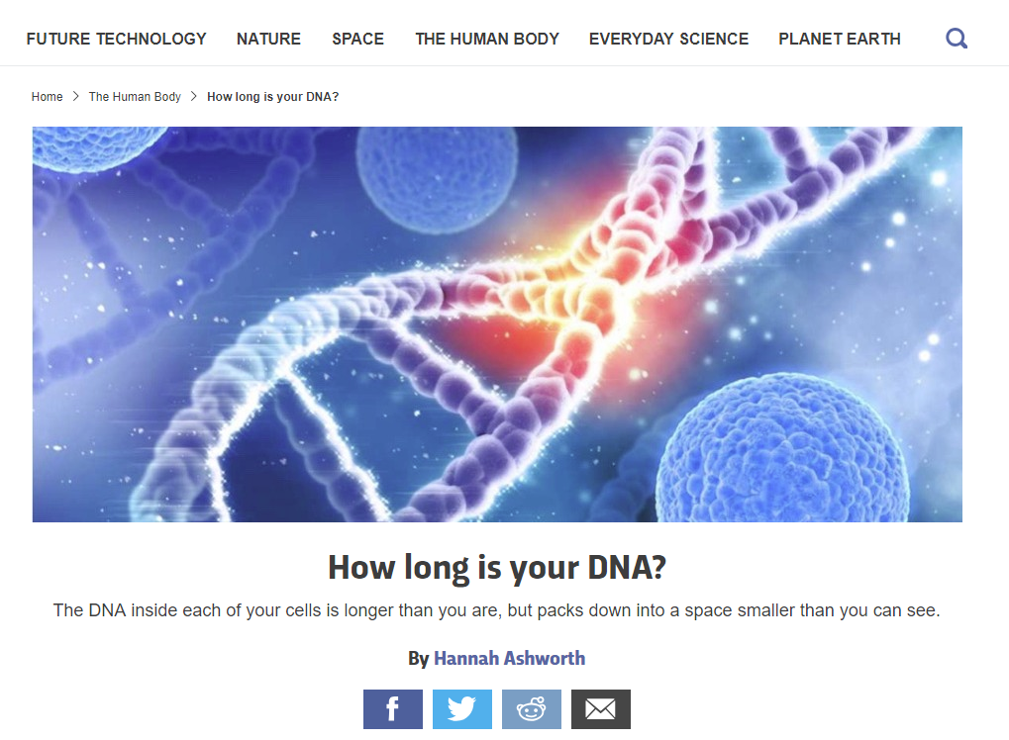
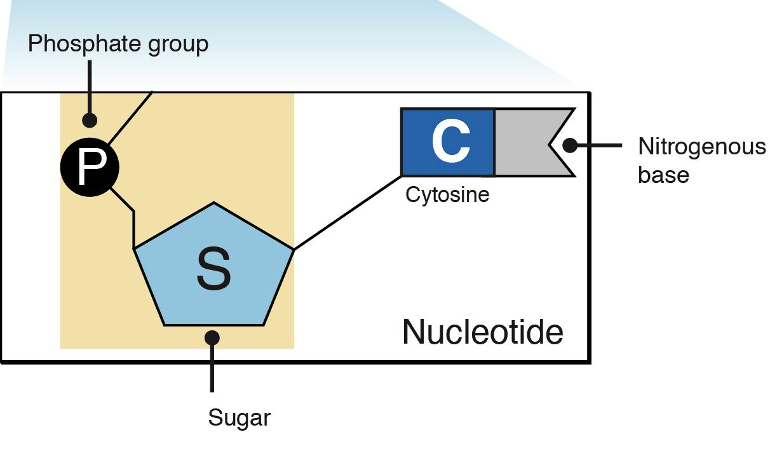

Slide 5
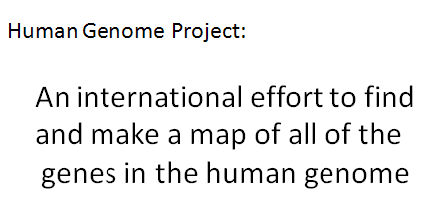
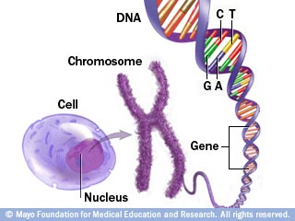
https://www.youtube.com/watch?v=qOW5e4BgEa4
https://www.youtube.com/watch?v=AhsIF-cmoQQ
https://thehill.com/opinion/healthcare/433921-unleash-the-full-potential-of-the-human-genome-project

Slide 6
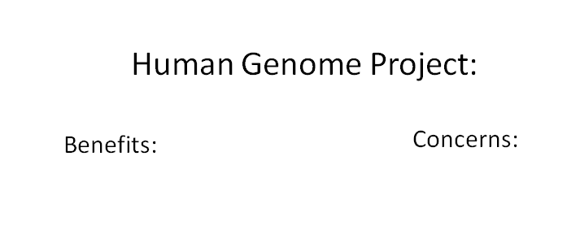

Slide 7
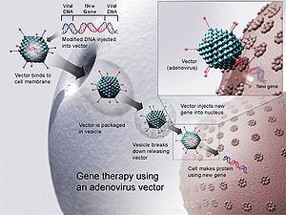
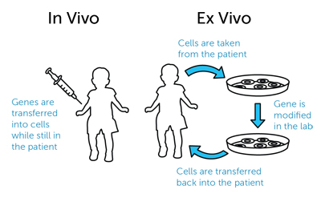
https://www.youtube.com/watch?v=xOQFJJOBGM0
https://www.youtube.com/watch?v=fZlZeHGCs3A
https://www.medpagetoday.com/hematologyoncology/hematology/63490

Slide 8
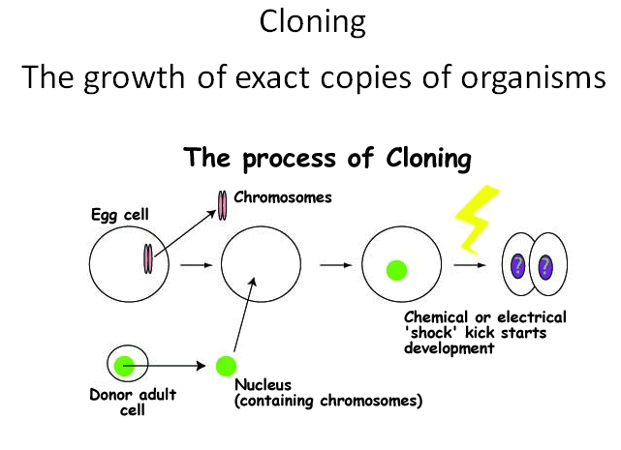
https://www.youtube.com/watch?v=-Qry1gYYDCA
https://www.youtube.com/watch?v=NpaBgvTpfLY
https://www.google.com/search?q=the+island+movie+trailer&oq=the+island&aqs=chrome.0.69i59j69i57j0l4.1872j0j7&sourceid=chrome&ie=UTF-8&safe=active&ssui=on#q=the+island+movie+trailer&safe=strict&tbm=vid

Slide 9
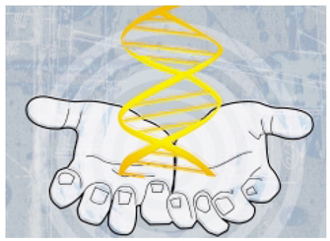
https://www.fertility-docs.com/programs-and-services/pgd-screening/choose-your-babys-eye-color.php
https://www.bioethics.msu.edu/what-is-bioethics

Slide 10
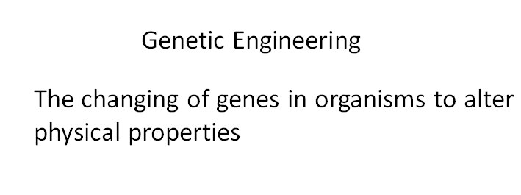
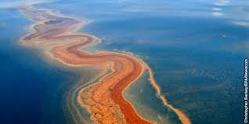
https://www.youtube.com/watch?v=jAhjPd4uNFY
https://www.youtube.com/watch?v=7TmcXYp8xu4
http://news.nationalgeographic.com/news/2011/04/110405-nsf-oil-somasundaran-video/

Slide 12
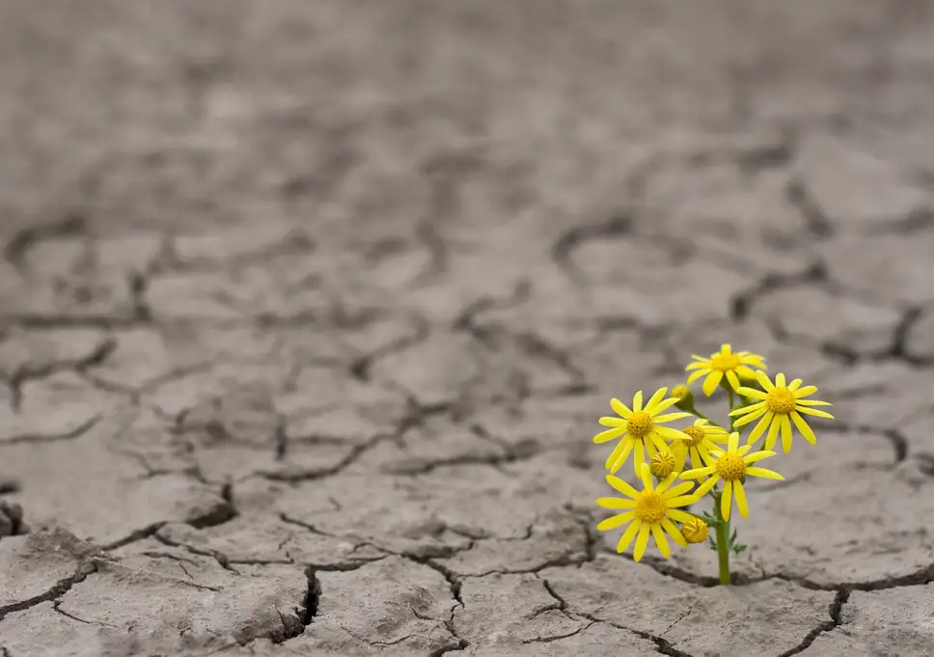
https://www.independent.co.uk/news/science/drought-resistant-crops-plants-genetic-engineering-a8091816.html

Slide 13
http://channel.nationalgeographic.com/videos/transgenic-animal-creations/
https://www.youtube.com/watch?v=QYH2uQ0xt5Q
https://www.youtube.com/watch?v=sH4bi60alZU

Slide 14
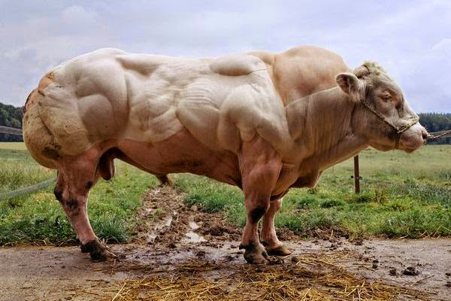

Slide 15
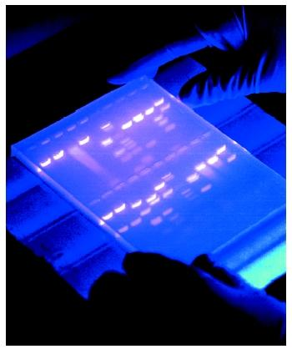
https://www.youtube.com/watch?v=AkBUriMK9u8

Slide 16
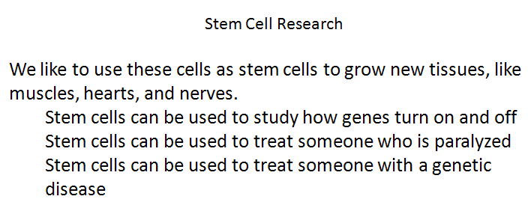
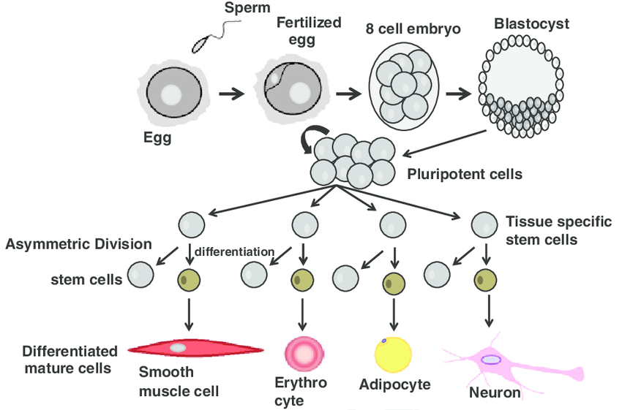
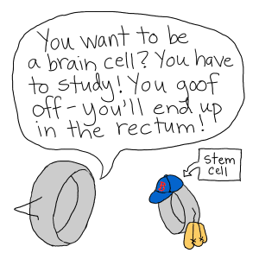
https://www.theguardian.com/science/2014/oct/21/paralysed-darek-fidyka-pioneering-surgery
https://www.youtube.com/watch?v=t3g26p9Mh_k
https://www.hopkinsmedicine.org/institute_cell_engineering/research_programs/stem_cell_biology.html

Slide 17
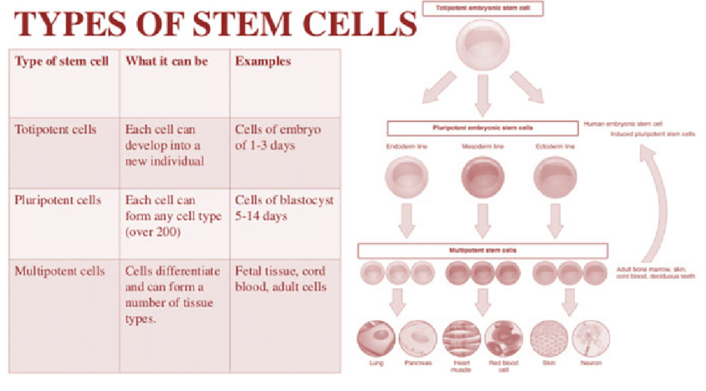
https://www.researchgate.net/figure/Types-of-stem-cells-As-reported-there-are-several-types-of-stem-cells-with-different_fig1_318107548

