Slide 1
Bell Ringer
Explain & draw DNA Replication using the words daughter cells, genetic information & hydrogen bonds.
How many chromosomes are in a human skin cell, a fruit fly and a wolf?
What are three reasons we need mitosis?
After a skin cell goes through mitosis how many chromosomes will be in each individual daughter cell?

Slide 2
Asexual Reproduction Notes

Slide 3
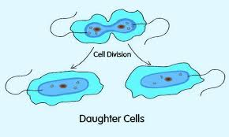
Asexual Reproduction
Definition: one parent produces genetically identical offspring.
Advantages:
Can produce offspring w/o a mate
Many offspring in short time
Disadvantages:
No variation in offspring
No adaptation to new/changing environments

Slide 4
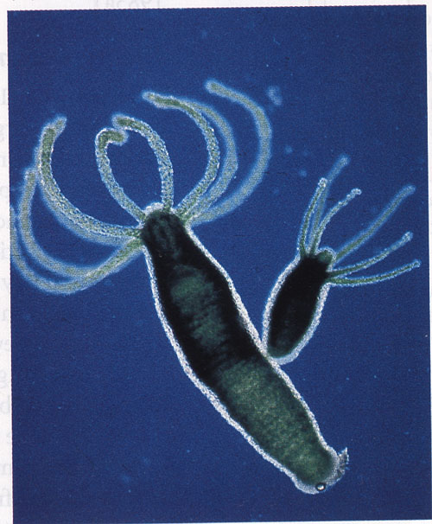
https://www.youtube.com/watch?v=rpKSQM2cDk0
Types of Asexual Reproduction
Budding - a new individual grows on a ‘parent’
Example: hydra, yeast

Slide 5
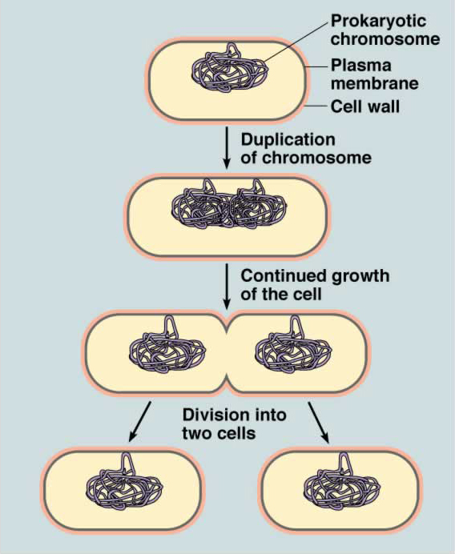
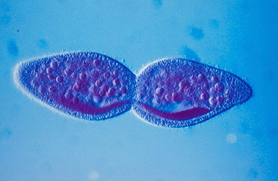
Types of Asexual Reproduction
Binary Fission - a ‘parent individual’ splits into two independent organisms
Example: bacteria

Slide 6
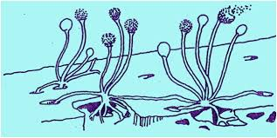
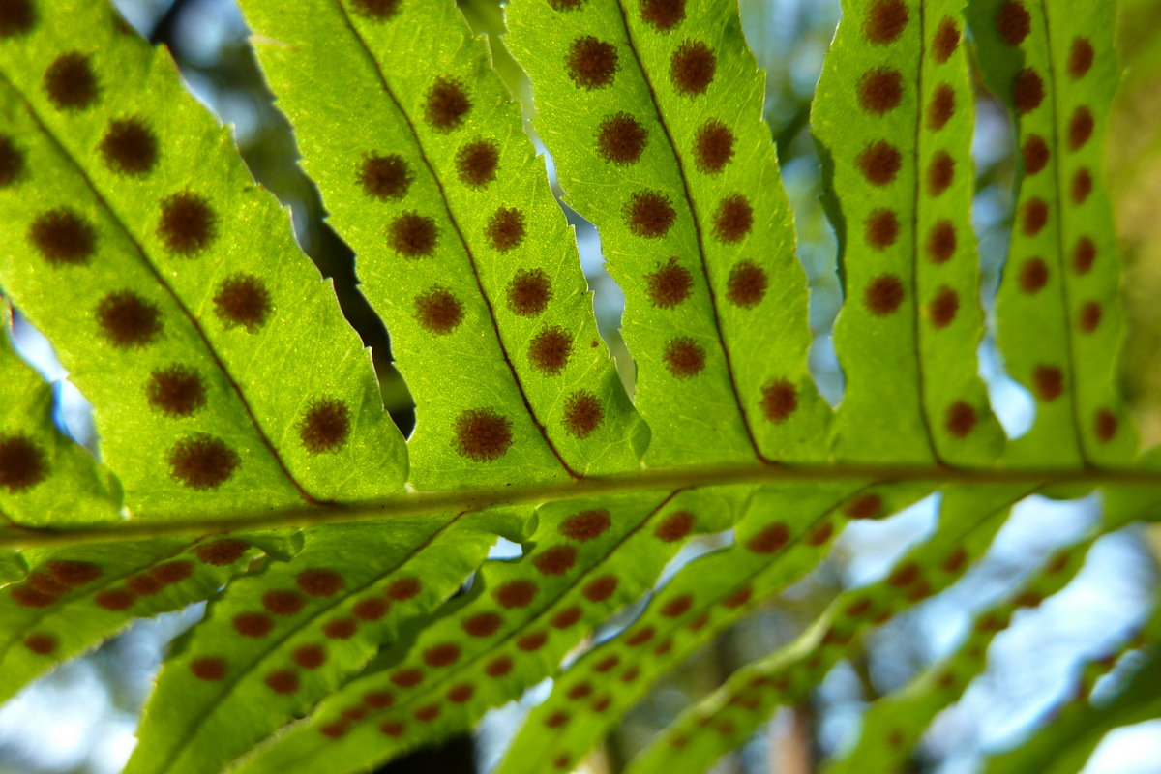
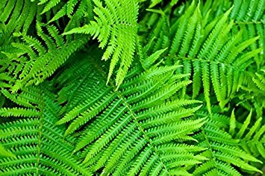
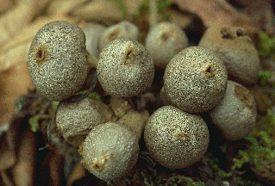
Sporulation
https://www.youtube.com/watch?v=E-bU4GUsgCE

Slide 7
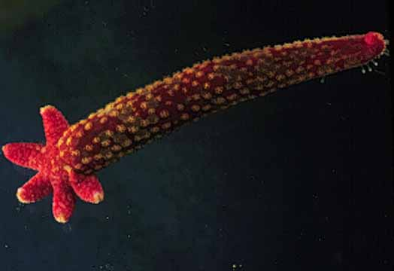
Types of Asexual Reproduction
Regeneration - fragments of the ‘parent’ can grow into new organisms
Example: starfish, planarian
https://www.youtube.com/watch?v=-ardrFZuFkU

Slide 8
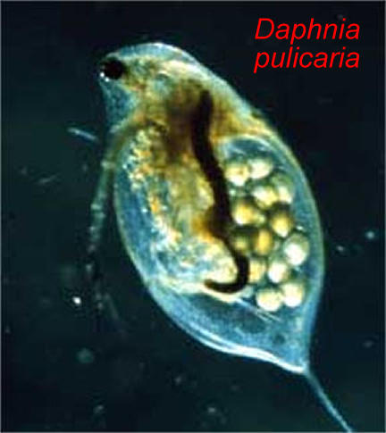
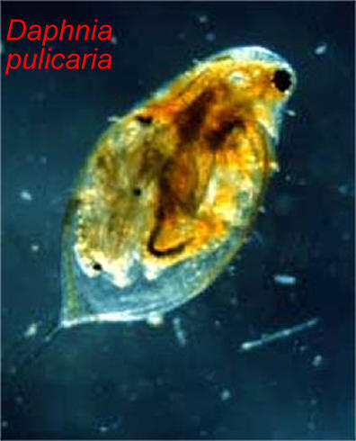
Types of Asexual Reproduction
Parthenogenesis - production of offspring from unfertilized eggs.
https://news.nationalgeographic.com/2017/01/zebra-shark-virgin-birth-reproduction/

Slide 9
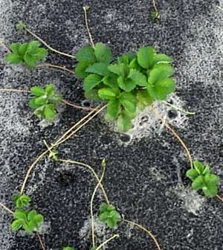
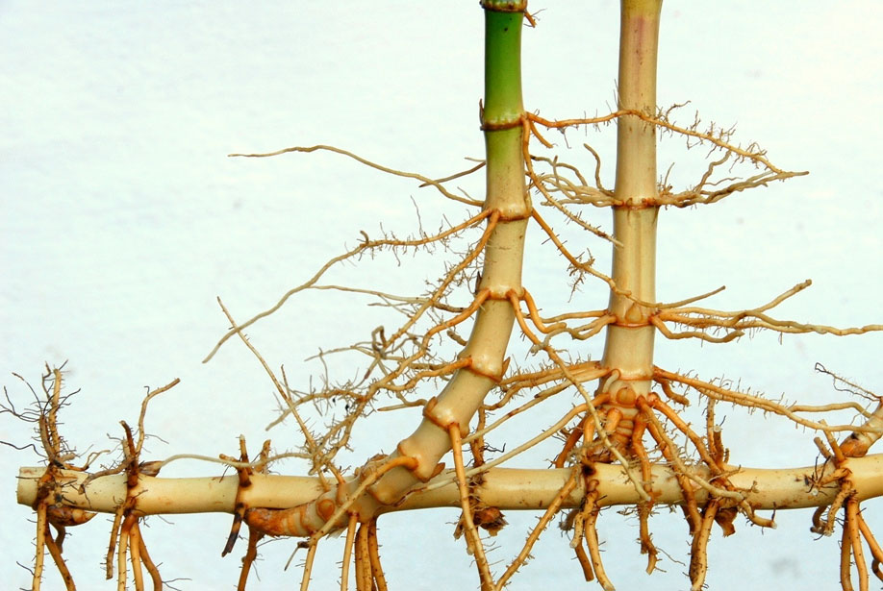
https://www.youtube.com/watch?v=ex6FxoO7LZw
Types of Asexual Reproduction
Vegetative reproduction - occurs in plants. New plants rise w/o the production of spores

Slide 10
Words to know…

Slide 11
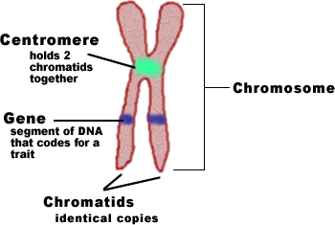
Chromosomes
-passed on from one generation to the next
-genetic material composed of genes which are made up of DNA
Only visible during cell division
Found in the nucleus
Condensed DNA

Slide 12
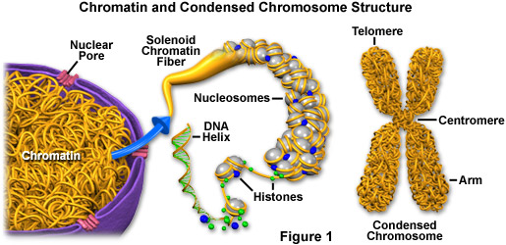
Chromatin
Chromatin – uncondensed DNA; appears very “stringy”
Form of DNA between cell divisions

Slide 13
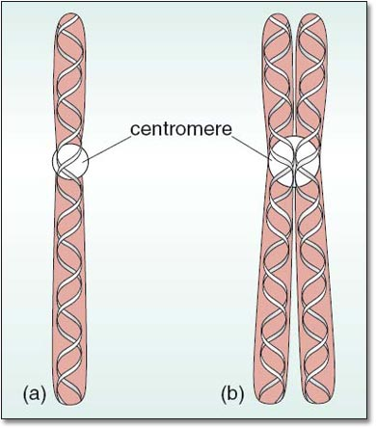
Parts of a Chromosome
Sister chromatids: identical copies of a chromosome
Made during the S phase of the cell cycle
Centromere: holds two
sister chromatids
together

Slide 14
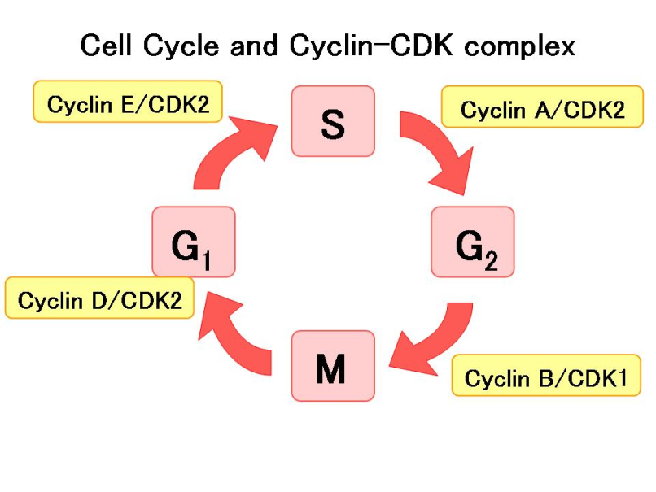
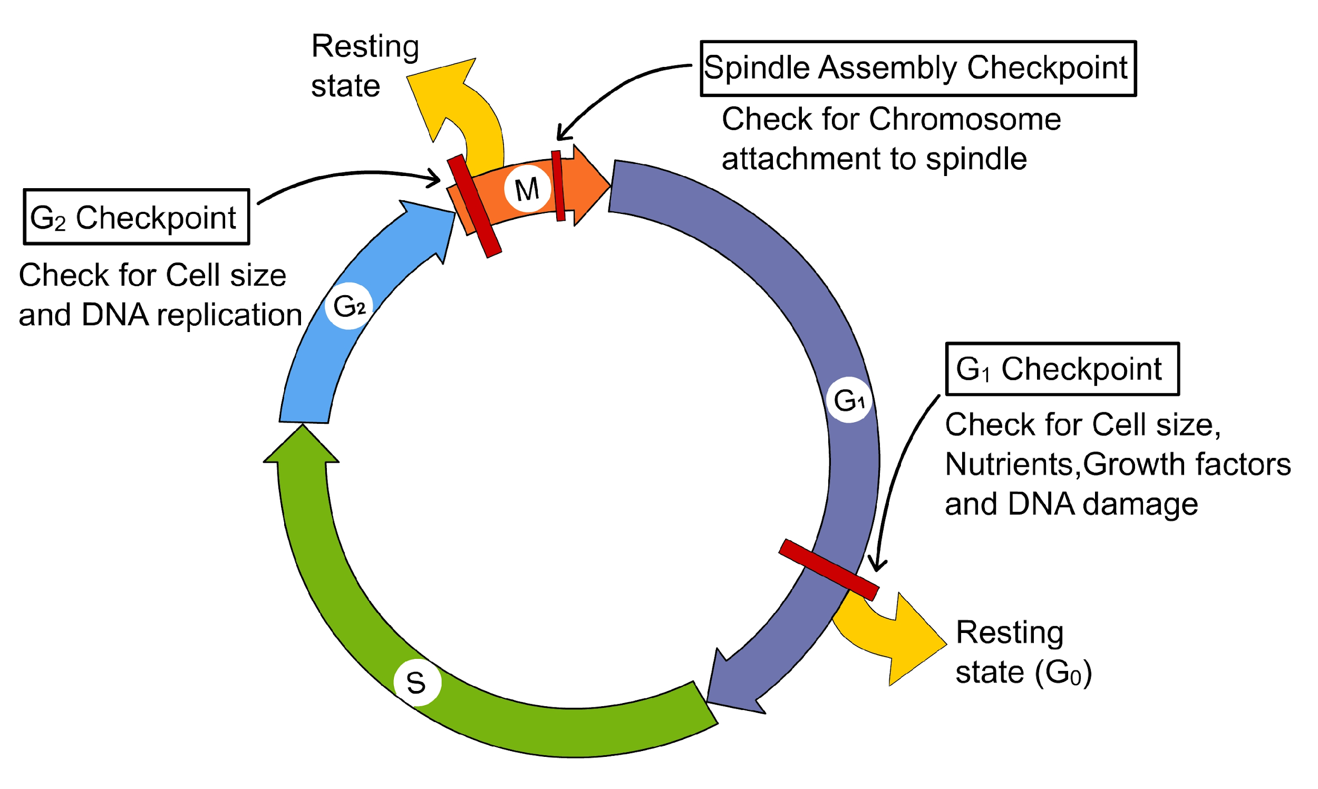
Cell Cycle Regulation
Cyclin – a group of proteins that regulates the timing of the cell cycle
Controls when cells go from G₁ to S phase
Controls when cells go from S to G₂ phase
Controls when cells go from G₂ to M phase

Slide 15
Uncontrolled Cell Growth
Cancer – abnormally rapid cell division
Cells of the tumor may break loose and spread or metastasize through the body
May be caused by radiation, pollution, bad luck, viral exposure
Many cancer cells have a mutation/defect in gene p53 (gene that normally tells the cell to wait until all chromosomes have been replicated before proceeding to mitosis)

Slide 16
Gallery Walk

Slide 17
Practice Quiz
How did you do? Do we need to tutor after school tomorrow? Do you need to study more?

Slide 18
RNA Close Read
X = Different than I thought
! = important
Check mark = Knew it
? = I don’t understand
Draw a picture in the columns to help visual.

Slide 19
Closure
What is a centromere?
Define binary fission.
What is the main difference between cell division in plant and animal cells?
What form of asexual reproduction is it when a starfish is growing a limb back?
What is the key to the cells ability to differentiate?

