Slide 1
Cell Transport

Slide 2
What is Brownian Motion? What type of particles can not easily pass through the membrane?

Slide 3
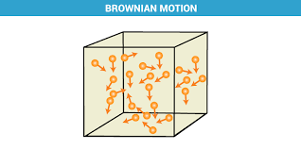
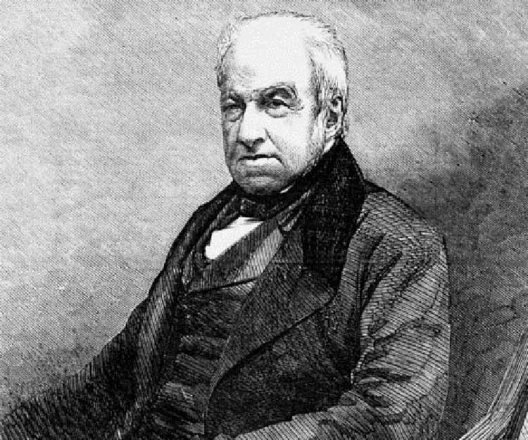
https://www.youtube.com/watch?v=Xscn-QSmFo4
the irregular motion of small particles suspended in a liquid or a gas, caused by the bombardment of the particles by molecules of the medium: first observed by Robert Brown in 1827.

Slide 4
Types of Transport
Active Transport:
Requires
Energy
Passive Transport:
Does NOT
Require Energy

Slide 5
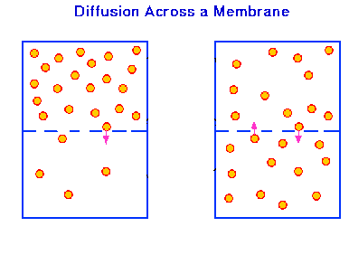
Passive Transport
Simple Diffusion:
The process of molecules spreading from an area of high concentration to an area of low concentration
When molecules are spread even throughout a space it is called equilibrium

Slide 6
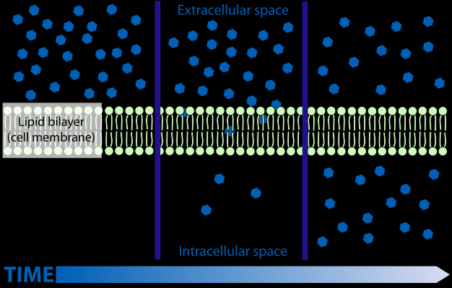
Passive Transport
Concentration Gradient:
The difference between concentrations in a space.
Semi-Permeable membrane allows some things through and not others. Ex: Plasma Membrane

Slide 7
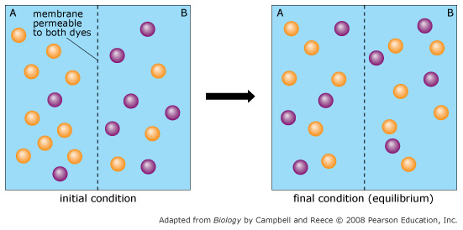
Move independently of each other

Slide 8
AND Type of Molecule

Slide 9
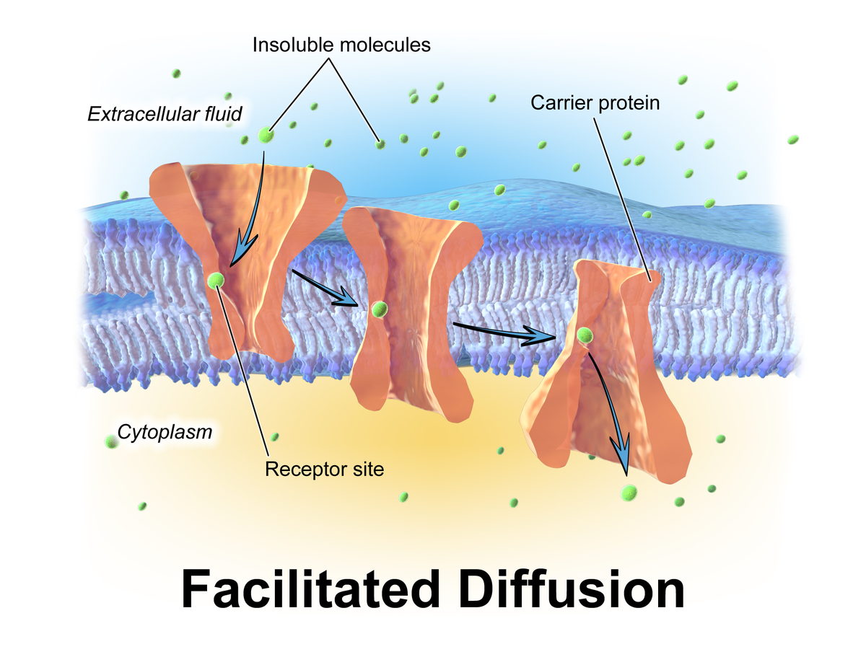
Passive Transport
Facilitated Diffusion: The movement of particles to large to move through the membrane through a carrier protein.

Slide 10
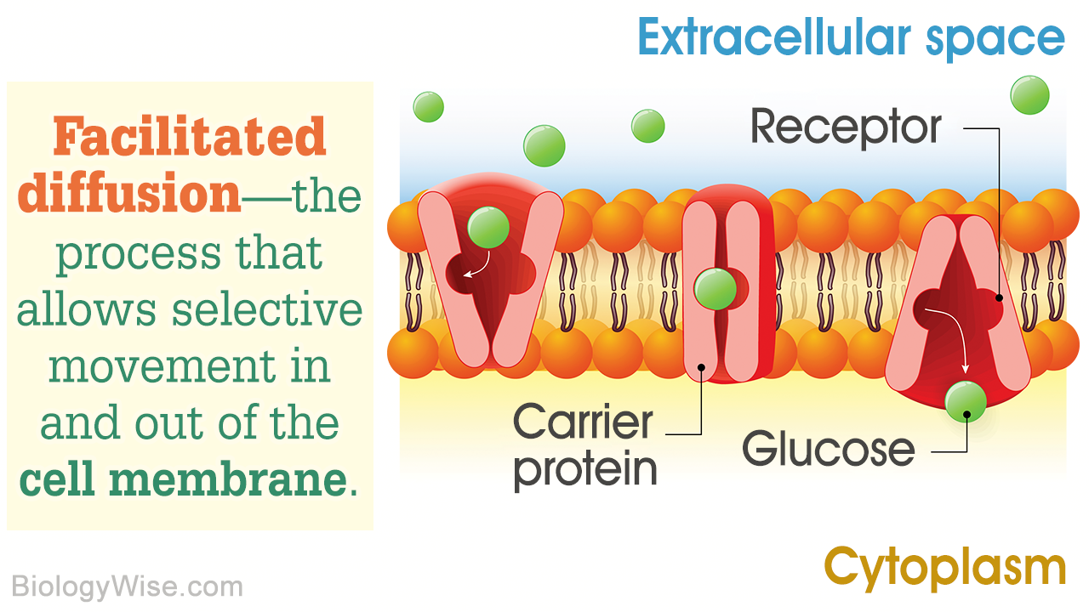

Slide 11
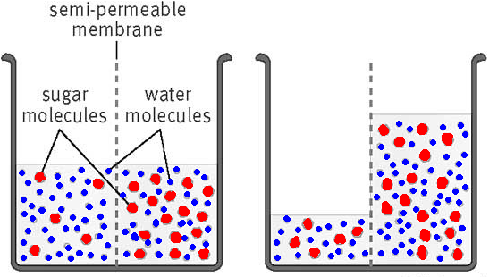
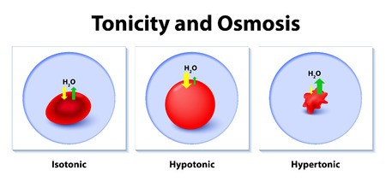
Passive Transport
Osmosis: The diffusion of water across a membrane.
https://www.youtube.com/watch?v=Ptmlvtei8hw

Slide 12
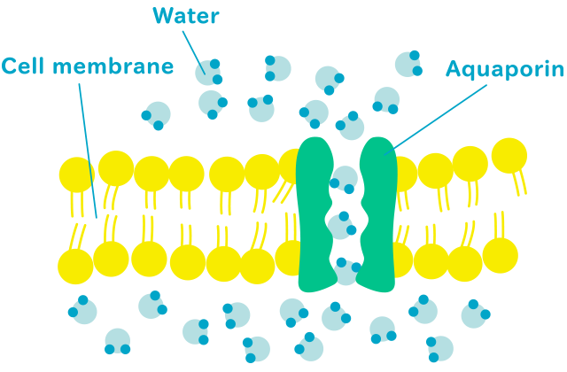

Slide 13
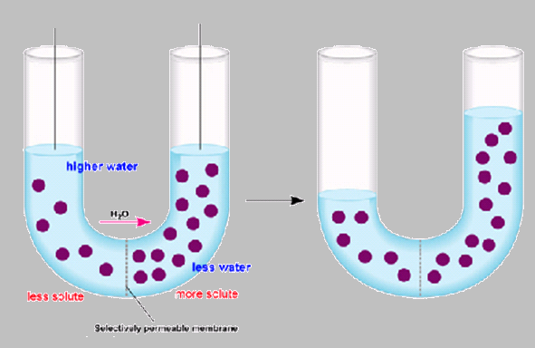
Passive Transport
Hypotonic
Hypertonic

Slide 14
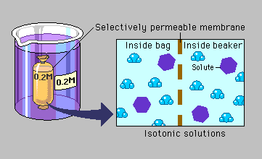
Passive Transport
Types of Solutions:
Isotonic
How much SOLUTE is on each side of the membrane?
ISO=Same

Slide 15
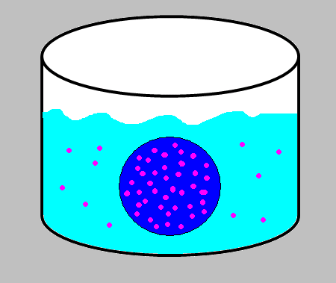
Passive Transport
Types of Solutions:
Hypotonic
90% Water
___% Salt
How much SOLUTE is in the cell compared to the beaker?
10% Water
___% Salt
HYPO=LESS

Slide 16
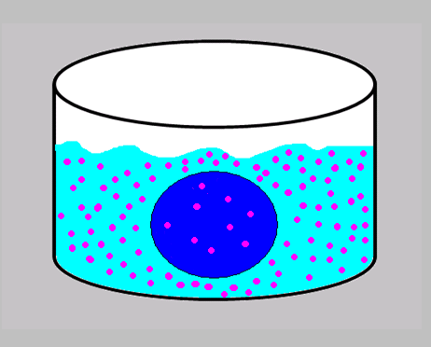
Passive Transport
Types of Solutions:
Hypertonic
10% Water
___% Salt
How much SOLUTE is in the Beaker compared to the Cell?
90% Water
___% Salt
HYPER=MORE

Slide 17
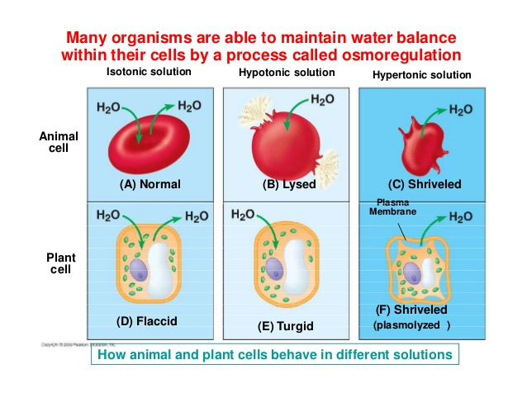
https://www.youtube.com/watch?v=OYoaLzobQmk

Slide 18
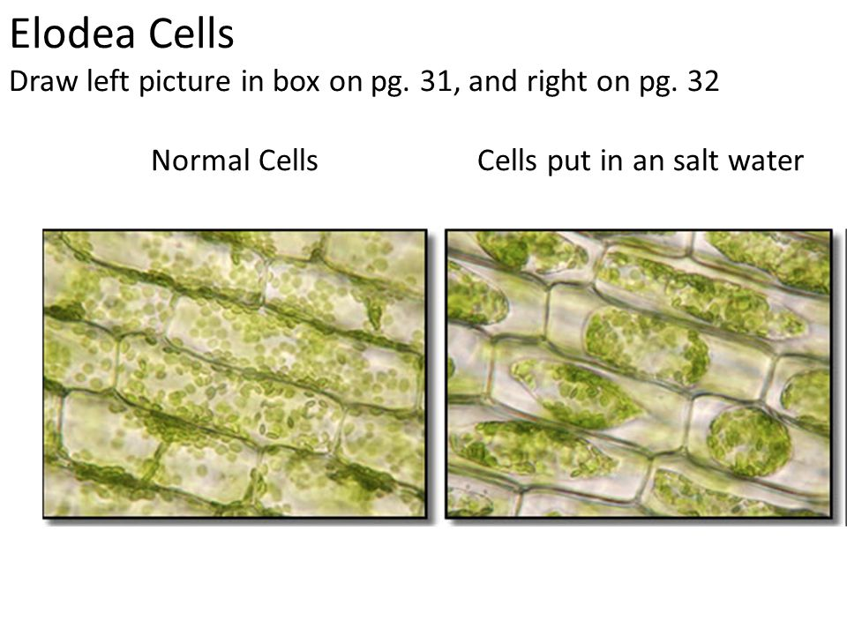
https://www.youtube.com/watch?v=t4RkOgcwWsg

Slide 20
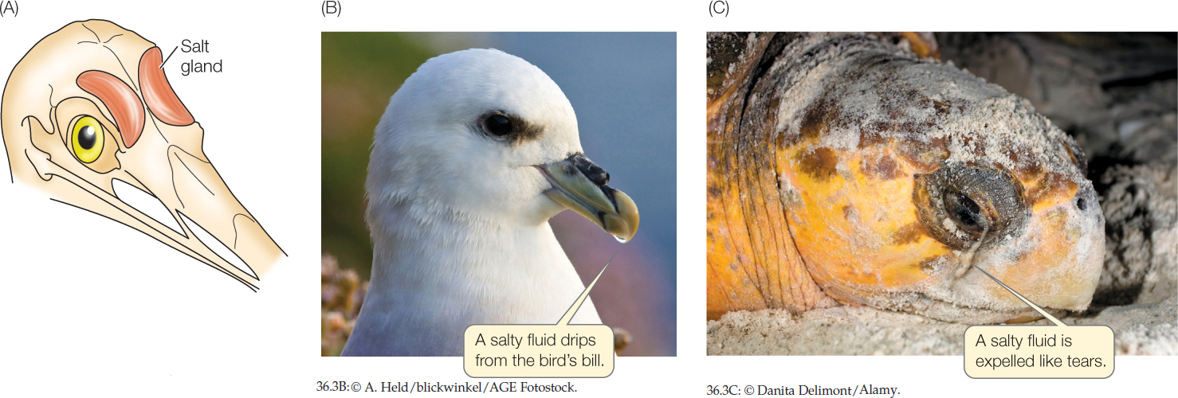
https://video.nationalgeographic.com/video/news/00000165-b0a7-d388-af75-f5a710b40000

Slide 21
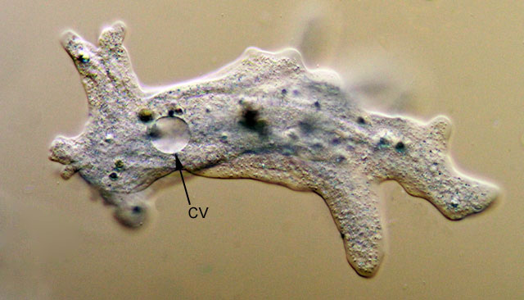
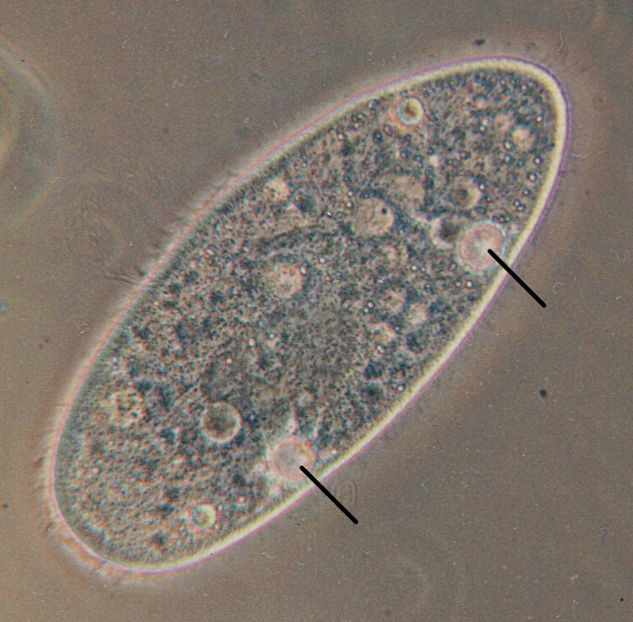
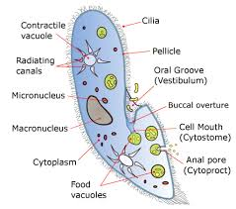
Contractile Vacuole

Slide 22
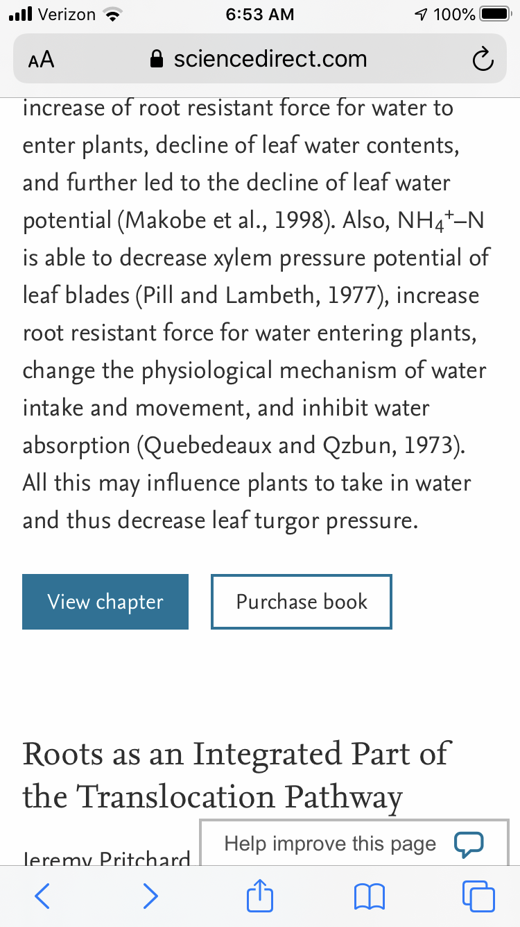
Think about it…
Placing wilted lettuce in cold water will make it crisp again. Which statement best describes what happens to restore the lettuce to its original condition?
A Water left the lettuce cells by diffusion.
B Water entered the cells of the lettuce by osmosis.
C Osmosis caused salts to enter the lettuce cells.
D Salts in the leaf caused water to leave the cells.
https://www.youtube.com/watch?v=OYoaLzobQmk
https://www.sciencedirect.com/topics/agricultural-and-biological-sciences/turgor-pressure

Slide 23
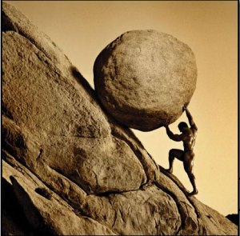
Active Transport
Requires Energy

Slide 24
Active Transport
High Concentration!!
Low Concentration!!

Slide 25
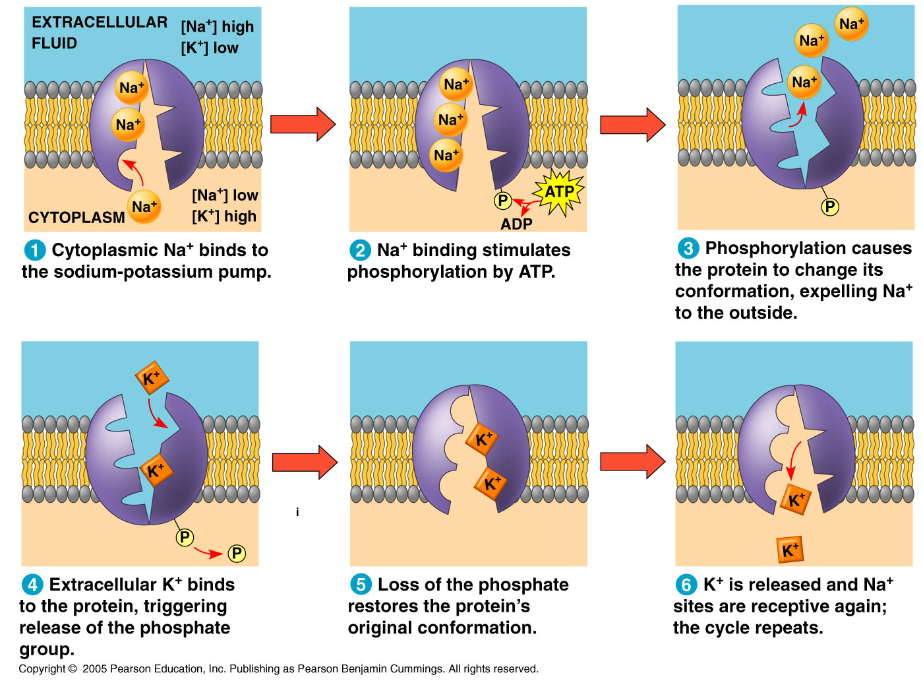
https://www.youtube.com/watch?v=xweYA-IJTqs

Slide 26
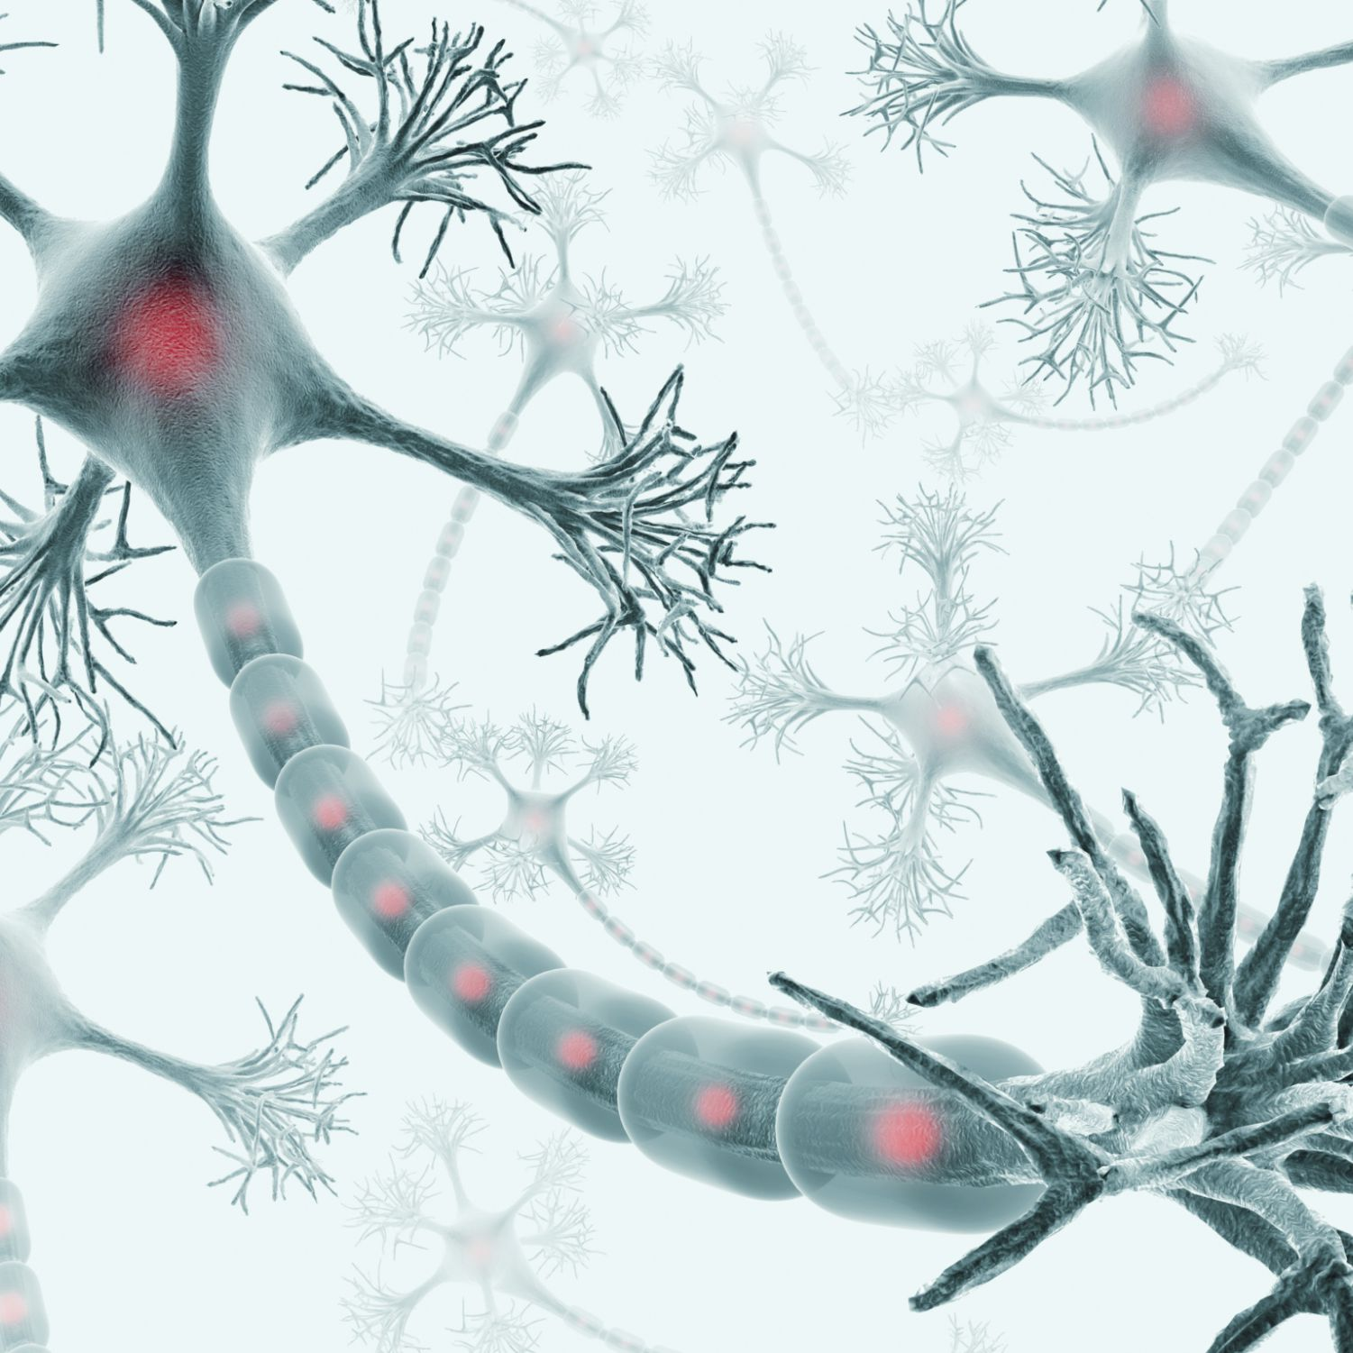
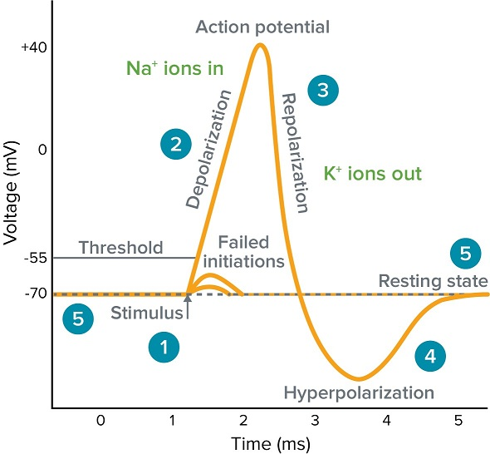
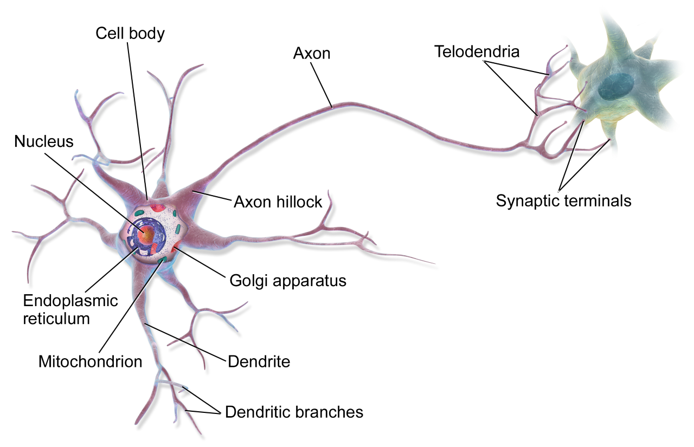
https://www.youtube.com/watch?v=OZG8M_ldA1M&app=desktop
https://www.youtube.com/watch?v=oa6rvUJlg7o

Slide 27
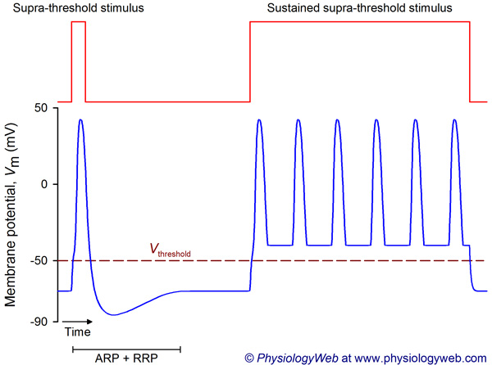
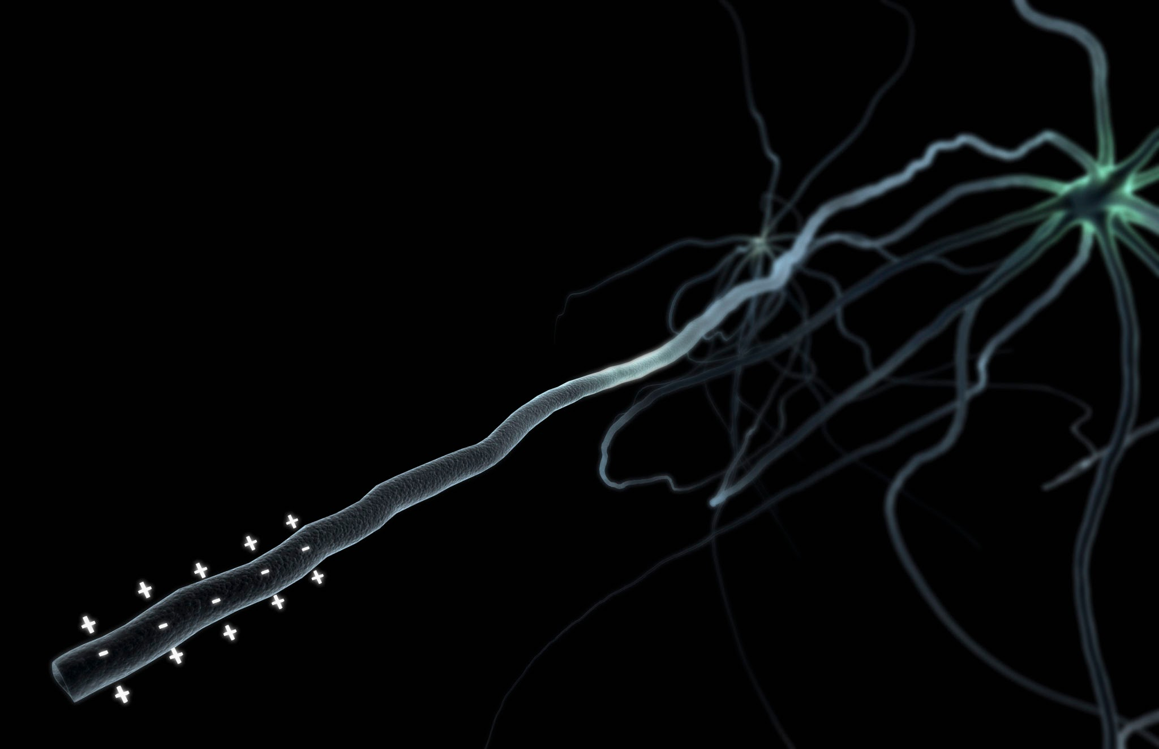

Slide 28
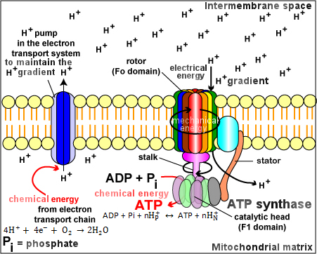
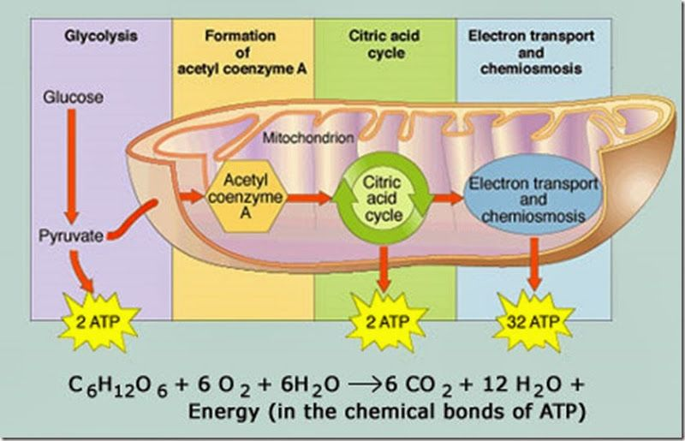
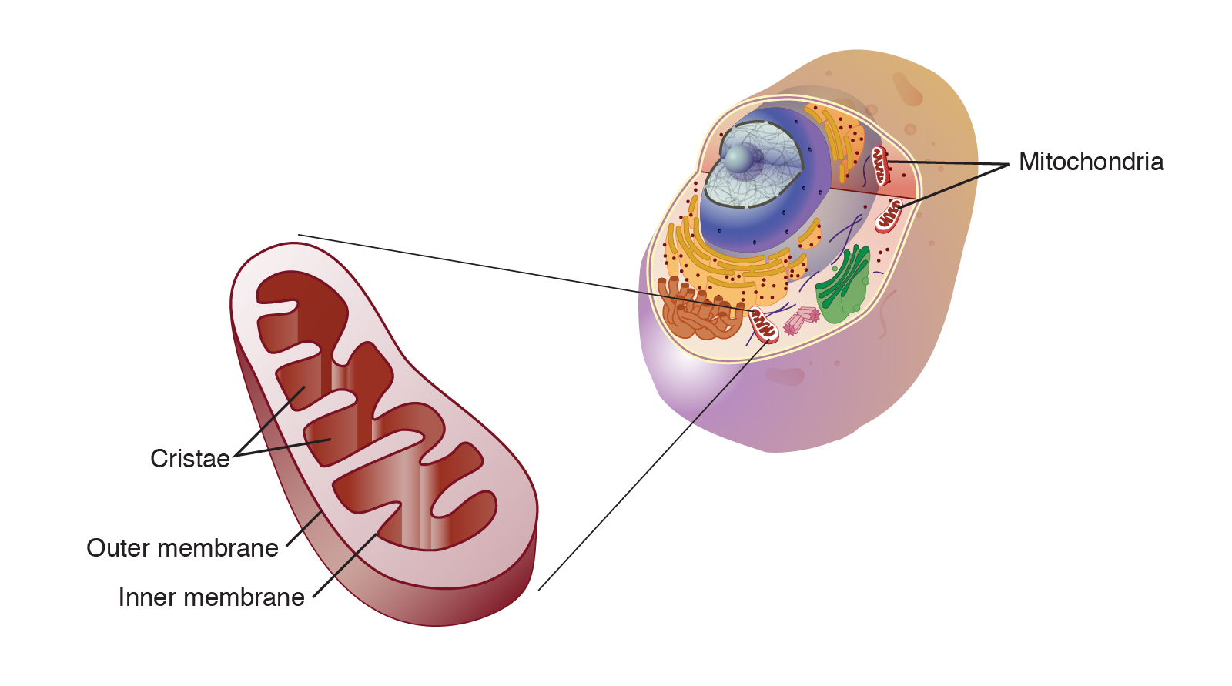
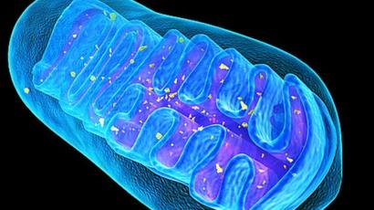
https://www.youtube.com/watch?v=rdF3mnyS1p0

Slide 29
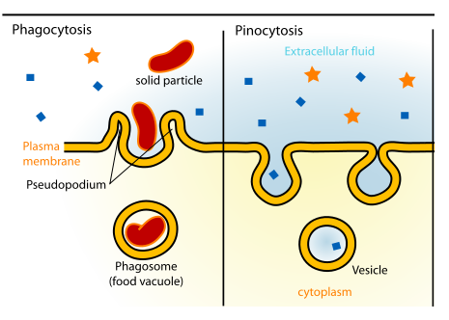
Active Transport
Endocytosis
https://www.youtube.com/watch?v=mv6Ehv06mXY

Slide 30
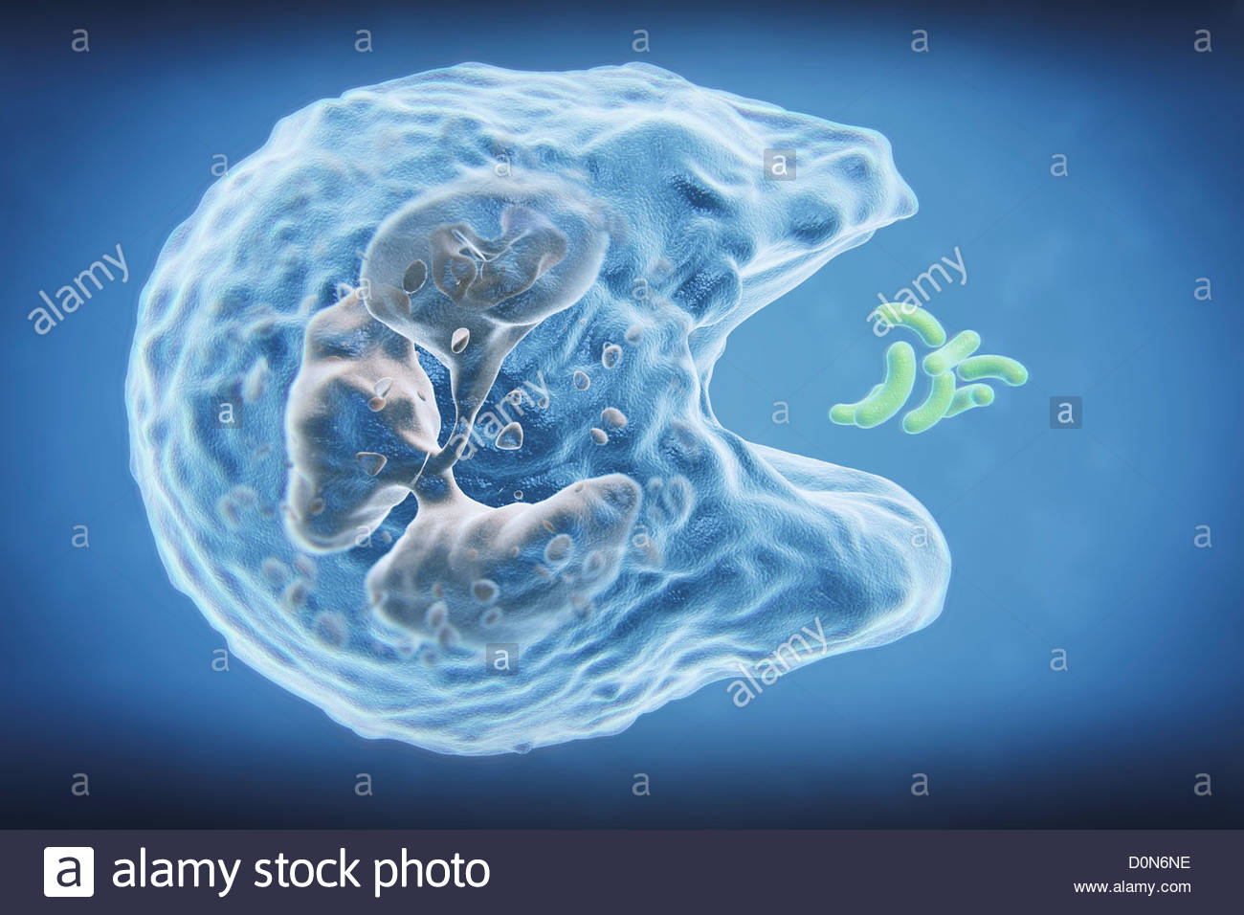
https://www.youtube.com/watch?v=Z_mXDvZQ6dU

Slide 31
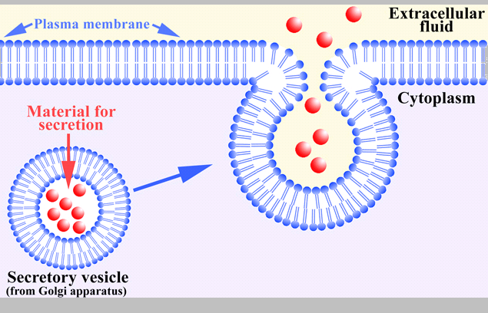
Active Transport
Exocytosis
https://www.youtube.com/watch?v=Ptmlvtei8hw

Slide 32
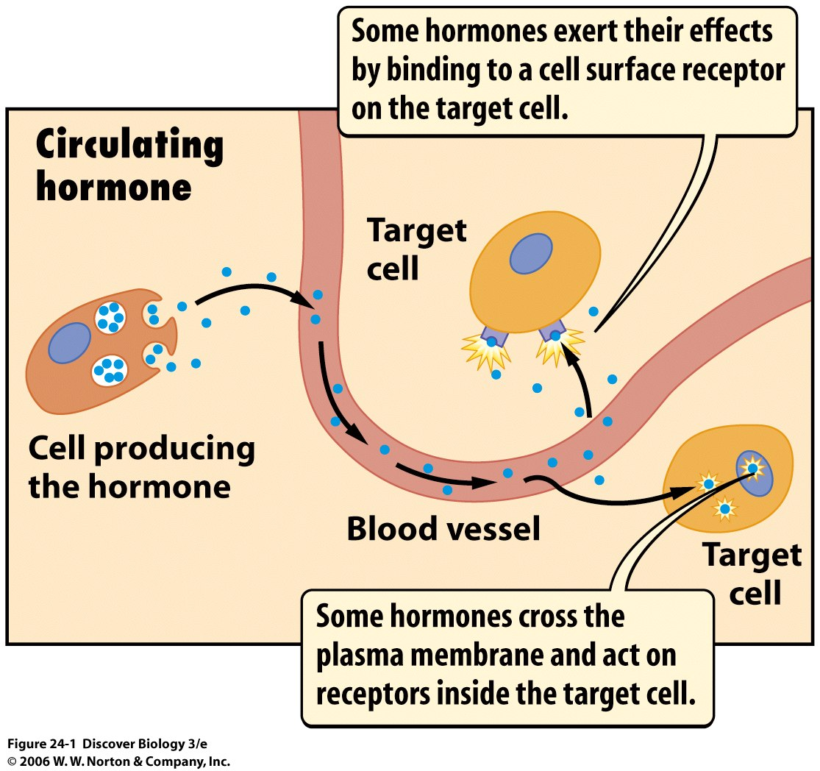
https://www.youtube.com/watch?v=kIPYVV4aThM

Slide 33
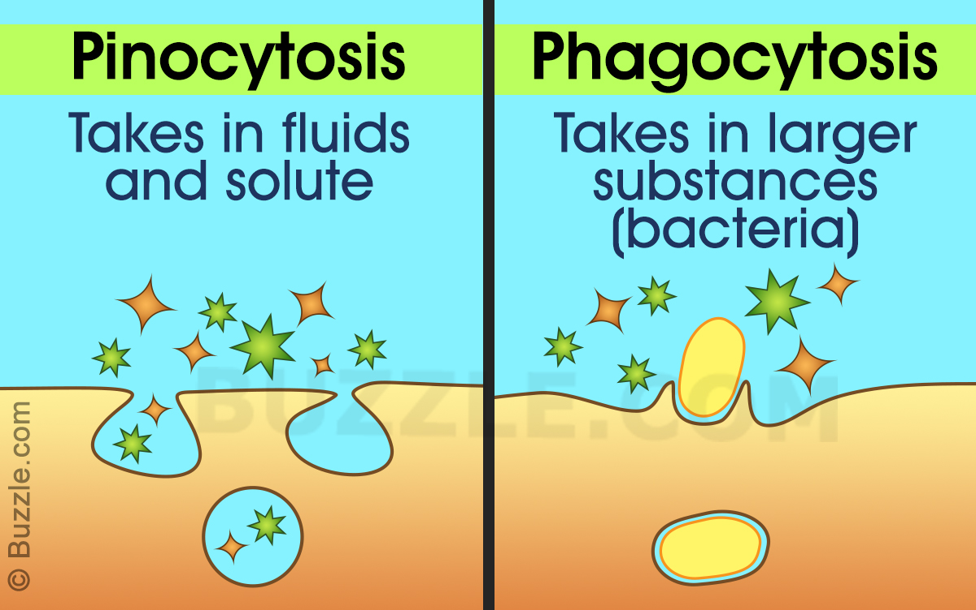

Slide 34
